Slide 1
ALCS Program Data Collection

Slide 2
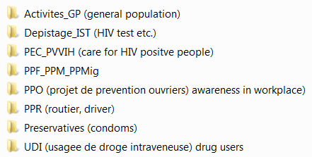
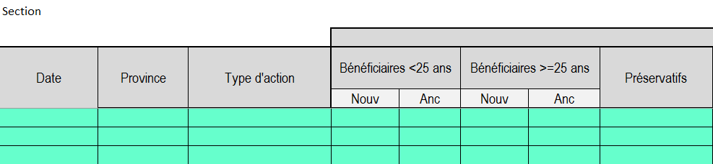
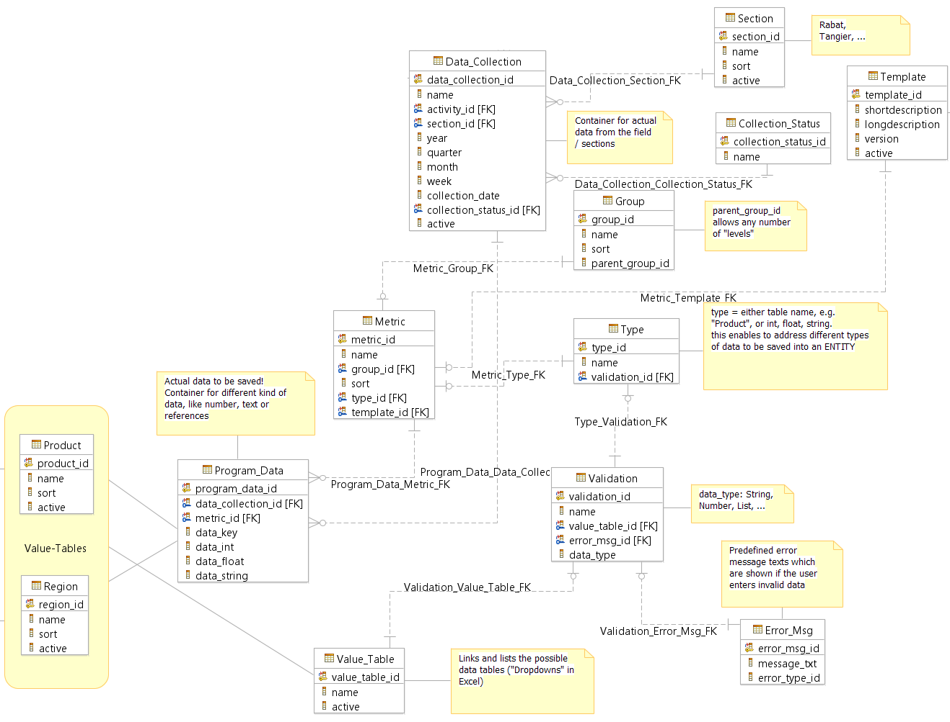
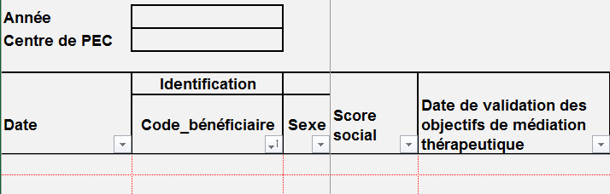
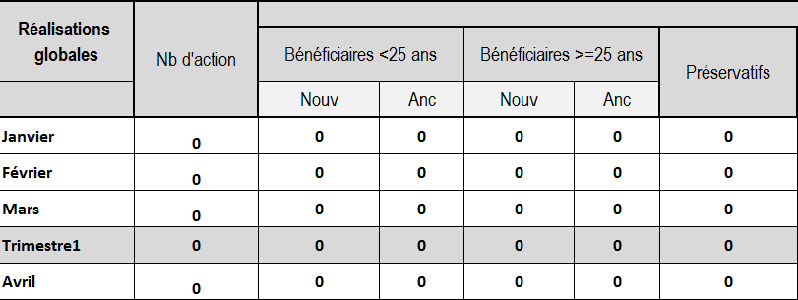
Today - Future

Slide 4
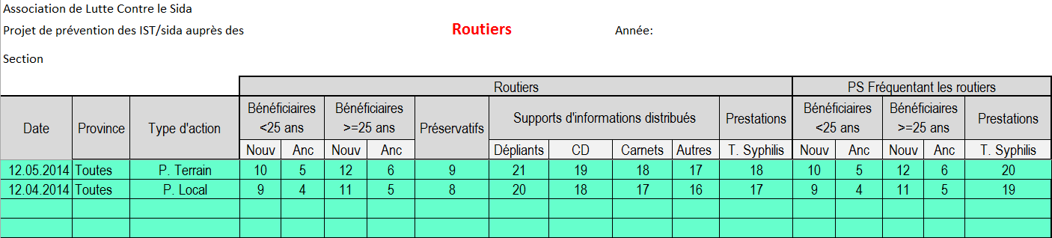

Slide 5
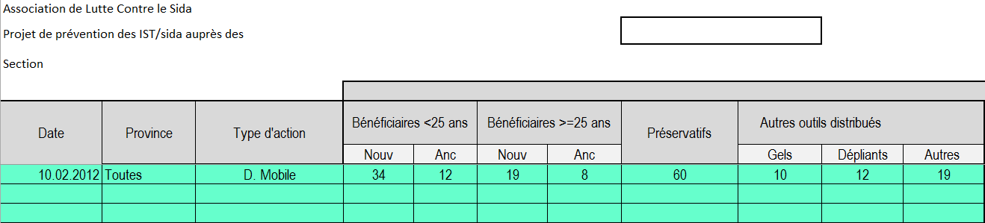

Slide 6
Required functionalities for program data collection
Create, modifiy, delete data collection activities
Create, modify, delete data collection templates
Enter data into a data collection [Data_Collection] (task performed on branch leader level, using the input from the field workers)
Change the status of a data collection (submitted, validated, rejected, … ), based on the role / privileges of the user
Create, modifiy, delete report structures (which business data and timeframes are relevant for which project?)*
Execute reports*
* Reporting is not part of this document, a separate reporting solution (existing external software) could be considered.

Slide 7
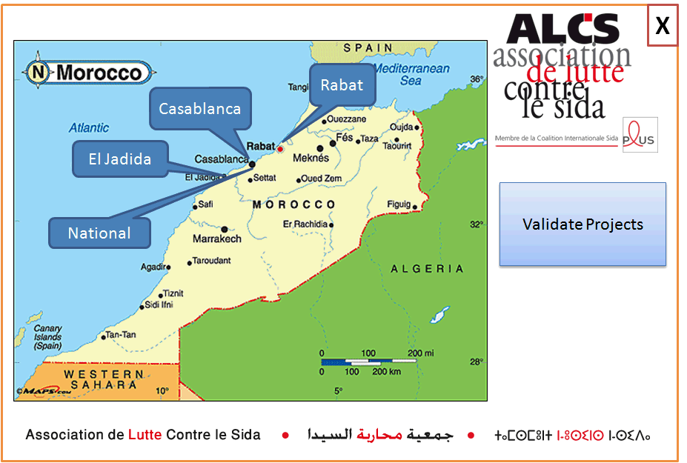

Slide 8
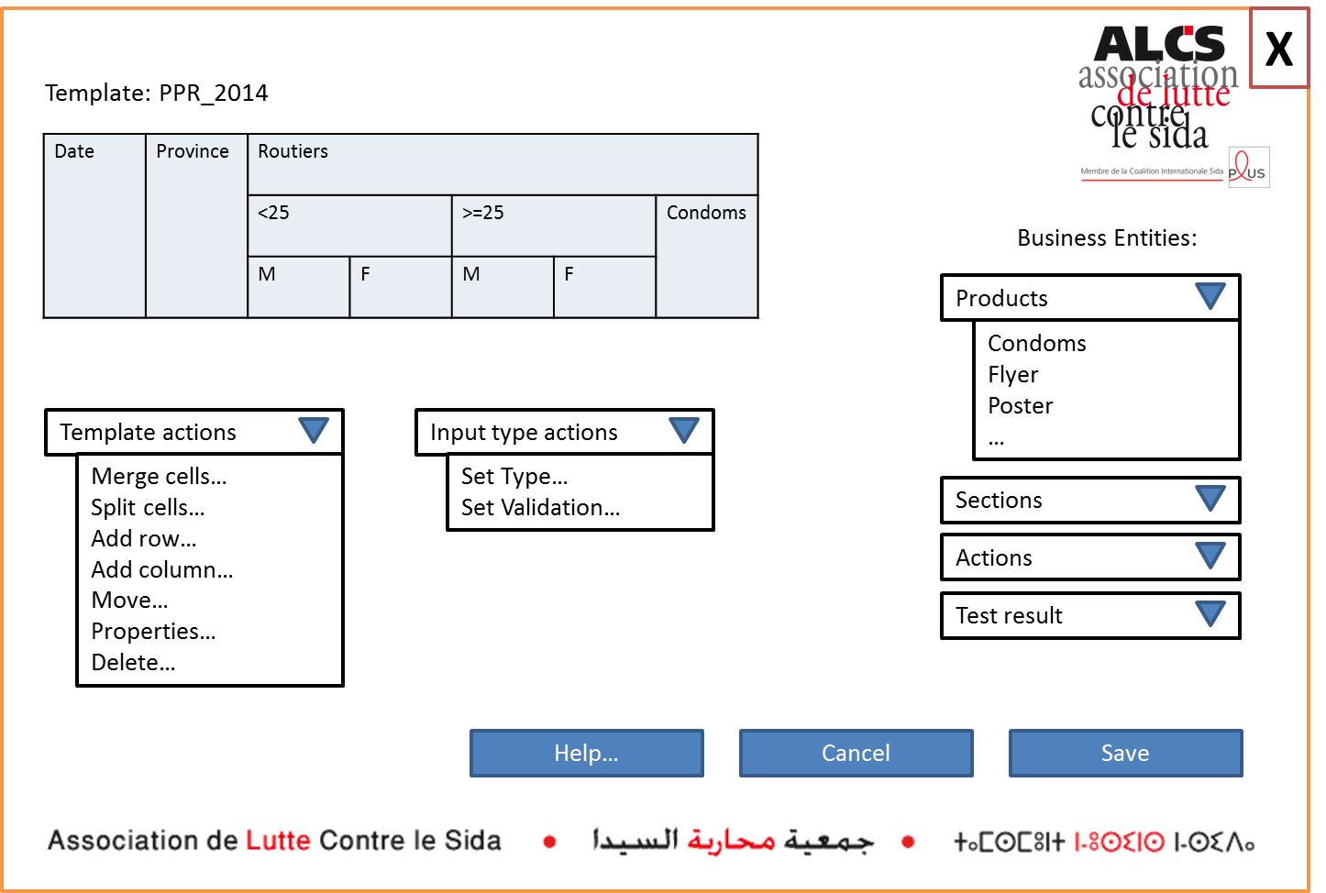

Slide 9
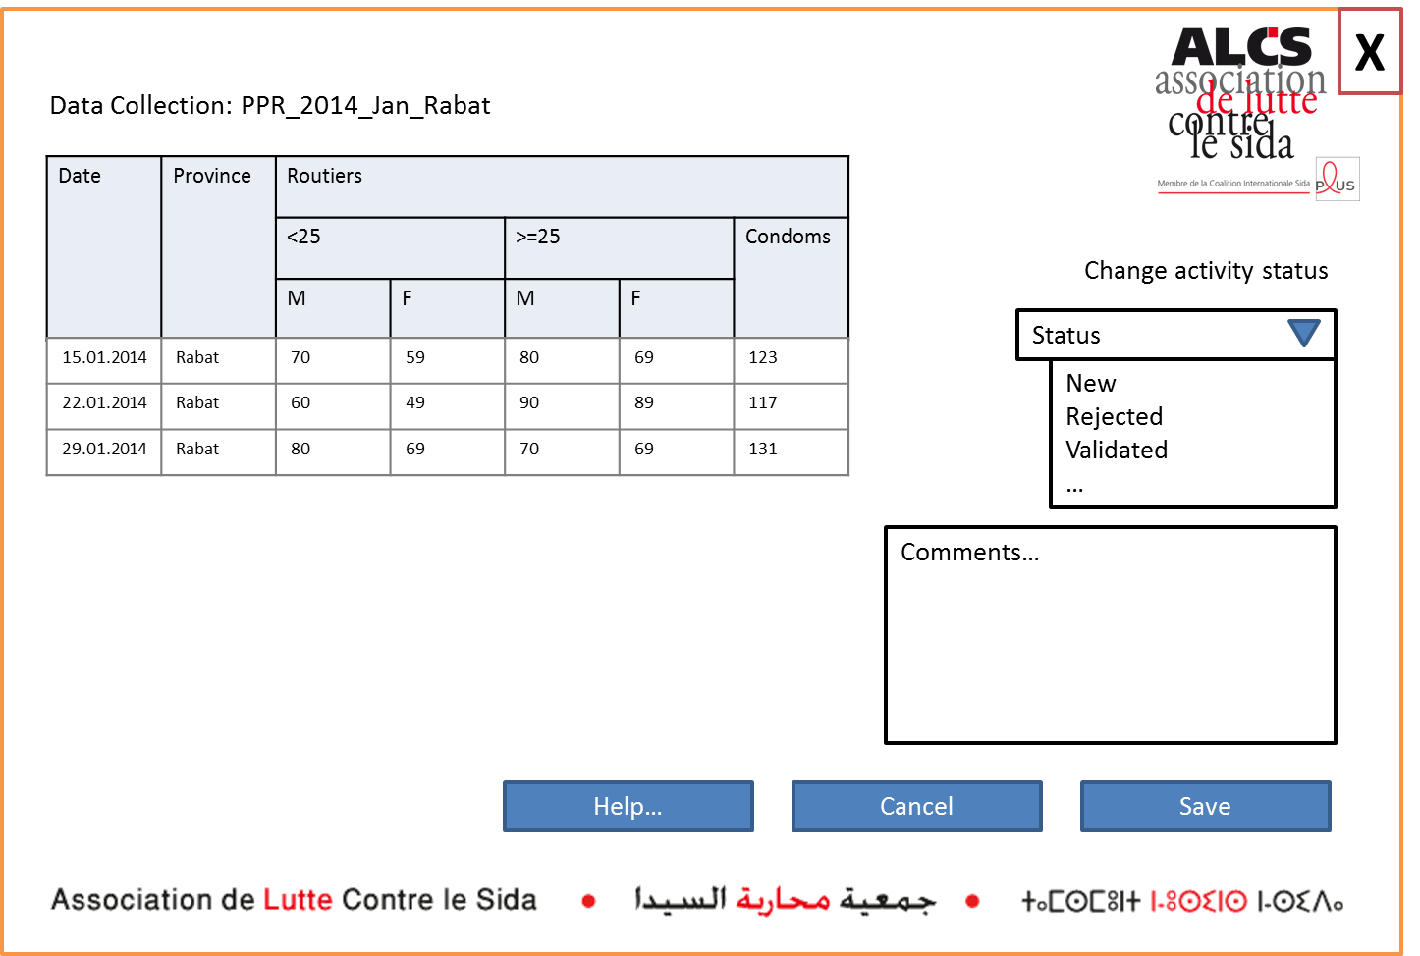

Slide 11
