Slide 1
ALCS Program Data Collection

Slide 2
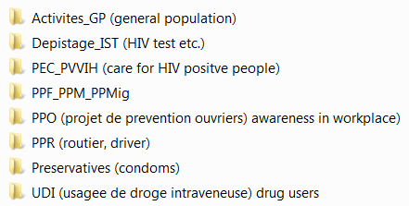
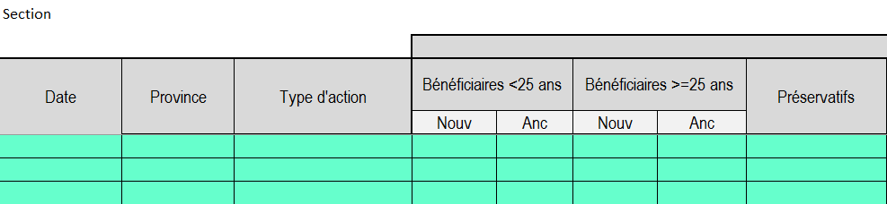
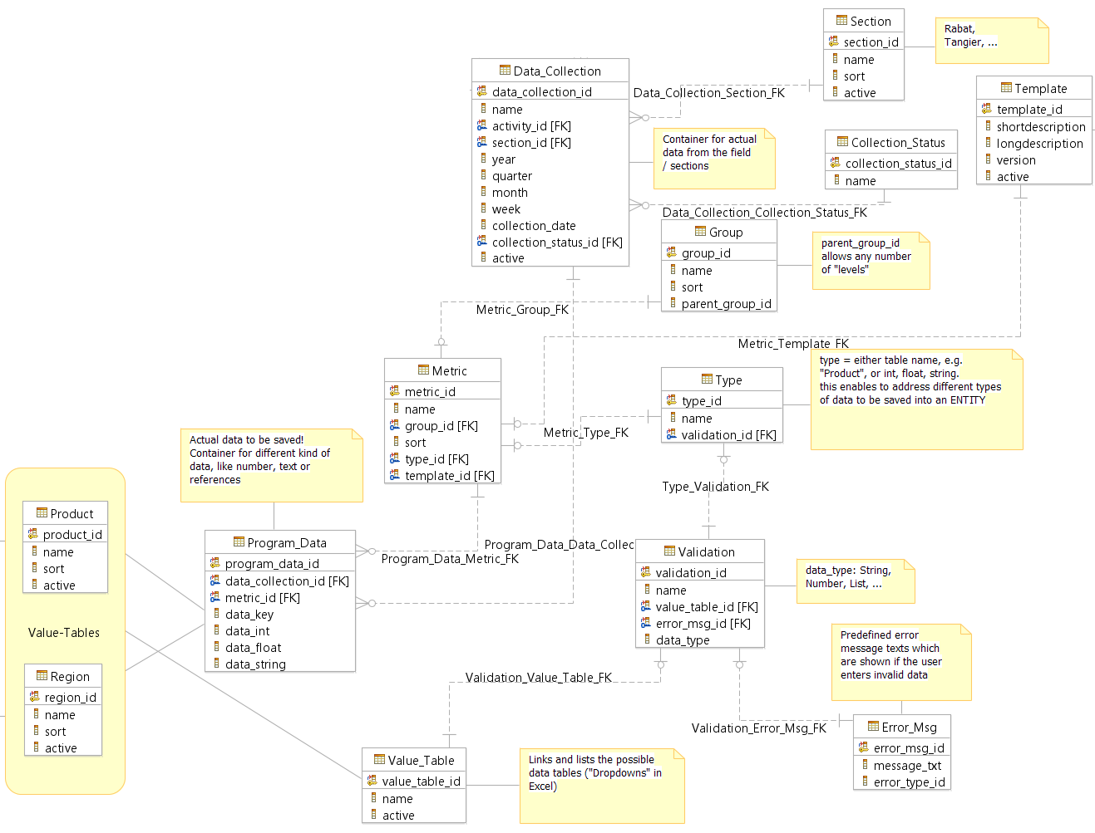
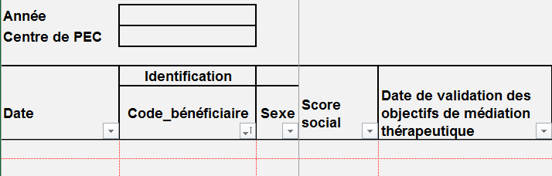
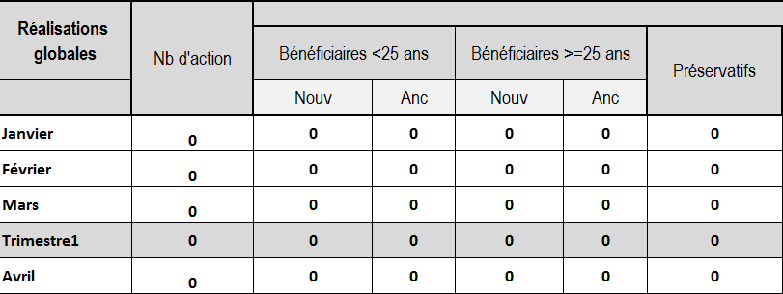
Today - Future

Slide 3
Data Collection Process

Slide 4
Data Collection Process

Slide 5
Data Collection Process

Slide 6
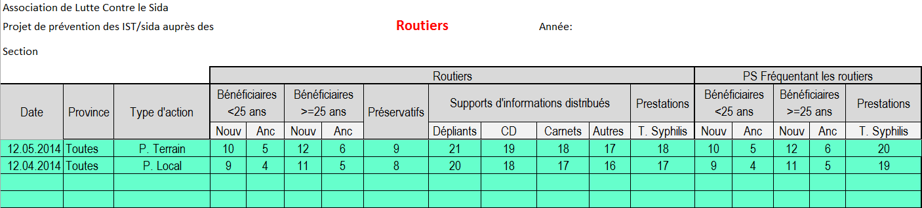

Slide 7
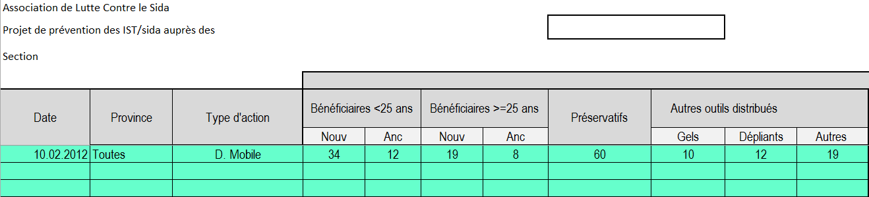

Slide 8
Required functionalities for program data collection
Create, modifiy, delete data collection activities
Create, modify, delete data collection templates
Enter data into a data collection [Data_Collection] (task performed on branch leader level, using the input from the field workers)
Change the status of a data collection (submitted, validated, rejected, … ), based on the role / privileges of the user
Create, modifiy, delete report structures (which business data and timeframes are relevant for which project?)*
Execute reports*
* Reporting is not part of this document, a separate reporting solution (existing external software) could be considered.

Slide 9

X
Data Collections
Project
Choose Project
Search Results
Activity
Choose Activity
PPR_Collection_Rabat_2014_Q1
PPR_Collection_Rabat_2014_Q2
Section
Choose Section
Type
Choose Type
Date
Year
Quarter
Month
Name
Description…
View
Edit
Delete
Search
New Collection…
Help…
Back

Slide 10
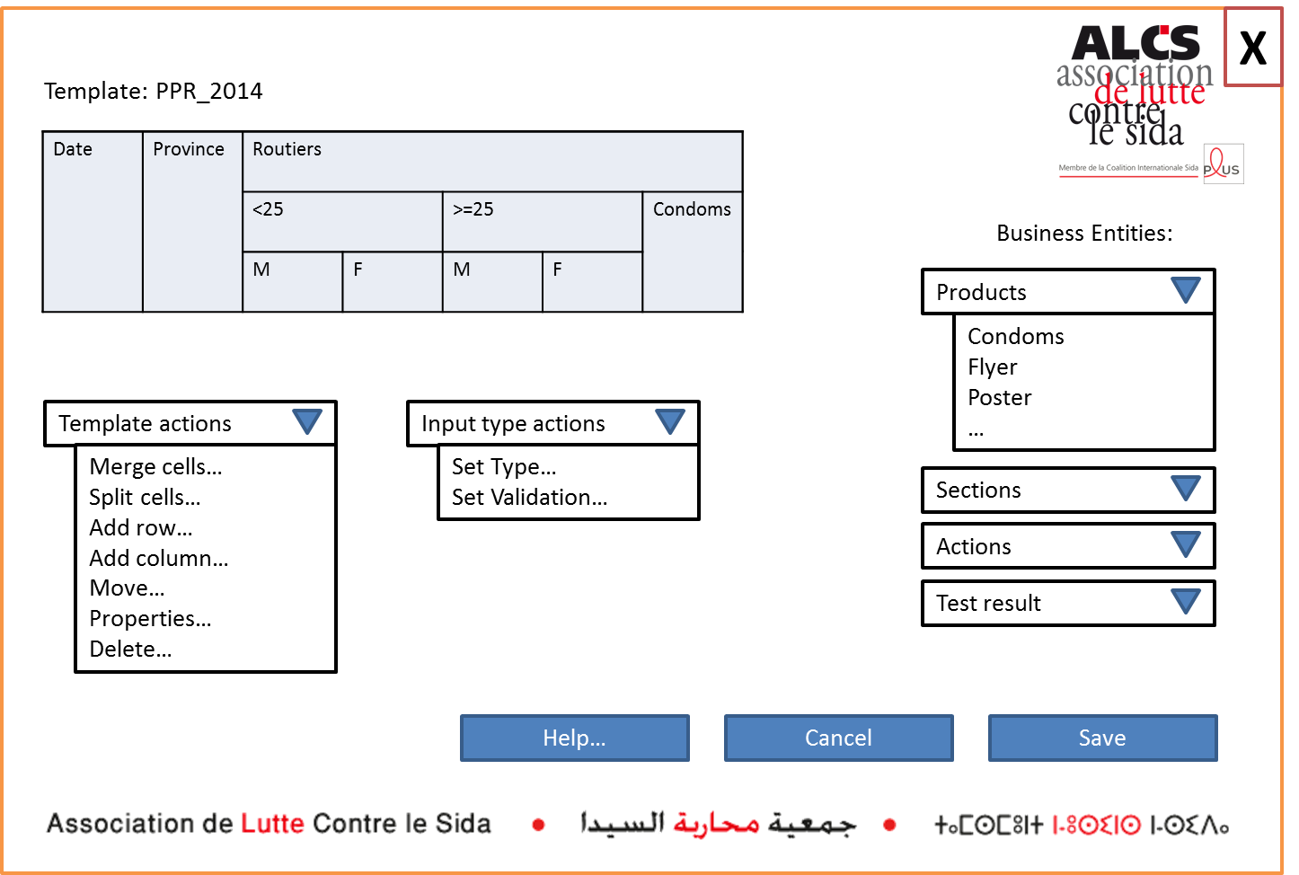
Template Design Screen

Slide 11
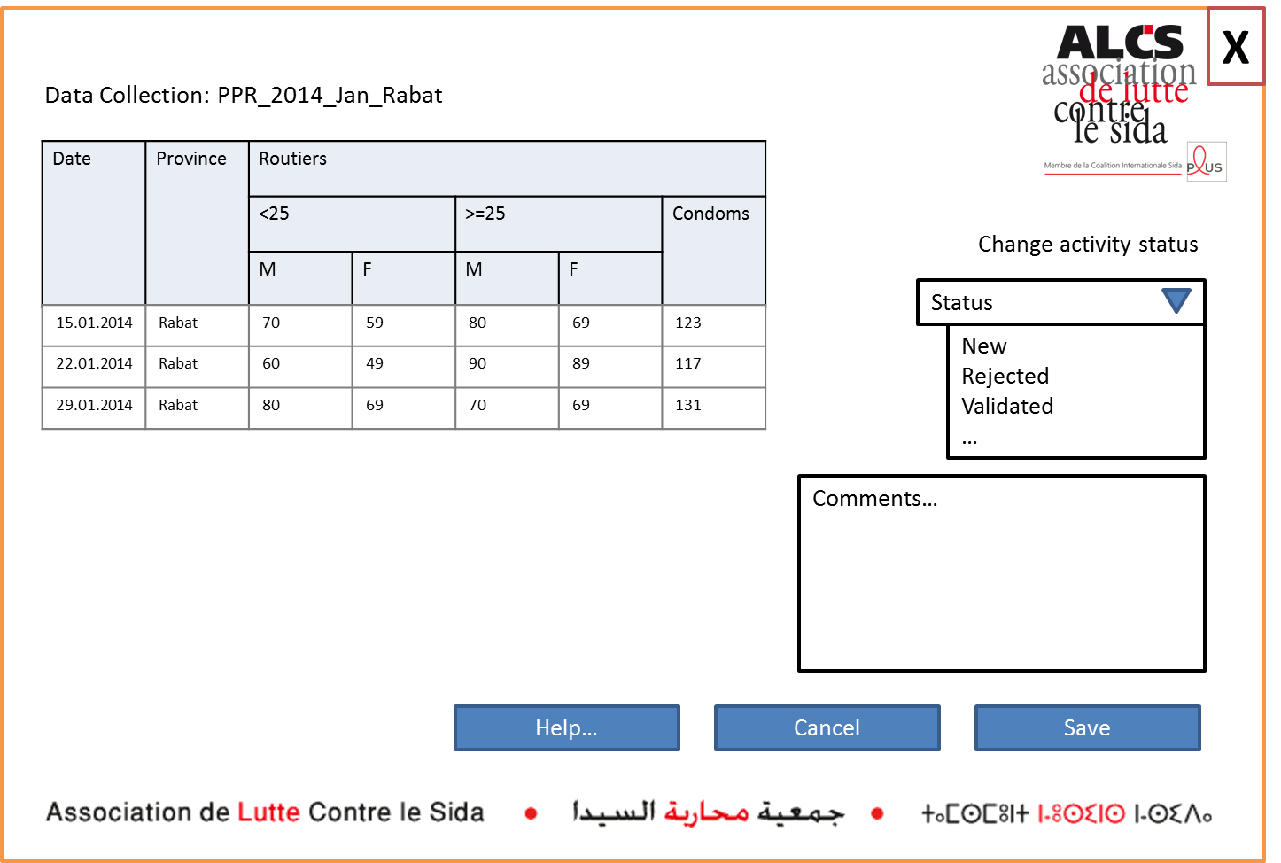
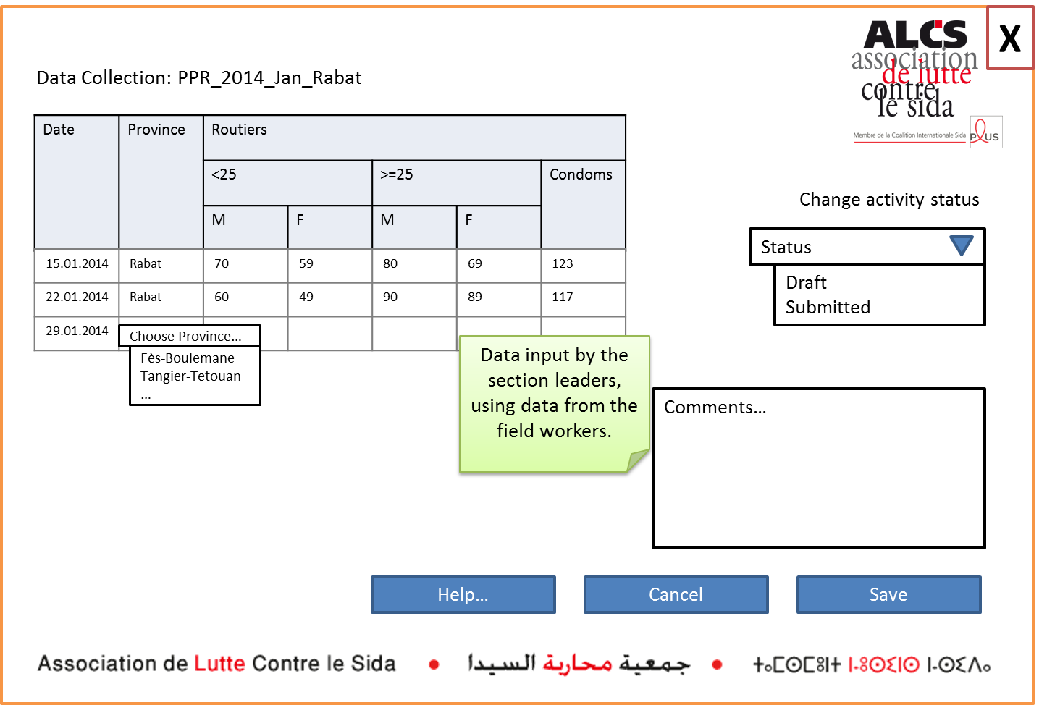
Enter Data at Branch Level

Slide 12
Validation Process

Slide 13
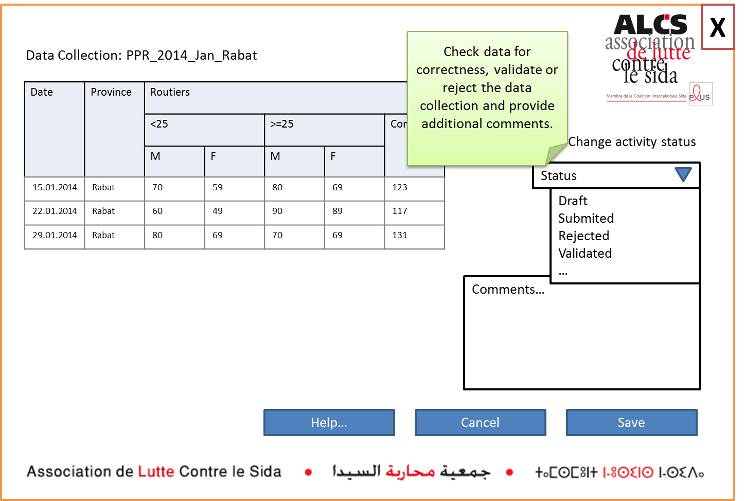
Validate collected Data at National Level

Slide 14
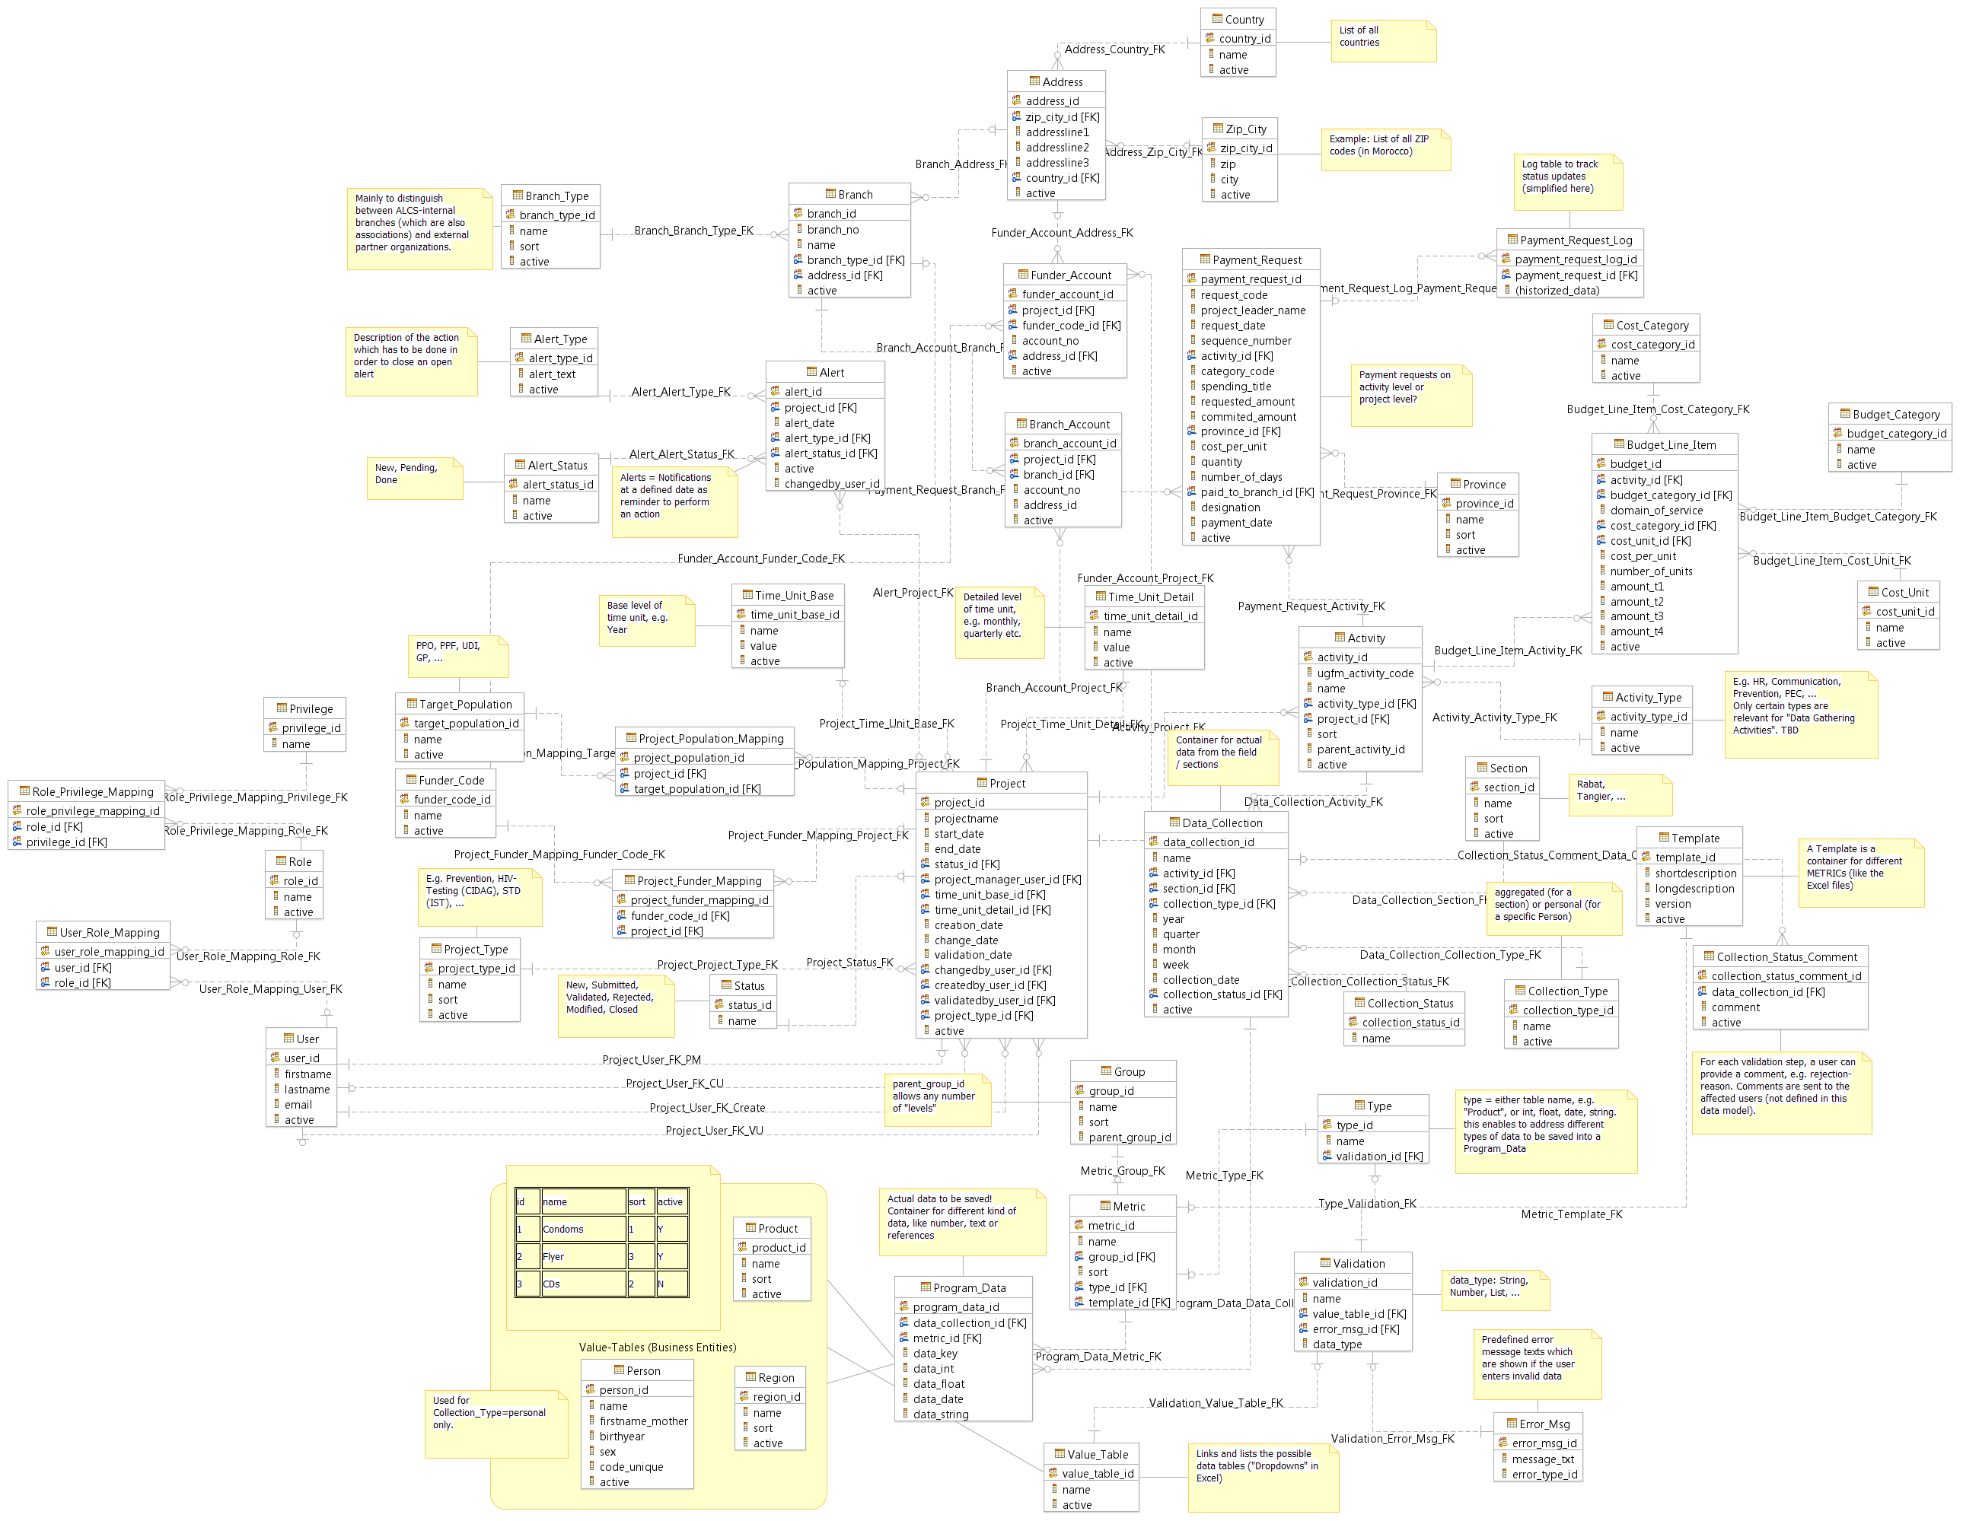
Data Model - Complete
Finance
User Admin
Project Admin
Data Collection

Slide 15
