Slide 1


IT Solutions for Business Impact and Sustainability Association de lutte contre la sida (ALCS)
May 23, 2014
IBM Corporate Services Corps – Morocco 5 Team
This report contains information that is confidential and proprietary to IBM and is solely for the use of IBM personnel. No part of it may be used, circulated, quoted, or reproduced for distribution outside IBM. If you are not the intended recipient of this report, you are hereby notified that the use, circulation, quoting, or reproducing of this report is strictly prohibited and may be unlawful.

Slide 2


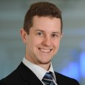
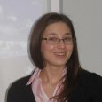




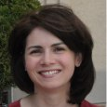









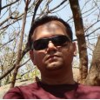









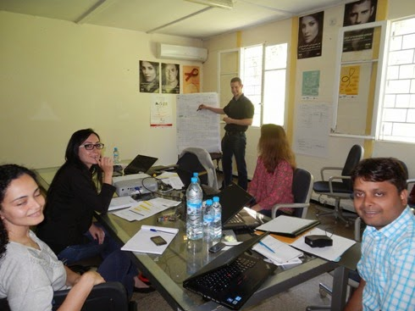
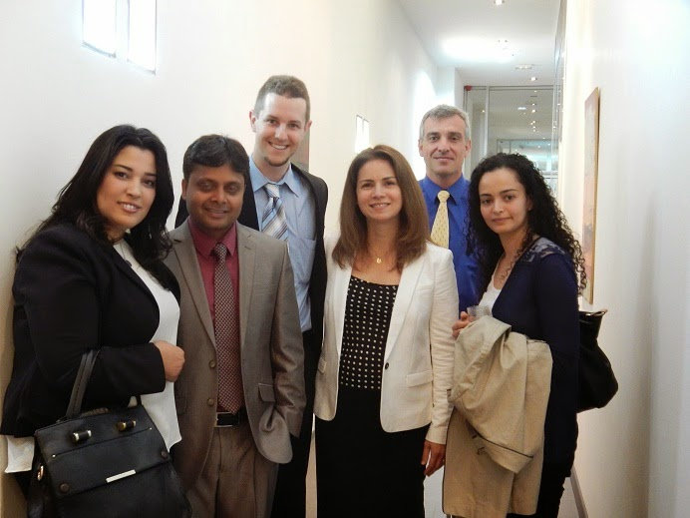
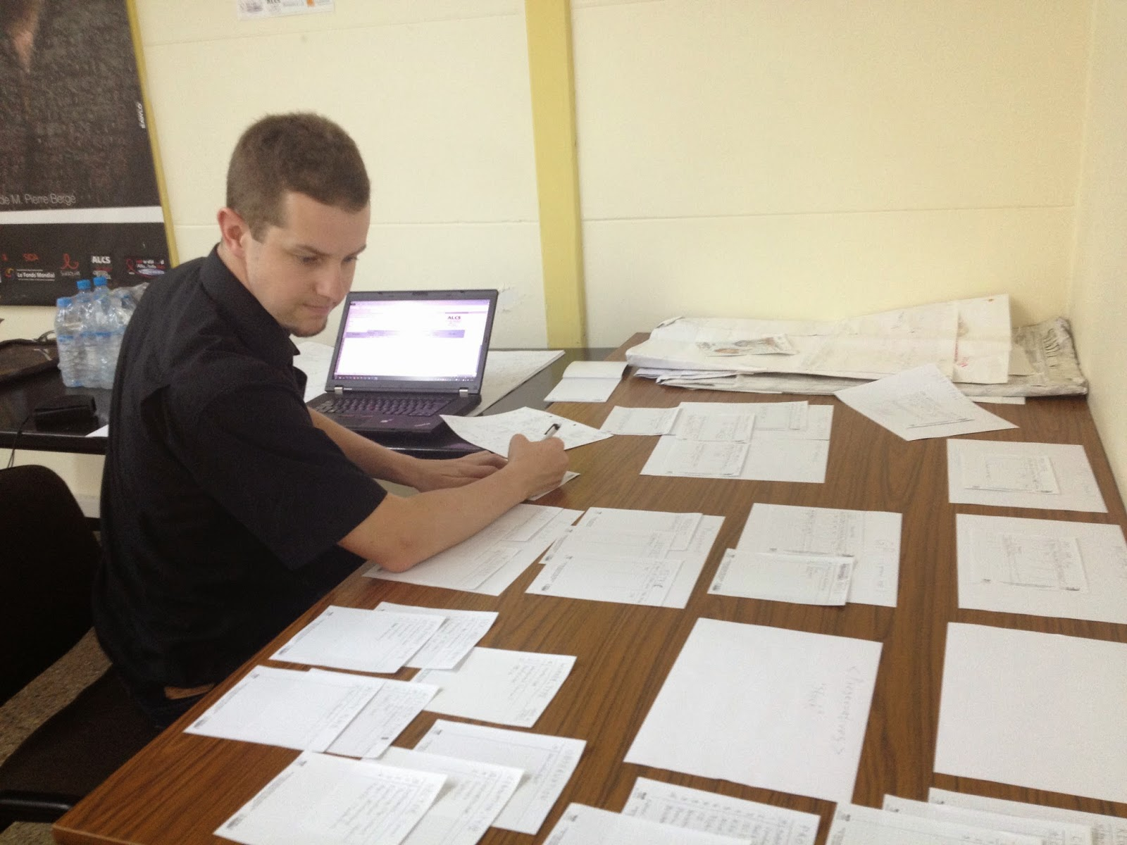
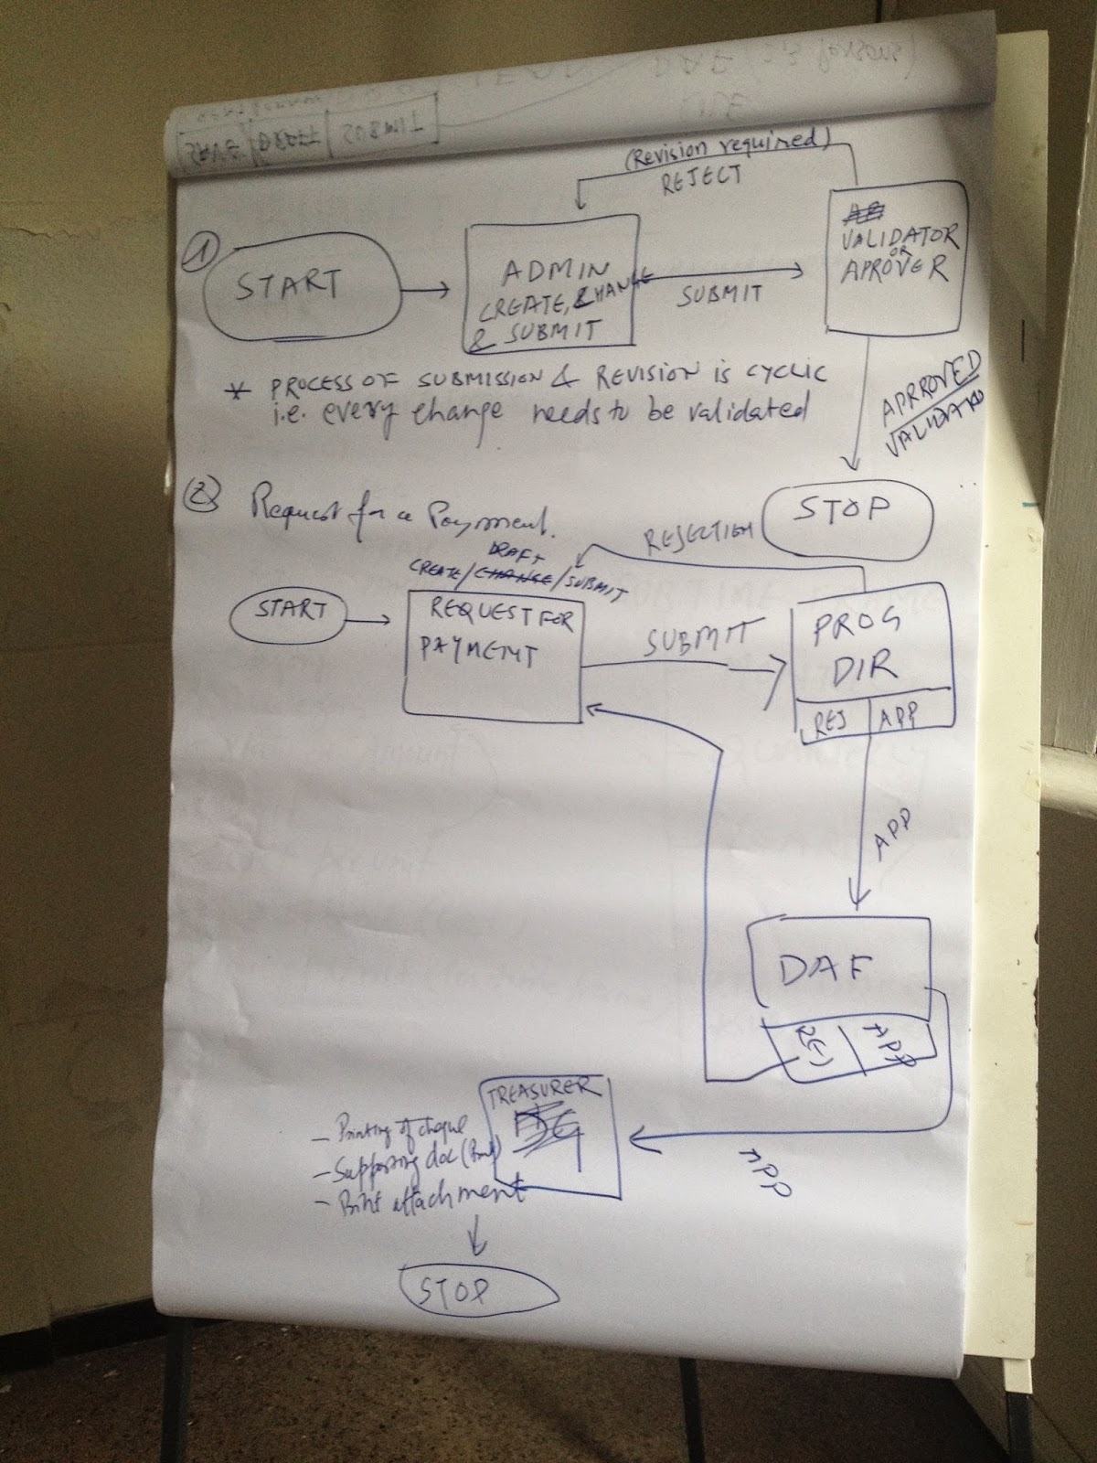
IBM Corporate Service Corps Morocco 5 Team
Team Composition
  15 global representatives
  10 nationalities
  5+ unique professional profiles
Client Partners
    ALCS
    CHU Ibn Rochd
    OFPPT
    Ministry of Tourism
Gerry Broennimann, IT Development Specialist
Catherine Fillare, Education & Knowledge Leader
Patrick Joussen, Project Manager, Manager
Ramgopal Yadav, SAP Technical Consultant

Slide 3
Our Understanding of ALCS Priorities
ALCS has clearly defined priorities for the next several years:
Better knowledge of at risk populations by tracking demographics
Prevention including access to treatment in early stages
Consistent application of national program objectives at regional levels
Optimization of financial and personnel resources
Financial transparency and quality to trusted business partners
Dynamic volunteer program
Coordination and collaboration with like minded institutions
Capabilities for driving international, national and regional mission and values
The IBM CSC team is committed to enabling these activities by providing strategic advisory support and recommendations for improving operational business practices and IT capabilities

Slide 4
Executive Summary
Our Goal
Develop strategic IT recommendations to achieve operational efficiency and sustainability
Strategic Plan Objectives
Key Recommendations
Improve information and management systems between headquarters and branch offices
Strengthen financial management and linkages to program monitoring
Assess and integrate social media and new technology tools to increase national outreach
Continue to scale operations nationally through enhanced organizational development
Continue to position ALCS as a HIV/AIDS Centre of Excellence in Morocco and the region
IT Assessment: Stabilize IT capability through strategic outsourcing
Financial Management: Institute real-time information gathering for improved planning, budgeting and forecasting accountability
Operational Metrics: Centralize information collection to improve data quality and achieve national targets for HIV/AIDS prevention
Communications: Leverage online collaboration tools to strengthen internal communications and information sharing
Archiving/Backup: Institute a plan to support continuity of operations and information security
Fundraising: Optimize the donor database to effectively address potential funding sources
Mobile: Create a customized application based on existing HIV/AIDS frameworks
1
2
3
4
5
6
7
4
Notes:
4

Slide 5
Overall CSC Project Goals
The IBM CSC Team will provide a clear and objective
assessment of organizational gaps - IT information, management and budget –
in keeping with anti-AIDS nationwide strategies and enable the organization to continue to scale as per its strategic plan
Enable ALCS objectives and the social development agenda of Morocco
Focus on technology optimization to facilitate scaling of ACLS at a national level
Design development of new applications to improve operational efficiency
Ultimately, help in fight against AIDS prevention, both in Morocco, and potentially regionally

Slide 6
Our Commitments to ALCS
To contribute to the vision and ALCS core objectives of
HIV Prevention
Care & Psychological Support
Advocacy & Human Rights
by
1
2
Improving operational efficiency through streamlined financial management practices
Strengthening capacity for reporting operational outcomes and return on program investments
6

Slide 7
Our Approach
ALCS IT Solutions Design: Statement of Work
April 28 – May 23
1
2
3
4
Initiate project
Gather Requirements
Draft Information Management Approach
Develop Logical Database Design
Activities
Conduct kick off meeting
Participate in section site visit
Learn ALCS priorities, including 7 proposed projects
Finalize scope, approach deliverables
Define communications method and meeting schedule
Conduct 1-on-1 ALCS interviews to understand projects, budget approvals, payment processing and operational reporting
Assess headquarters IT/ telelphony infrastructure
Capture /categorize findings
Develop information model for finance, administration and operational activities
Determine ALCS project dependencies, constraints and assumptions
Define and validate key information entities and data relationships
Develop logical design, documenting technical, functional, and non-functional requirements
Document user interface and reporting preferences
Draft SOW for systems developer
Deliverables
☑
☑
☑
☑
Revised SOW / project deliverables
High level approach to delivering recommendations for 7 propose projects
SWOT Analysis
Synthesis of our understanding of current challenges & issues
IT infrastructure inventory
Application workflow model
Documented requirements for application and database configuration
Education and validation session on database design
☑
Logical database design
Sample dashboards
Recommendations for short-term and long-term sustainability
☑
☑
☑
☑
☑
☑
Time
3 days
1-2 weeks
1 week
1 week
7

Slide 8
ALCS operations and management are driven by programs/projects
Implementation Activities
Contract defined activities for target audiences
HIV Testing
Contraceptive distribution
Counseling/ support services
STD testing
Budgeting, Planning and Forecasting
Payment Processing
Finance & Accounting
Operational Metrics
ALCS Program/Project
Communications
Key performance indicators
Program outcomes
Capacity status
Trends
Website, Facebook
Print Media
Internal
External/PR
Calendar of events
8

Slide 9
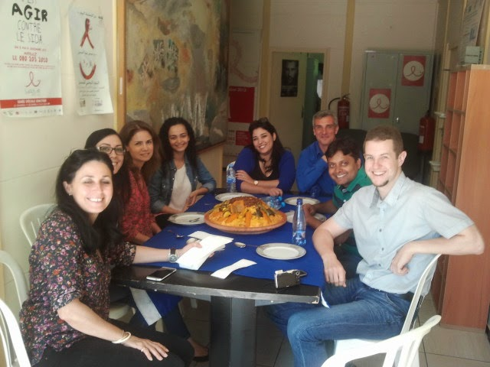
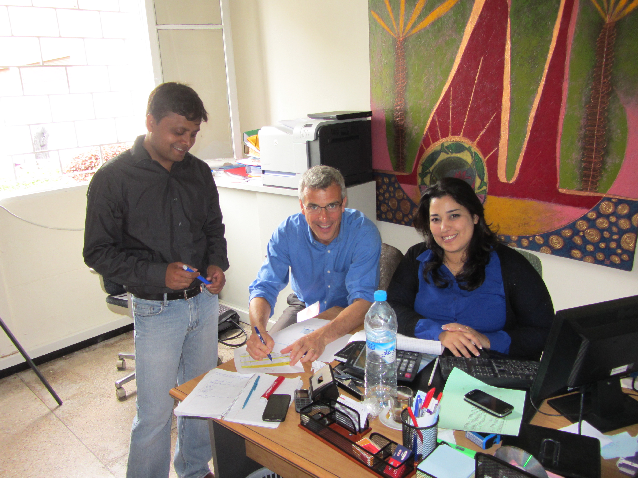
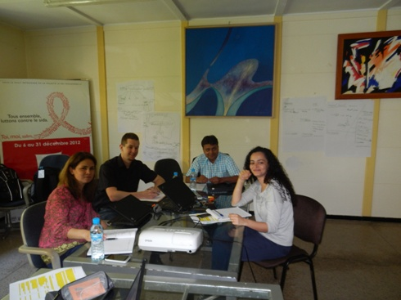
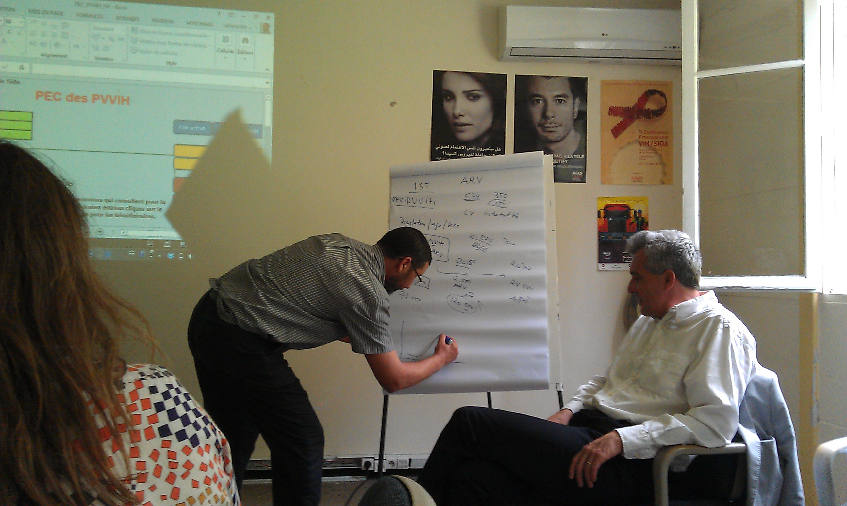
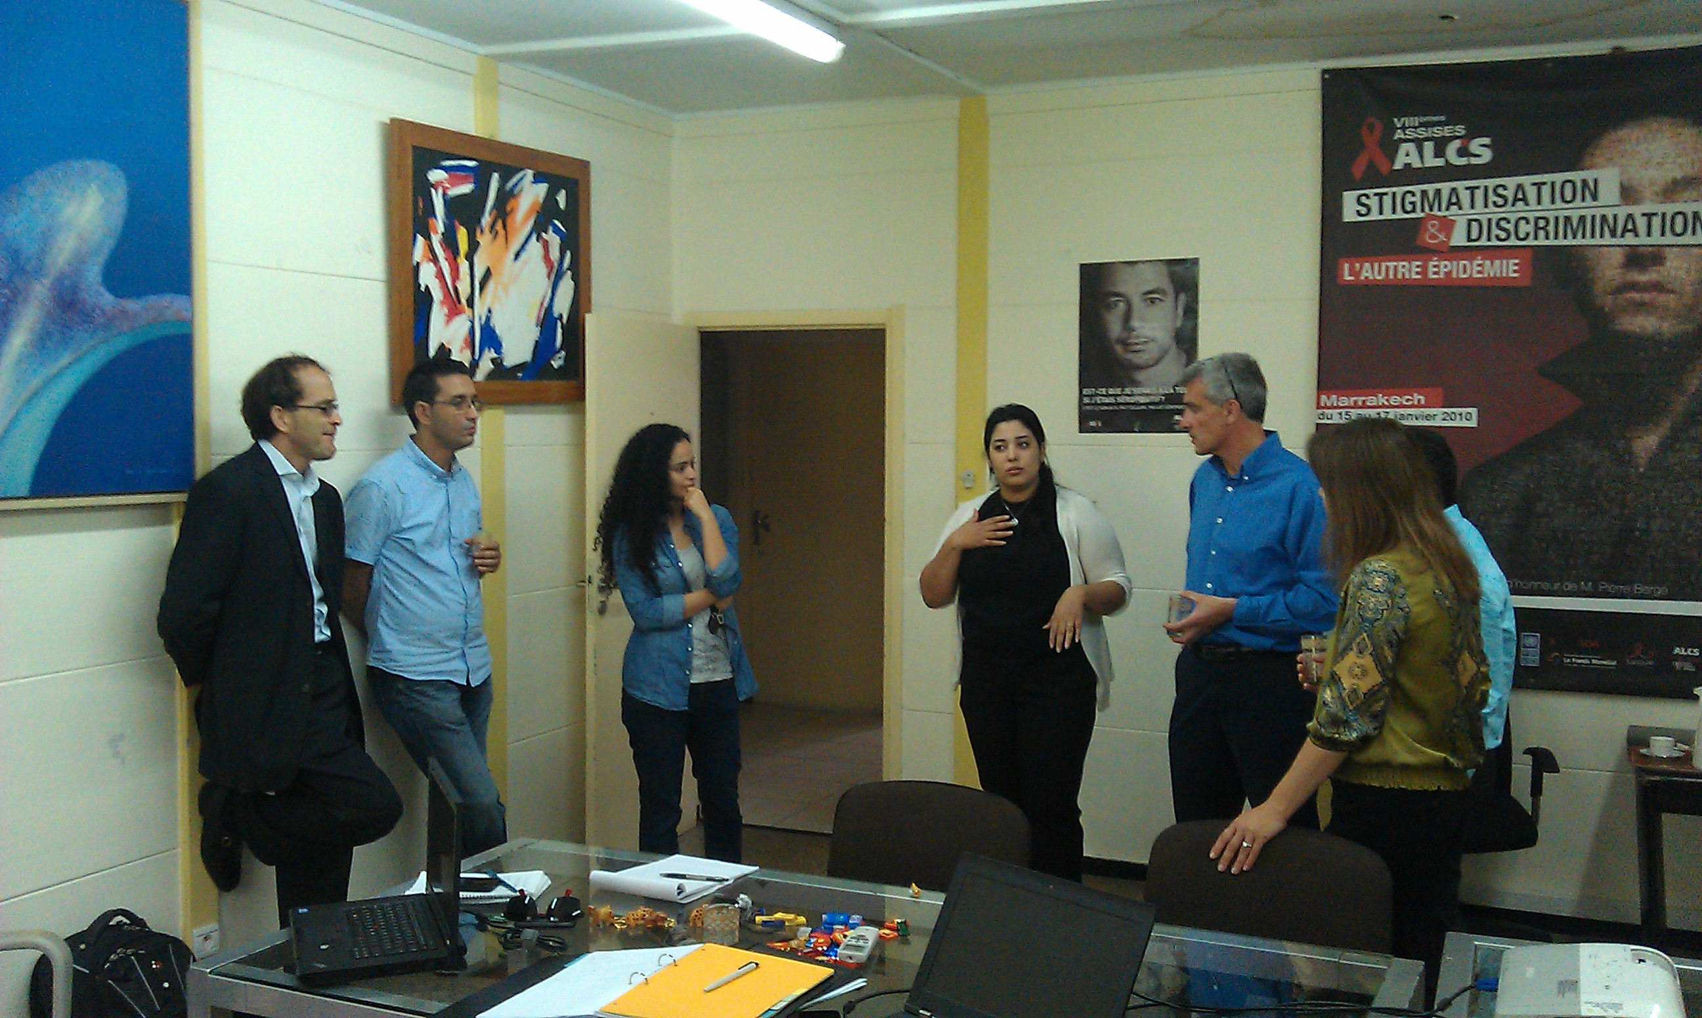
ALCS members contributed to the project with their passion, expertise and tremendous Moroccan hospitality
9
Notes:
9

Slide 10
Current business model & SWOT
1
Analysis and Assessment
2
Design Recommendations
3
Planning & Next Steps
4
Appendix
10

Slide 11
Our project focus aligns with ALCS short-term and long-term objectives
Goal: Develop an information management and integration approach for effectively managing project information and related outcomes
Scope: IT infrastructure assessment for headquarters; information management and processes requirements gathering; logical database design and draft SOW
Approach: Interviews with current leaders, as-is assessment, validation of initial requirements, design development approach
Time: April 28 – May 23
Key stakeholders:
  Ms. Fouzia Bennani
  Ms. Nidal Chafiai
  Ms. Karima Chakiri
  Dr. Lahoucine Ouarsas
Internal
Information
Sources
External
Information
Sources
Project Database
ANALYSIS
XLS & SPSS
PLANNING
REPORT
KPI
REPORTING

Slide 12
ALCS has a strong base of capabilities – and a series of challenges
Strengths
Allegiance to founding principles and core values
Strong organizational identity and ALCS brand
Expansive national reach to target audiences
Strong political support, including partnership with the Ministry of Health
Experienced, engaged and motivated personnel and volunteers
Well defined operational business processes and performance metrics
Global partnerships with like minded organizations
Innovative approaches to fundraising and marketing, including SIDACTION
Open to change and continuous process improvements
Weaknesses
Lack of secure global funding sources in the future
Strong dependency on individual funding resource commitments and their compliance requirements
Cumbersome data gathering methods to report program effectiveness; return on investments
Limited physical and cyber security in place; lack of back up/disaster recovery plan
Limited use of social media to tap funding sources/ potential donors
Strong dependency on individual personnel performance, limited succession planning
Limited personnel resources for IT infrastructure support; limited IT capacity for field and mobile units
Source: Discussions with FTAM
12
Notes:
12

Slide 13
Strengths and weaknesses may be turned into opportunities – keeping in mind the potential threats
Opportunities
Become a ‘Center of Excellence’ in the Magreb region for HIV/AIDS prevention
Serve as a role model, sharing best practice methods with other NGOs and health care providers
Extend prevention support for other contagious diseases
Adopt a centralized information repository to improve operational efficiency, increase performance and information sharing
Use collaboration tools to improve communications and performance metrics reporting
Outsource IT infrastructure support, ensuring use of latest technology and security methods
Leverage social media, including mobile applications to:
  Provide care and support for target audiences
  Share real time data between doctors and clients on testing results, appointments and treatments
  Support public awareness campaign activities
  Increase promotion of success stories/income generating activities
  Leverage key networks and past donors to support fundraising strategy for sustainability
Threats
Future pipeline of international and government funding may be limited
Potential of stronger funding consideration for other NGOs
Lack of qualified personnel resources, including doctors and trained volunteers
Ongoing discrimination and human rights violations against target audiences
Limited ability to track trending data following participation with ALCS
Potential for IT security incidents and data breaches
Source: Discussions with FTAM
13
Notes:
13

Slide 14
1
Analysis and Assessment
  IT Assessment
  Financial Management
  Operational Metrics
2
Design Recommendations
1
2
3
3
Planning & Next Steps
4
Appendix
14

Slide 15
Investing in a centralized program management application will improve operational efficiency and sustainability
From
To
No real time access to project information
Limited visibility of overall key performance indicators and project details
Manual input and analysis of key performance indicators
Notable errors in information collection
Lag in response time to reporting requirements
Limited number of resources trained to use current tools
Paper based recording methods for supporting documentation
Real time access to information
Integrated view of project status and performance
Automated tool for data collection and analysis
Controlled entry and role based access reducing data error risks
Friendly user interfaces and customized dashboards supporting user acceptance
Flexible development model for customization and future project requirements

Slide 16

Design Considerations
What to use
What not to use, why not
Implementation cost
Maintenance/sustainability
Constraints
  Real time data access and data collection
  Cost
  Feasibility of technology availability

