Slide 1



IT Solutions for Business Impact and Sustainability Association de lutte contre la sida (ALCS)
May 23, 2014
IBM Corporate Services Corps – Morocco 5 Team
This report contains information that is confidential and proprietary to IBM and is solely for the use of IBM personnel. No part of it may be used, circulated, quoted, or reproduced for distribution outside IBM. If you are not the intended recipient of this report, you are hereby notified that the use, circulation, quoting, or reproducing of this report is strictly prohibited and may be unlawful.

Slide 2
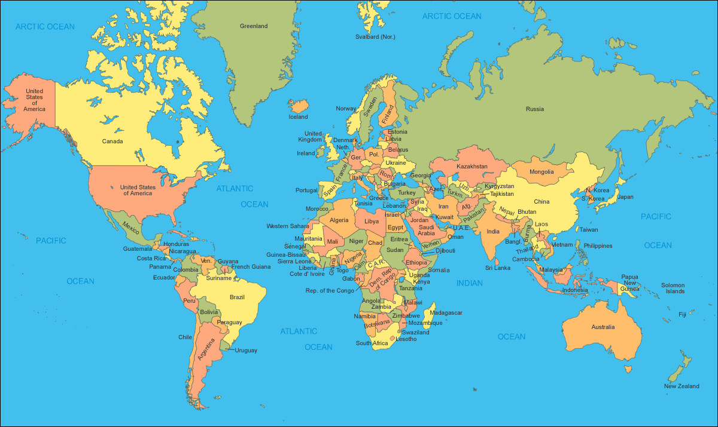

























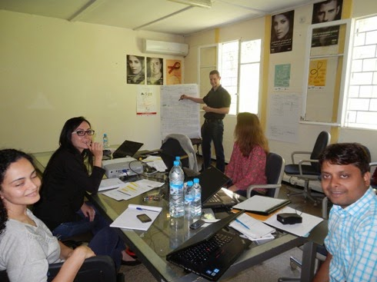
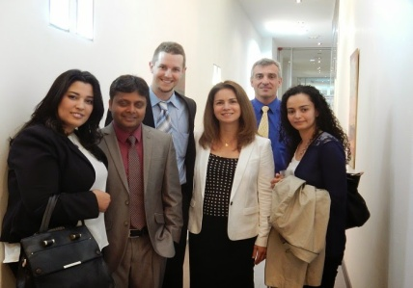
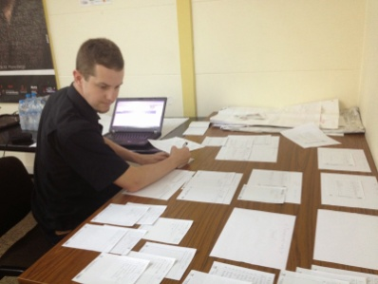
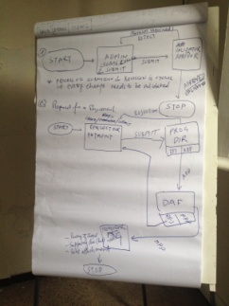
IBM Corporate Service Corps Morocco 5 Team
Team Composition
  15 global representatives
  10 nationalities
  5+ unique professional profiles
Client Partners
    ALCS
    CHU Ibn Rochd
    OFPPT
    Ministry of Tourism
Gerry Broennimann, IT Development Specialist
Catherine Fillare, Education & Knowledge Leader
Patrick Joussen, Project Manager, Manager
Ramgopal Yadav, SAP Technical Consultant

Slide 3
Our Understanding of ALCS Priorities
ALCS has clearly defined priorities for the next several years:
Better knowledge of at risk populations via demographics tracking
Prevention, including access to treatment during early stages
Consistent application of national program objectives at regional levels
Optimization of financial and personnel resources
Financial transparency and quality recognized by trusted business partners
A dynamic volunteer program
Coordination and collaboration with like minded institutions
Capabilities for driving international, national and regional mission and values
The IBM CSC team is committed to enabling these activities by providing strategic advisory support and recommendations for improving operational business practices and IT capabilities

Slide 4
Executive Summary
Our Goal
Develop strategic IT recommendations to achieve operational efficiency and sustainability
Strategic Plan Objectives
Key Recommendations
Improve information and management systems between headquarters and branch offices
Strengthen financial management and linkages to program monitoring
Assess and integrate social media and new technology tools to increase national outreach
Continue to scale operations nationally through enhanced organizational development
Continue to position ALCS as a HIV/AIDS Centre of Excellence in Morocco and the region
IT Assessment: Stabilize IT capability through strategic outsourcing
Financial Management: Institute real-time information gathering for improved planning, budgeting and forecasting accountability
Operational Metrics: Centralize information collection to improve data quality and achieve national targets for HIV/AIDS prevention
Communications: Leverage online collaboration tools to strengthen internal communications and information sharing
Archiving/Backup: Institute a plan to support continuity of operations and information security
Fundraising: Optimize the donor database to effectively address potential funding sources
Mobile: Create a customized application based on existing HIV/AIDS frameworks
1
2
3
4
5
6
7
4
Notes:
4

Slide 5
Defined Project Priorities & ALCS/IBM Commitments
IT Infrastructure Review of Headquarters
Financial Management – Budget and Payment Processing Application
  Accounting System Interface (SAGE 100 vs. 1000 Assessment)
Operational Data Collection & Analysis
Communications and Collaboration Tools
Archiving / Backup / Security
Fundraising - Donor Database Usage
Mobile Application Development

Slide 6
Our Approach
ALCS IT Solutions Design: Statement of Work
April 28 – May 23
1
2
3
4
Initiate project
Gather Requirements
Develop Information Management Approach
Design Application Framework
Activities
Conduct kick off meeting
Participate in section site visit
Learn ALCS priorities, including 7 proposed projects
Finalize scope, approach deliverables
Define communications method and meeting schedule
Conduct 1-on-1 ALCS interviews to understand projects, budget approvals, payment processing and operational reporting
Assess headquarters IT/ telelphony infrastructure
Capture /categorize findings
Draft information model for finance, administration and operational activities
Determine ALCS project dependencies, constraints and assumptions
Define and validate key information entities and data relationships
Develop logical design, documenting technical, functional, and non-functional requirements
Document user interface and reporting preferences
Create functional specification document for system developers
Deliverables
☑
☑
☑
☑
Revised SOW / project deliverables
High level approach to delivering recommendations for 7 proposed projects
SWOT Analysis
Synthesis of our understanding of current challenges & issues
IT infrastructure inventory
Application workflow model
Documented requirements for application and database configuration
Education and validation session on database design
☑
Logical database design
Sample dashboards
Recommendations for short-term and long-term sustainability
☑
☑
☑
☑
☑
☑
Time
3 days
1-2 weeks
1 week
1 week
6

Slide 7

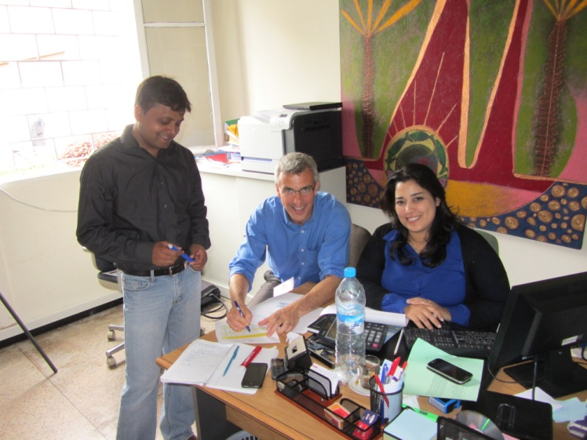
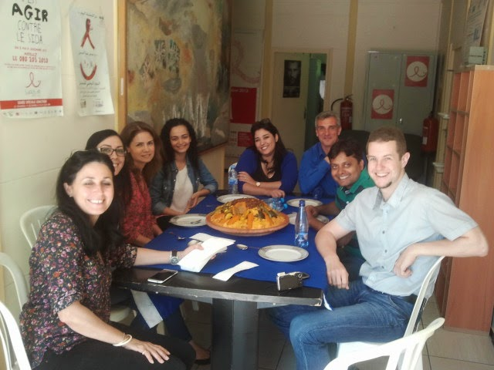
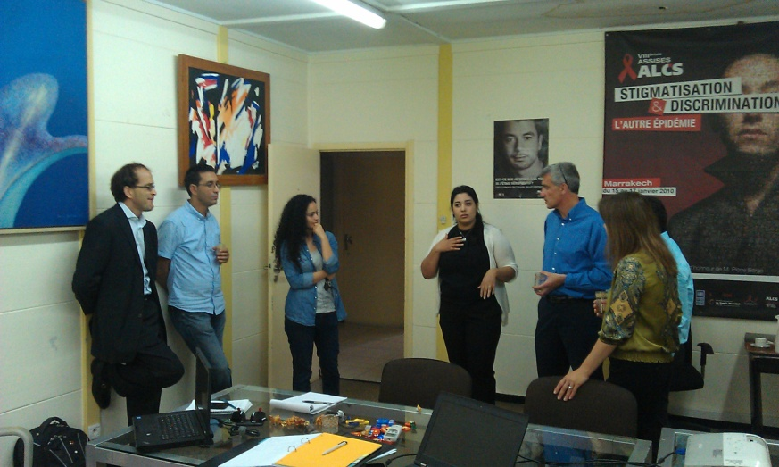
ALCS members contributed to the project with their passion, expertise and tremendous Moroccan hospitality
7
Notes:
7

Slide 8
SWOT analysis
Project Parameters
1
Analysis and Assessment
2
Design Recommendations
3
Design Considerations
4
Additional Recommendations for Prioritized Projects
5
Appendix
8

Slide 9
ALCS has a strong base of capabilities – and a series of challenges
Strengths
Allegiance to founding principles and core values
Strong organizational identity and ALCS brand
Expansive national reach to target audiences
Strong political support, including partnership with the Ministry of Health
Experienced, engaged and motivated personnel and volunteers
Well defined operational business processes and performance metrics
Global partnerships with like minded organizations
Innovative approaches to fundraising and marketing, including SIDACTION
Open to change and continuous process improvements
Weaknesses
Lack of secure global funding sources in the future
Strong dependency on individual funding resource commitments and their compliance requirements
Cumbersome methods to report program effectiveness; return on investments
Manual business operations and limited use of IT infrastructure
Limited physical and cyber security in place; lack of back up/disaster recovery plan
Limited use of social media to tap funding sources/ potential donors
Strong dependency on individual personnel performance, limited succession planning
Limited personnel resources for IT infrastructure support; limited IT capacity for field and mobile units
Source: Discussions with FTAM
9
Notes:
9

Slide 10
Strengths and weaknesses may be turned into opportunities – keeping in mind the potential threats
Opportunities
Become a ‘Center of Excellence’ in the Maghreb region for HIV/AIDS prevention
Serve as a role model, sharing best practice methods with other NGOs and health care providers
Extend prevention support for other contagious diseases
Adopt a centralized information repository to improve operational efficiency, increase performance and information sharing
Use collaboration tools to improve communications and performance metrics reporting
Outsource IT infrastructure support, ensuring use of latest technology and security methods
Optimize donor information to support fundraising strategy for sustainability
Leverage social media, including mobile applications to:
  Provide care and support for target audiences
  Share real time data between doctors and clients on testing results, appointments and treatments
  Support public awareness campaign activities
  Increase promotion of success stories/income generating activities
Threats
Future pipeline of international and government funding may be limited
Lack of robust IT infrastructure to support growth
Lack of qualified personnel resources, including doctors and trained volunteers
Ongoing discrimination and human rights violations against target audiences
Limited ability to track trending data following participation with ALCS
Potential for IT security incidents and data breaches
10
Notes:
10

Slide 11
ALCS operations and management are driven by programs/projects
Activities
Contract defined activities for target audiences
HIV Testing
Contraceptive distribution
Counseling/ support services
STD testing
Budgeting, Planning and Forecasting
Payment Processing
Finance & Accounting
Operational Metrics
ALCS Program/Project
Communications
Key performance indicators
Program outcomes
Capacity status
Trends
Website, Facebook
Print Media
Internal
External/PR
Calendar of events
11

Slide 12
1
Analysis and Assessment
  Information Technology Assessment
  Financial Management
  Operational Data Collection and Analysis
2
Design Recommendations
1
2
3
3
Design Considerations
4
Additional Reccomendations for Prioritized Projects
5
Appendix
12

Slide 13
1
Information Technology Assessment
Overview of the approach and proposed recommendations
13

Slide 14
Information Technology Assessment: Recommendations
IT Space and Hardware: Designate secure area and hardware rack (by IT provider)
Telephony: Review integrated solutions offered by Telecom providers in Morocco
Electricity: Renew installation via 2 options (by IT provider)
  Power secured network for PC/screens on uninterruptible power supply (UPS) + standard network
  Standard network only
Network: Renew installation (by IT provider)
Security/Backup: Assess Office 365 features, unified threat management (UTM) in rack, local backup disks and tools in rack (by IT provider and Office 365 for non-profits)
Licenses: Evaluate Office 365 for non-profits offering (by IT Analyst Intern)
Facility Management: Consider a service contract agreement, enabling latest technology and security features
IT Analyst Internship: Propose partnership with OFPPT and/or other local universities to support projects such as Office 365 evaluation, collaboration tools feasibility study, MS Access donor database development

Slide 15
1
Analysis and Assessment
  Information Technology Assessment
  Financial Management
  Operational Data Collection & Analysis
2
Design Recommendations
1
2
3
3
Design Considerations
4
4
Additional Recommendations and Next Steps
Additional Recommendations for Prioritized Projects
5
Appendix
15

Slide 16
Investing in a centralized program management application will improve operational efficiency and sustainability
From
To
No real time access to project information
Limited visibility of overall key performance indicators and project details
Manual input and analysis of key performance indicators
Notable errors in information collection
Lag in response time to reporting requirements
Limited number of resources trained to use current tools
Paper based recording methods for supporting documentation
Real time access to information
Integrated view of project status and performance
Automated tool for data collection and analysis
Controlled entry and role based access reducing data error risks
Friendly user interfaces and customized dashboards supporting user acceptance
Flexible development model for customization and future project requirements
16

Slide 17
2
Financial Management
Overview of the approach and proposed recommendations
Current State
Proposed Solutions
Other considerations
17

Slide 18
Financial Management: Overview
From
  Manual
  Reactive audit reporting
  Stifled decision making – manual senior level sign off
  Significant time to input approvals
  No direct integration with other databases/information sources
  Discrepancies between financial information and metrics
To
  Automated
  Efficient “just in time” audit reporting and streamlined data availability
  Delegation of responsibilities
  Reduced time for data input
  Integrated operations and finance database application
  Reduced risk of data discrepancies

Slide 19
Financial Management
Project Definition/Creation: is the specification of a project with a fixed objective that is to be achieved with:
  allocated funds,
  with the planned resources,
  and to an agreed level of quality in a given time
The project is distinguished by
  its uniqueness,
  The element of risk involved
  its organizational importance
The project will have
  fixed attributes
  variable attributes
In ALCS, currently projects are categorized into 5 groups
  Prevention (PPM, PPF, PPR, PPO, PPMig, PuD)
  Testing of HIV (CIDAG)
  Sexually transmitted diseases: STD (IST)
  People living with HIV (Support for people living with HIV)
  Non funded projects to increase awareness

Slide 20
Project Creation and Validation
Project will be created by DAF or group of Individuals having access to create projects
Every project needs to validated
Any Individual from user group could be a person to validate project definition
Every change done in project definition needs to be validated
Project will include Fixed & Variables attributes
Project may have Financial or Operational activities or both depending on nature of project
Financial activities will be used for payment processing
Operational activities will be the referenced points for capturing operational data
Each activity may have budget categories which may also break down to subcategories
Comments field will be added for person validating projects to specify reasons for rejection
A log will be created for all modifications to the project definition including approval and rejections

Slide 21
Payment Request and Approval Process

Slide 22
Payment Request and Approval Process
Payment request will be created by Project leads, DAF or group of Individuals having access to create payment request
Static information should be pre-populated after keying in project id/ project name
Every payment request needs to validated by Program Director and DAF
Payment requests should have supporting documents for the approval, no payment will be processed without these attachments
Approver may reject for revision or approve for next steps
Approver’s will have same view of data as person creating it with additional field comments for capturing reasons for rejection or any guidelines
Business rules for basic validation and alerts; mandatory clarification
Automated mechanism will be set to trigger printing of supporting documents for final processing of payment for online transfers
A log will be created for all modifications to payment request including approval and rejections

Slide 23
Dashboard DAF

Slide 24
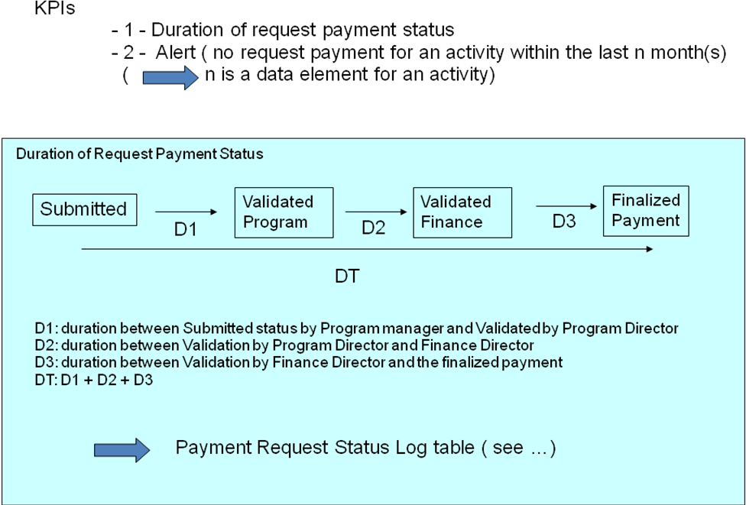
Dashboard DAF

Slide 25
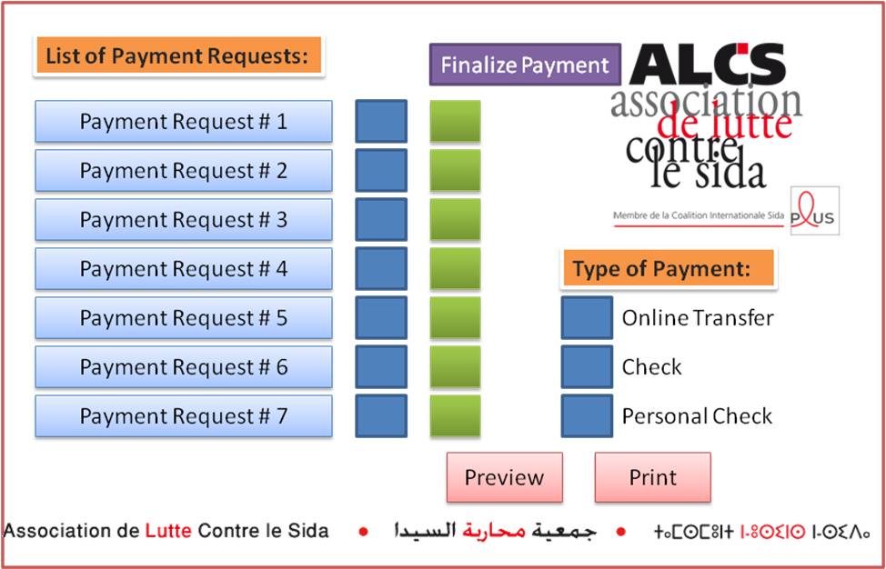
Dashboard Treasurer

Slide 26
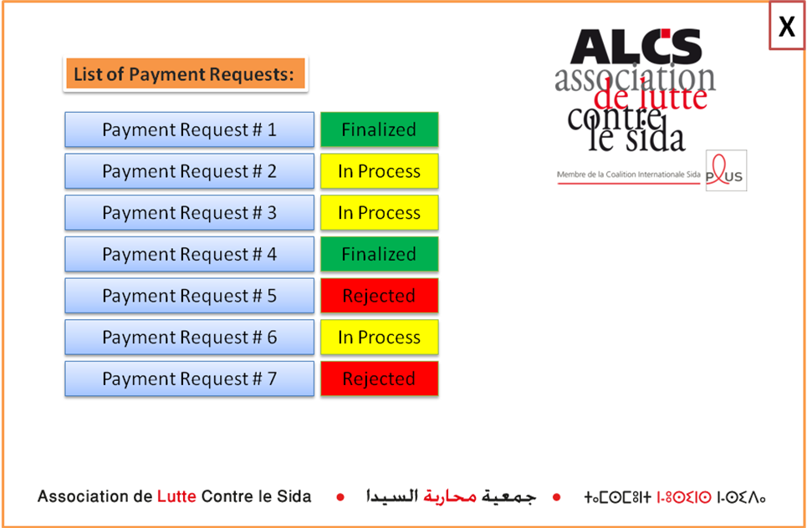
Dashboard Branch Coordinator for Payment Request

Slide 27
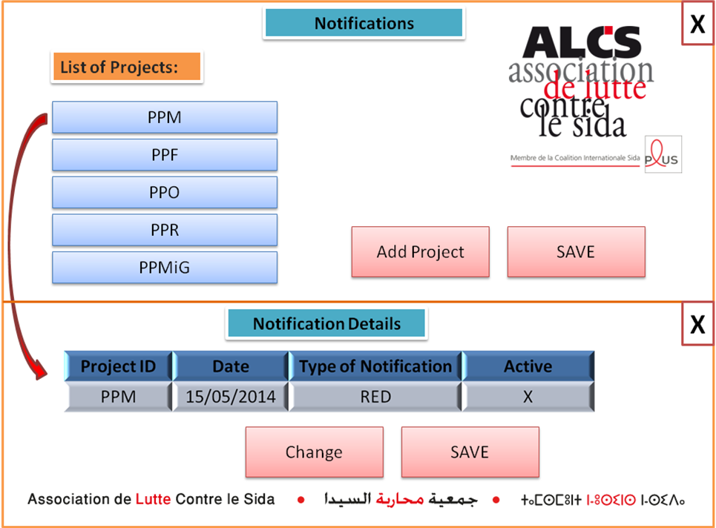
Notification for Reporting – Dashboard for DG
Notification framework will be developed to notify ALCS team members to provide details for reporting
Notification details will be defined and created along with the project
Only specific users will have access to maintain notifications

Slide 28
Financial Management Recommendations
Recommendations
  Short Term
    Built this independent offline application with capability to synch with main server when online
  Long Term
    Implement the proposed solution in SAGE to have integrated solution
    Implement intranet infrastructure for better communication and accessibility to projects
Benefits (to staff, ALCS overall, patients/participants, other stakeholders)
  Faster and efficient definition and approval process
  Normalized and error prone data entry
  Better return on investment
  Better metrics generation and proactive audit report
Project Assumptions
  ALCS will have infrastructure and budget to implement the proposed solution
  ALCS will have resources and budget for ongoing maintenance
Project Dependencies
  Infrastructure
  Budget
  Resources
Challenges/Risks
  Budget
  Interfacing capability for future enhancement

Slide 29
3
Operational Data Collection and Analysis
Overview of the approach and proposed recommendations
Current State
Proposed Solutions
Other considerations
29

Slide 30
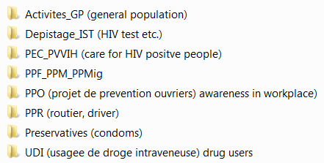
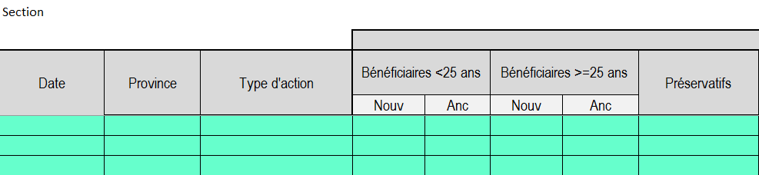
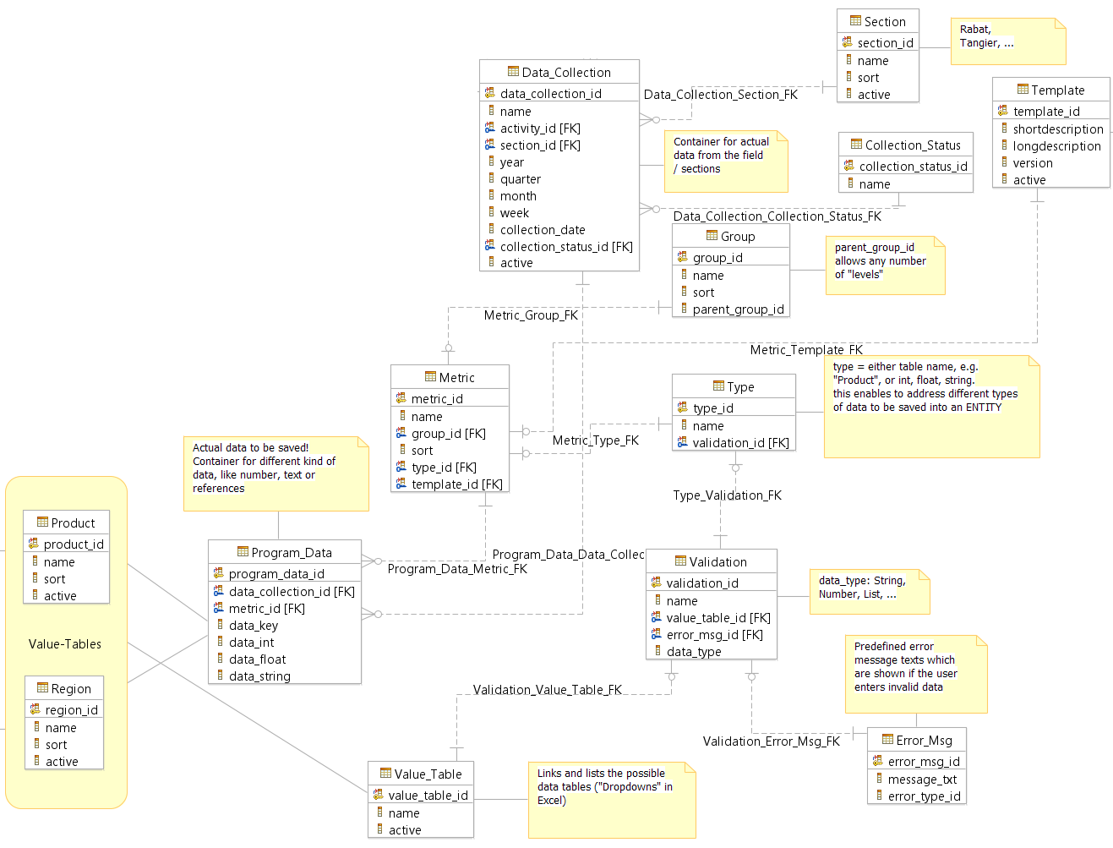
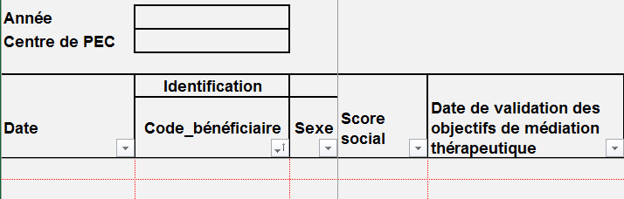
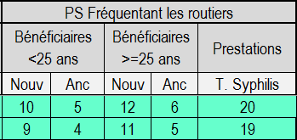
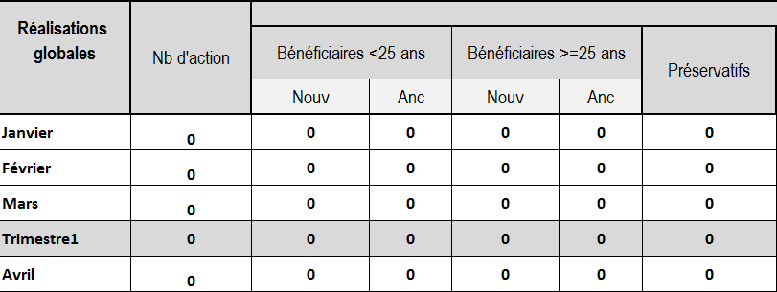
Today Future
Delays
Source of errors
Current state
  Manual reconciliation of Excel sheets
  Decentralized data storage
  No real-time project status information
Future state
  Automated reconciliation and reports
  Centralized data storage in relational DB
  Real-time project status information
30

Slide 31
Data Collection Process
31

Slide 32
Data Collection Process
32

Slide 33
Data Collection Process
33

Slide 34
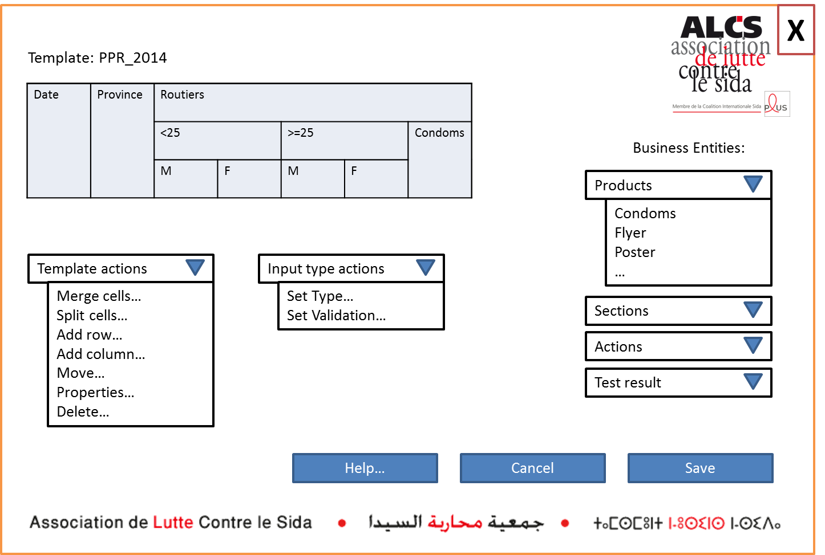
Template Design Screen

Slide 35
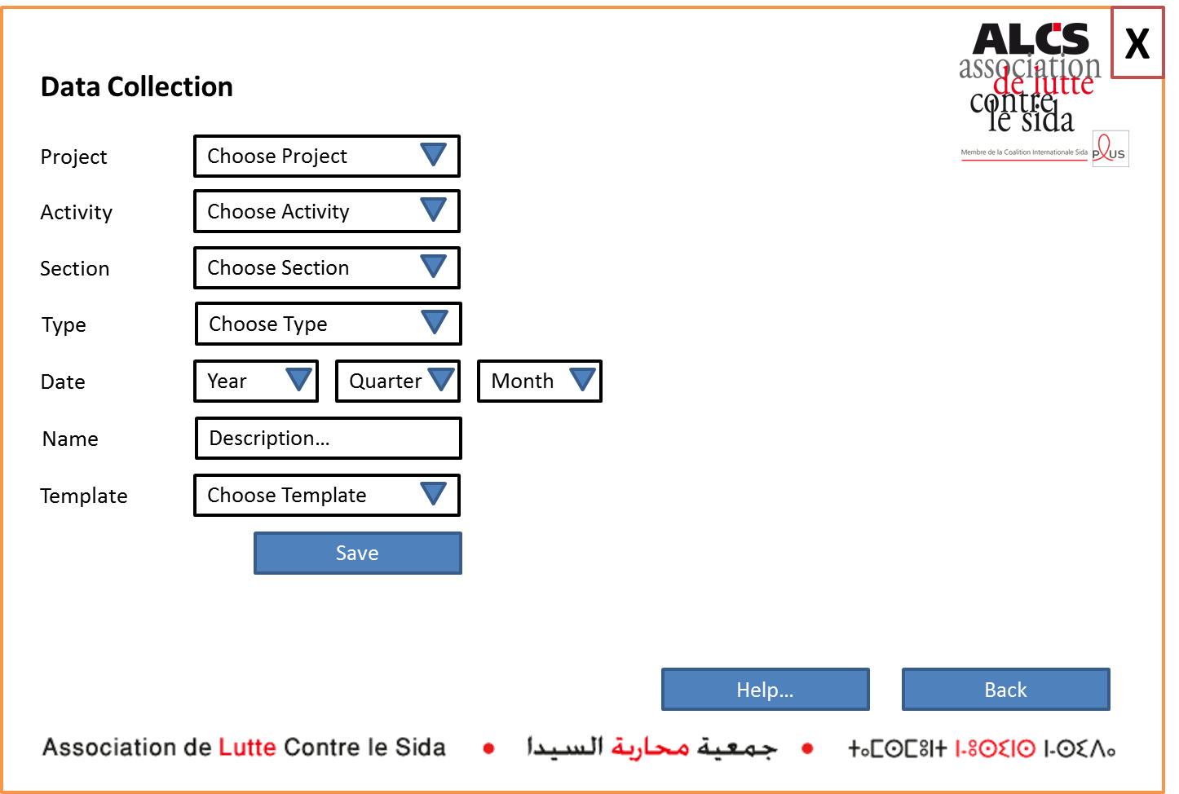
Assign Data Collection Task

Slide 36
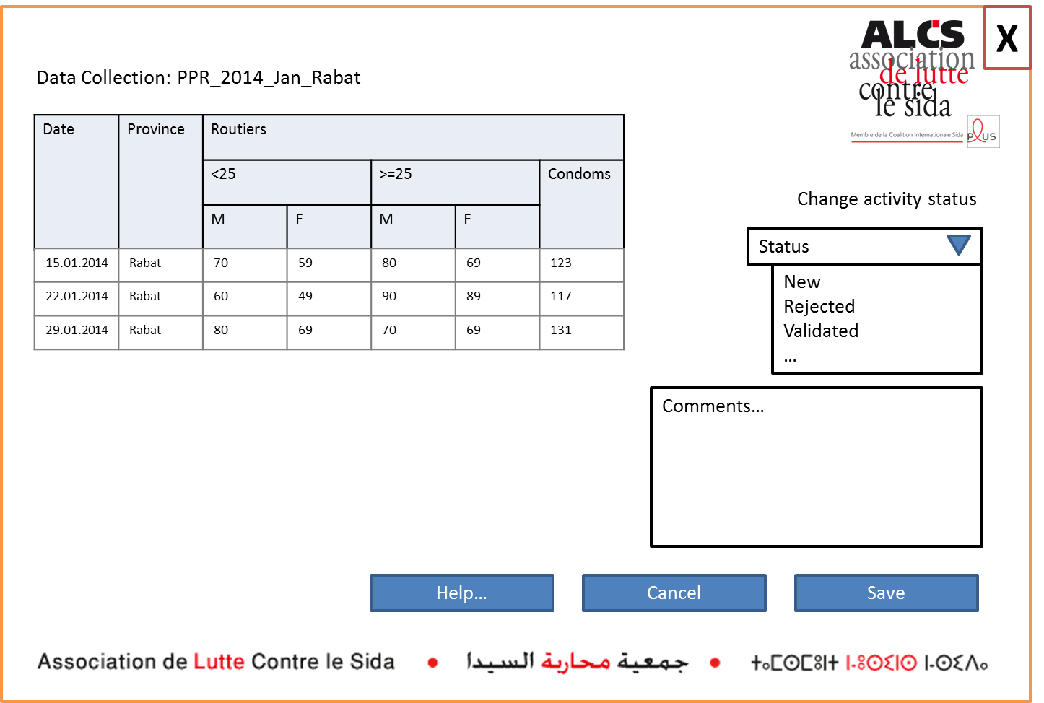
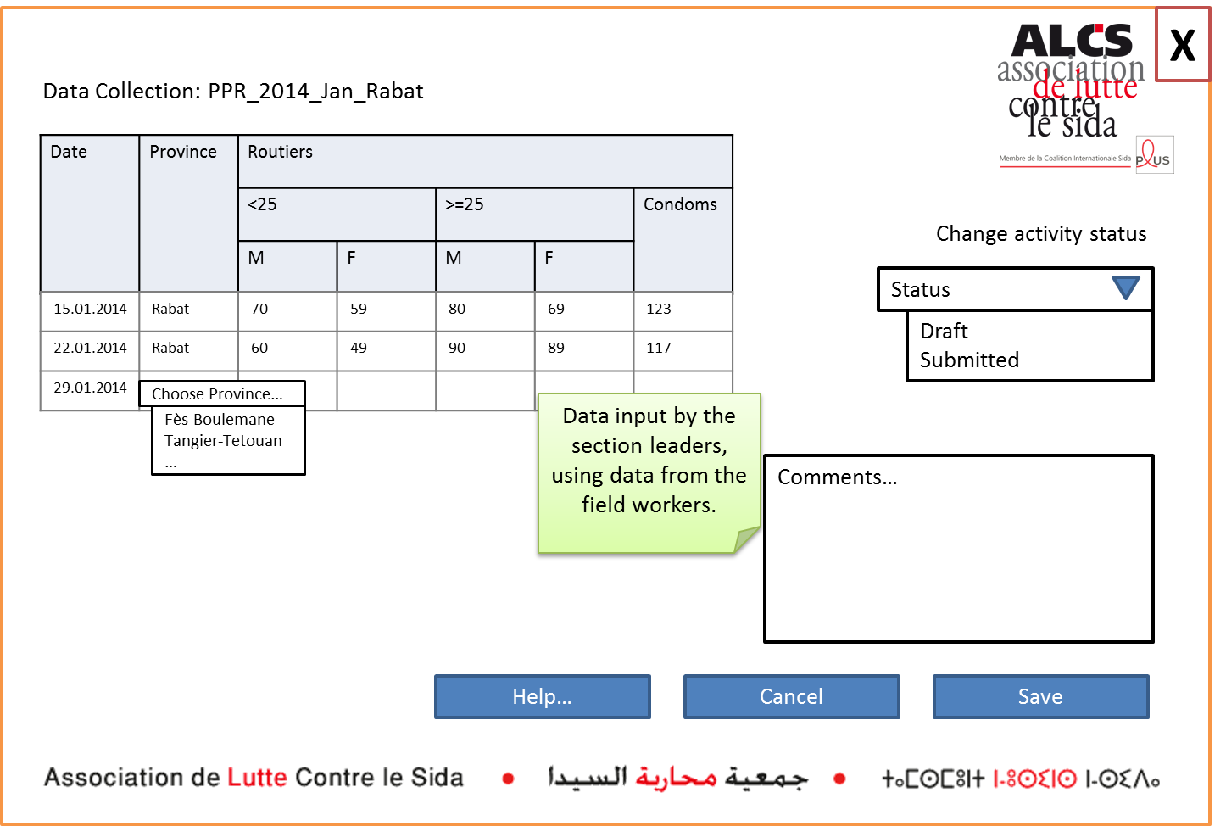
Enter Data at Branch Level

Slide 37
Validation Process

Slide 38
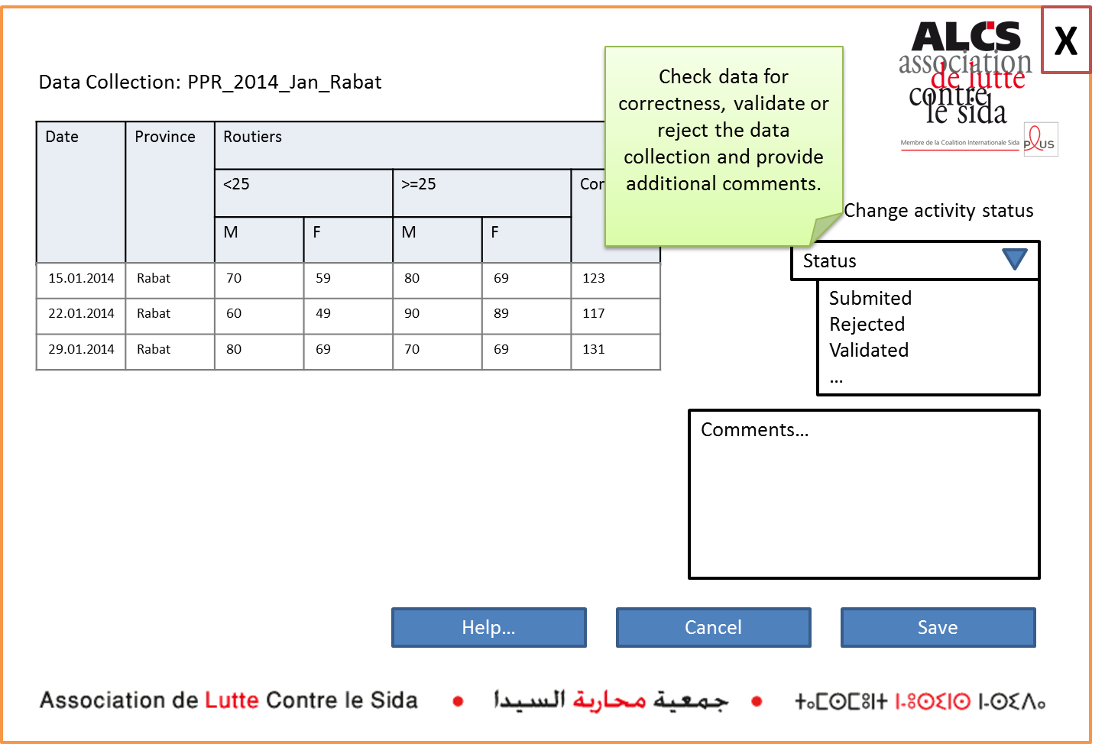
Validate collected Data at National Level

Slide 39
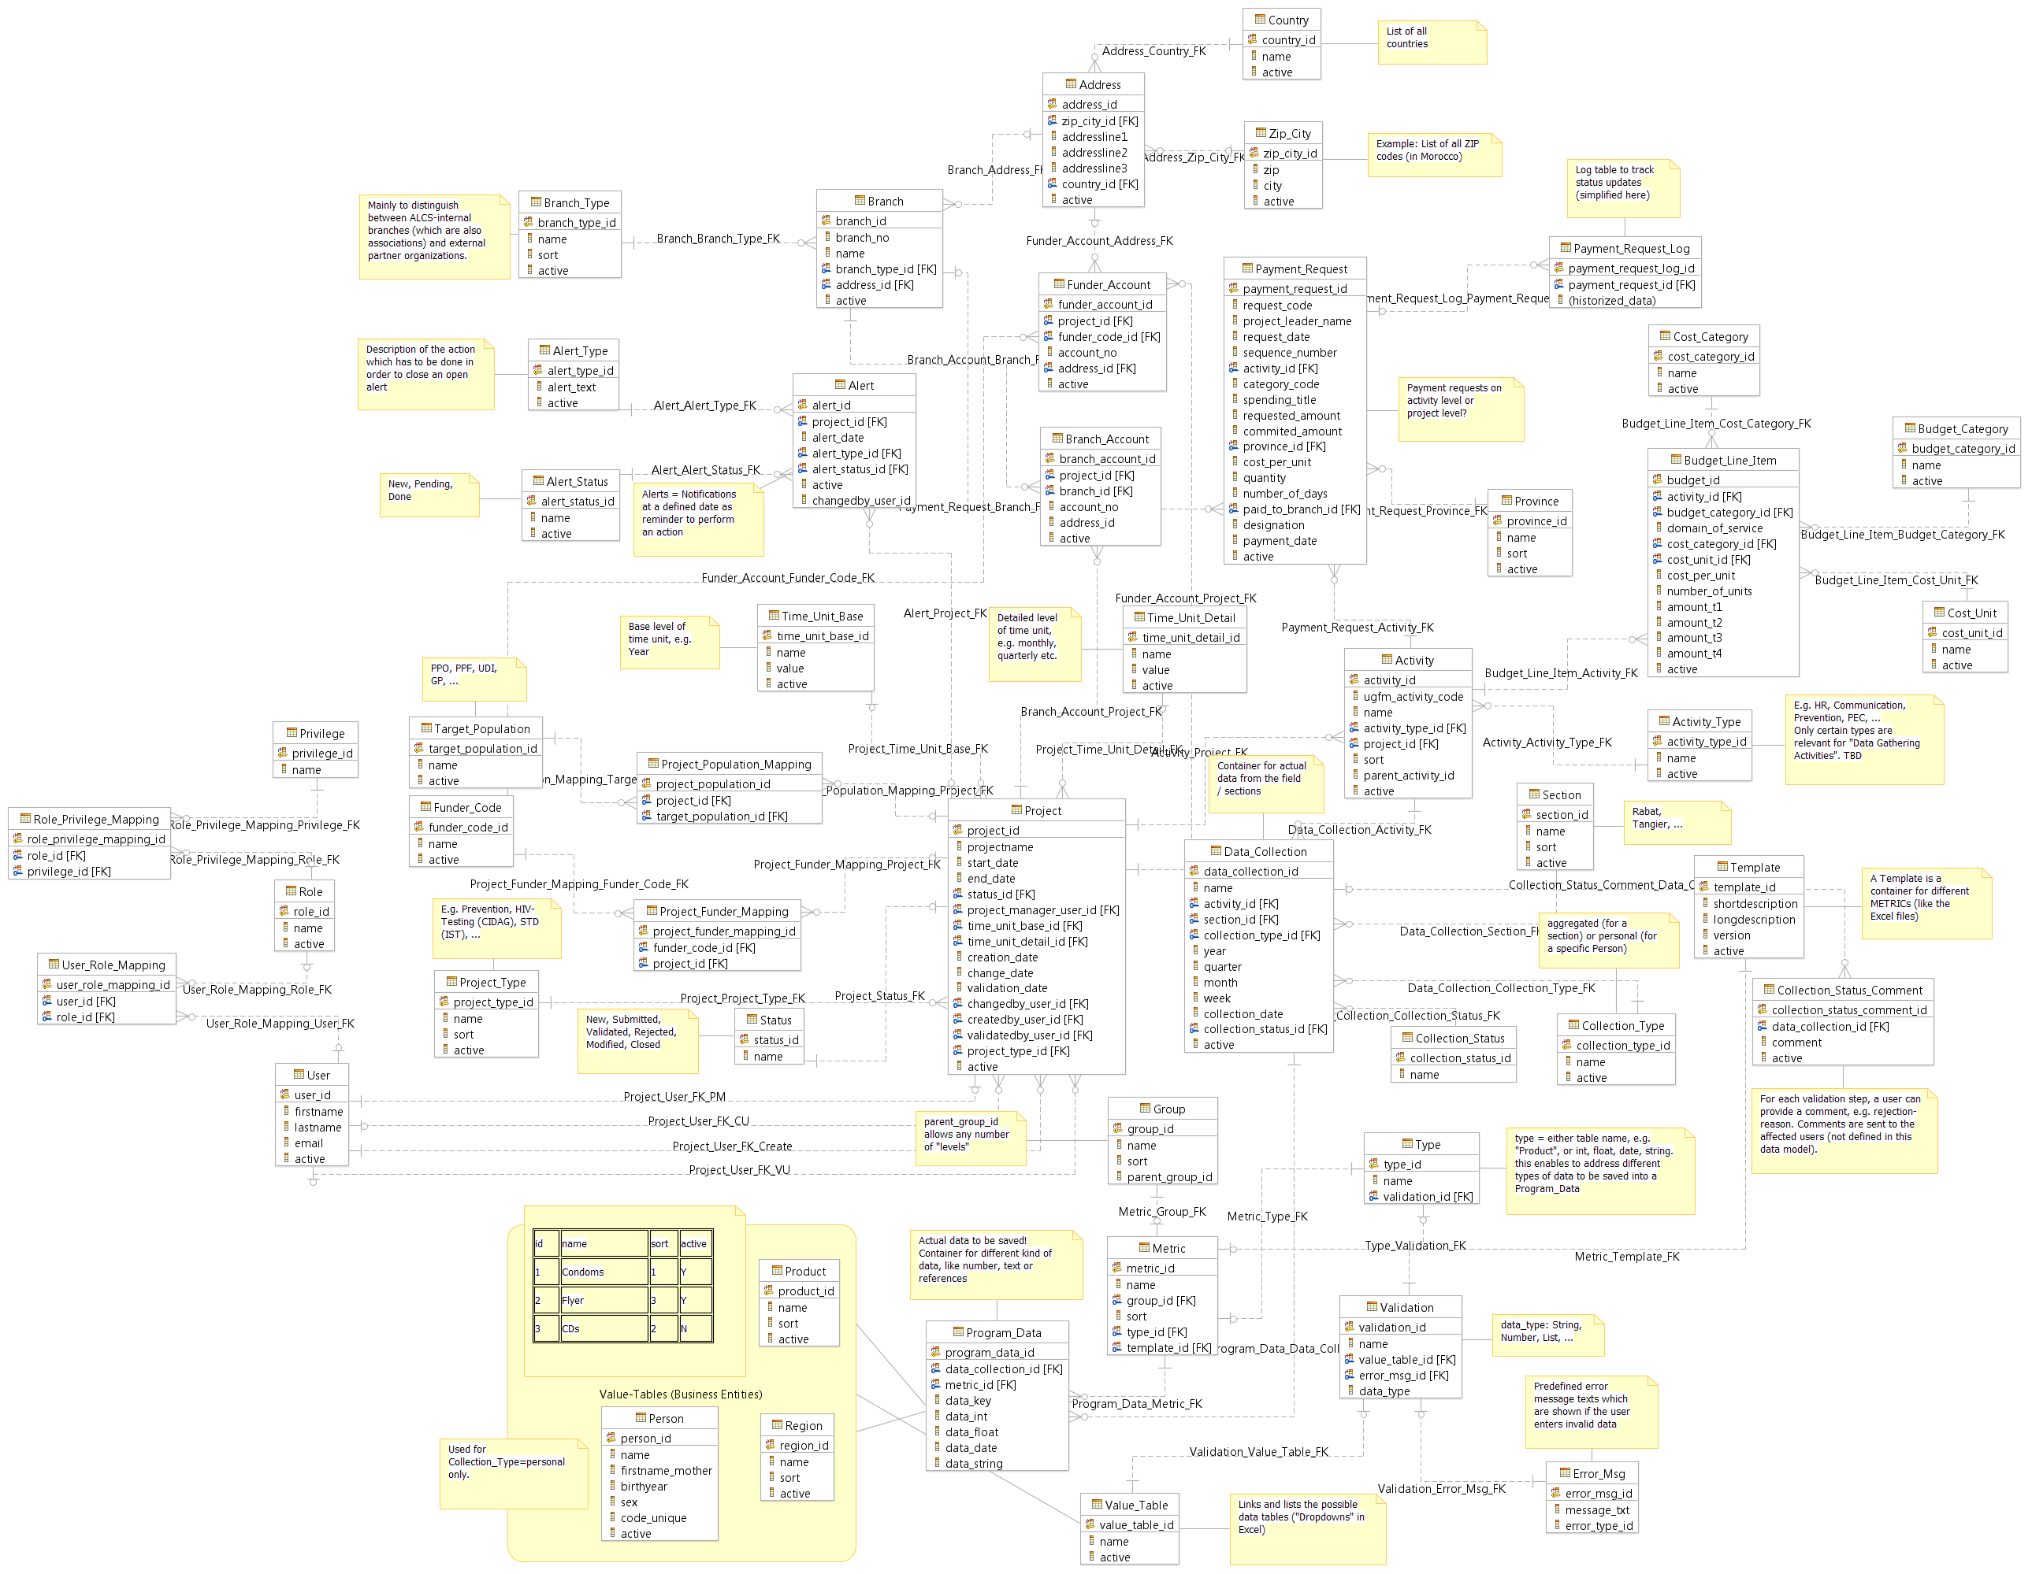
Data Model
Finance
User Admin
Project Admin
Data Collection

Slide 40
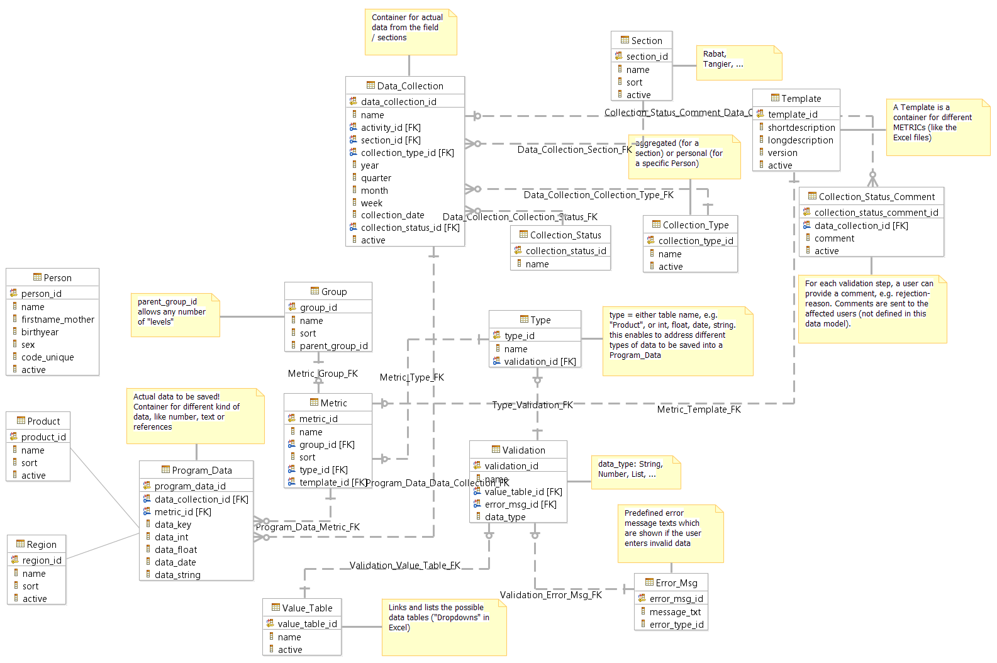
Data Model – Operational Data Extract

Slide 41
Operational Data Collection: Recommendations
Recommendations
  Target an integrated solution, i.e. project-, budget- and operational components in the same system
  Integrate person data (unique code) into the data collection system
  Keep flexibility and extensibility in focus during design phase
Benefits (to staff, ALCS overall, patients/participants, other stakeholders)
  No manual data reconciliation needed anymore
  Reduction of process time and sources of possible errors
  Central data storage
  Instant reporting possibilities
Project Dependencies
  Application changes for operational data have to be in synch with finance data changes
Challenges/Risks
  Data model complexity
  Implementation costs
  Storage (number of records) / performance
Next Steps
  Initiate request for proposal

Slide 42
Operational Data Collection: Recommendations
Recommendations
  Target an integrated solution, i.e. project-, budget- and operational components in the same system
  Integrate person data (unique code) into the data collection system
  Keep flexibility and extensibility in focus during design phase
Benefits (to staff, ALCS overall, patients/participants, other stakeholders)
  No manual data reconciliation needed anymore
  Reduction of process time and sources of possible errors
  Central data storage
  Instant reporting possibilities
Project Dependencies
  Application changes for operational data have to be in synch with finance data changes
Challenges/Risks
  Data model complexity
  Implementation costs
  Storage (number of records) / performance
Next Steps
  Initiate request for proposal

Slide 43
Financial and Operational Management Recommendations
Recommendations
  Short Term
    Integrate person data (unique code) into the operational data collection system
  Long Term
    Implement the proposed solution in SAGE to have integrated solution
    Implement intranet infrastructure for better communication and accessibility to projects
Benefits (to staff, ALCS overall, patients/participants, other stakeholders)
  Faster and efficient definition and approval process
  No manual data reconciliation needed
  Normalized and less error prone data entry
  Better return on investment
  Better metrics and proactive audit reports
  Flexible and extensible solution with central data storage
Project Dependencies
  Infrastructure
  Budget
  Resources
Challenges/Risks
  Lack of budget
  Interfacing capability for future enhancement
Next Steps
  Initiate request for proposal

Slide 44
Financial and Operational Management Recommendations (2/2)
Project Dependencies
  Infrastructure
  Budget
  Resources
Challenges/Risks
  Lack of budget
  Interfacing capability for future enhancement
Next Steps
  Initiate request for proposal

Slide 45
Financial Management Recommendations
Recommendations
  Short Term
    Built this independent offline application with capability to synch with main server when online
  Long Term
    Implement the proposed solution in SAGE to have integrated solution
    Implement intranet infrastructure for better communication and accessibility to projects
Benefits (to staff, ALCS overall, patients/participants, other stakeholders)
  Faster and efficient definition and approval process
  Normalized and error prone data entry
  Better return on investment
  Better metrics generation and proactive audit report
Project Assumptions
  ALCS will have infrastructure and budget to implement the proposed solution
  ALCS will have resources and budget for ongoing maintenance
Project Dependencies
  Infrastructure
  Budget
  Resources
Challenges/Risks
  Budget
  Interfacing capability for future enhancement

Slide 46
Financial Management: Overview
From
  Manual
  Reactive audit reporting
  Stifled decision making – manual senior level sign off
  Significant time to input approvals
  No direct integration with other databases/information sources
  Discrepancies between financial information and metrics
To
  Automated
  Efficient “just in time” audit reporting and streamlined data availability
  Delegation of responsibilities
  Reduced time for data input
  Integrated operations and finance database application
  Reduced risk of data discrepancies

Slide 47
1
Analysis and Assessment
2
Design Recommendations
3
Design Considerations
Program Management Design Points
Criteria for Decision Making
4
Additional Recommendations for Prioritized Projects
5
Appendix
47

Slide 48

Software/Development Partner Selection Considerations
What to use
What not to use, why not
Implementation cost
Maintenance/sustainability

Slide 49
Criteria for Decision Making
Cost
Impact on Business
Time
Sustainability
Flexibility
New development vs. customization
Cloud vs. in-house
Real time data access and data collection
Product functionality

Slide 50
1
Analysis and Assessment
2
Design Recommendations
3
Design Considerations
4
Additional Recommendations for Prioritized Projects
1
  Systems Integration
  Communications
  Archiving/Backup
  Fundraising
  Mobile
2
3
4
5
5
Appendix
50

Slide 51
Systems Integration Recommendations:
Assessment of interface possibilities between SAGE1000 & SAGE100
Key Recommendations
Process should be redefined or system should be customized to use single system only
Development in SAGE100 system only to reduce maintenance cost
Automating process of data cleansing and upload to SAGE1000
Standardize data for interfacing – file format and data elements
Define back up option in case of interface failure
Challenges/Risks
Both systems to interface are in disconnected landscape and share only 3-4 data elements
SAGE 100 puts most of the data manually which does not exist in SAGE 1000
No documentation of current functionality or implementation guide to understand existing functionality
No development framework/infrastructure available
Lack of information about product and its capability
Proposed Activities
Processes should be redefined to have more commonality so that automation can take place
SAGE 100 should be customized and users should be trained to use only SAGE 100 only
Test plan should be defined with specific test cases for testing of interface
A test environment should be created for interface implementation and testing before applying this
interface in live production system
Impact
Faster and error free data transfer between two systems
Better return on investment

Slide 52
Recommendation: Leverage online collaboration tools to strengthen internal communications and information sharing
Tool | Cost | Benefits | Considerations
eXo platform www.exoplatform.com | $0 for starter; storage up to 5GB; up to 25 personnel $3 per month per user; storage up to 1GB per user, help desk support | Open source No cost/low cost | Basic ‘starter’ access requires IT expertise from ALCS for maintenance & support
Office 365 http://www.microsoft.com/about/corporatecitizenship/en-us/office365-for-nonprofits/ | ALCS is eligible for non-profit program $0 to xx cost per user per month, depending on selected features, number of users | Similar to platform already in use Shorter learning curve Better integration No cost/ low cost | Requires evaluation for eligibility every 2 years.
Google Apps www.google.com/nonprofits/products/ | $0 cost for members of Google nonprofits; up to 30GB of storage across Gmail and Google Drive | Easy to use Low cost | Compatability issues with MS Office Requires membership to Google nonprofits

Slide 53

Fundraising Recommendations:
Optimize donor database to effectively address potential funding sources
Key Recommendations:
Optimize donor database (on MS Access base):
  Normalize tables
  Excel data import feature
  GUIs (screens) to work efficiently with the data
  Programmatically identify and clean duplicate donor entries
  Provide Reportings
Analyze current donor population demographics and level of support to target future funders
Proposed Activities:
Document business requirements / initiate request for proposal
Impact:
Improved time efficiency
Personalized fund raising possibilities

Slide 54





Donor Database Optimization Recommendation
List (Donors)
Name, Firstname [Details]
Name, Firstname [Details]
Name, Firstname [Details]
Name, Firstname [Details]
Name, Firstname [Details]
Name, Firstname [Details]
Name, Firstname [Details]
Name, Firstname [Details]
Name, Firstname [Details]
SIDACTION (2012)
Access DB
.xls
SIDACTION (2014)
.xls
Donor Details
Admin
x
x
Donor’s Details
Name, Firstname
Address
Email
Donations
Sidaction 2012
10’000 DH 11.10.2012
Sidaction 2010
5’000 DH 12.10.2010
Telephone
2’000 DH 31.03.2013
3’000 DH 28.04.2011
Import
Export
Edit
Duplicate search
Reports
Print
Export
Duplicate?
54

Slide 55
Archiving/Backup Recommendations:
Institute a plan to support continuity of operations and IT security
Key Recommendations
Challenges/Risks
Proposed Activities
Impact

Slide 56
Mobile Recommendations:
Create a customized application based on existing HIV/AIDS frameworks
Key Recommendations
Challenges/Risks
Proposed Activities
Impact

Slide 57
1
Analysis and Assessment
2
Design Recommendations
3
Design Considerations
4
Additional Recommendations for Prioritized Projects
5
Appendix
Deliverables
References
57

Slide 58
Deliverables
Prioritized Project Assessments
Requirements Gathering
Solution Design Document
IBM Data Studio Project Files
Information Technology Assessment
System Integration: Interfaces Overview
Security Fundamentals Briefing
Collaboration Tools Briefing
Archiving/Backup Overview Document
IT Analyst Internship Announcement
Hardware Solutions: Wifi
Final Presentation and Recommendations
Swiss Chocolates and Bollywood Movies :)

Slide 59
References

Slide 60
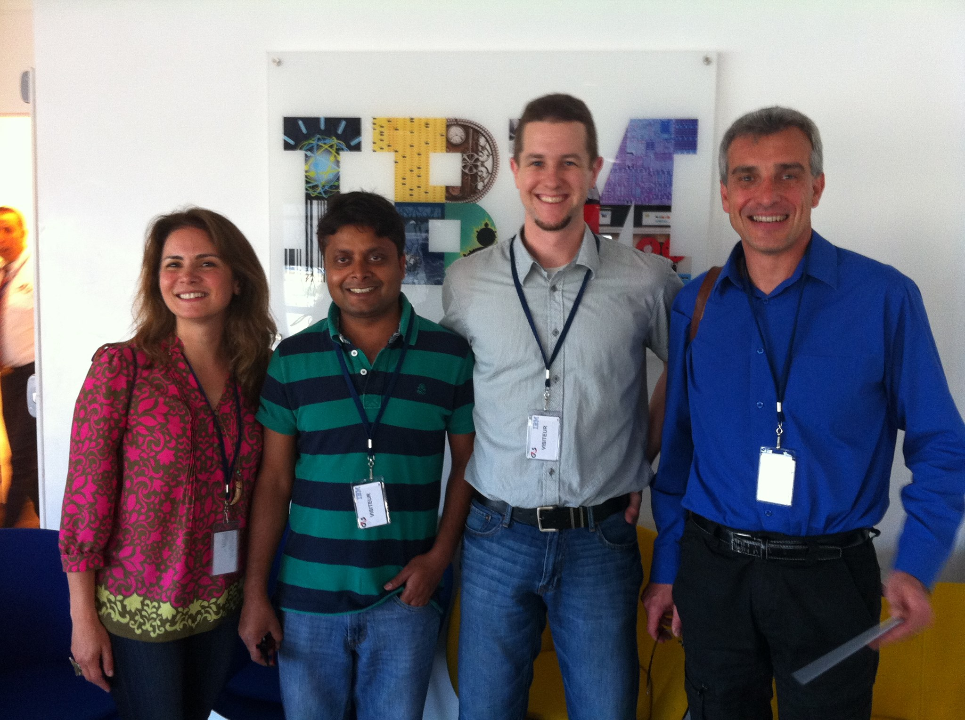

Thank you for the opportunity to learn and contribute at ALCS
60

