Slide 1
Cultural Adaptability:
Team 3 – Patrick, Grant, Durdica
Corporate Service Corps – Morocco 5

Slide 2
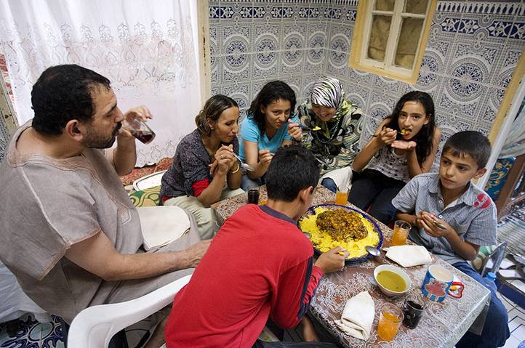
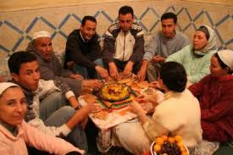
Family structure
Family - one of the most important elements of everyday life - the family unit’s ideals are held to a higher
standard than what the individual desires.
Characteristics:
  Nuclear family plays is the most important function within the transfer of cultural beliefs to children.
  Multiple generations live in the same house, 97% Moroccans believe it is the children’s duty to take
  care of a parent when they grow old (Tbatou)
  Elder respected and seen as wise,
  Extended family almost equally important as nuclear family, to keep the bond, often live in
  communal areas
  Making decisions as family, and really speak in opposition - still male dominated, but changing to equal family rights for female
Basic family division :
  Horizontally - nuclear family, extended family, lineage, district, tribe and confederation
  Vertically - classes, status and prestige
Categorization:
  Rural
  Urban
Notes:
lineage - origin, origins, descent, ancestry, source

Slide 3
Greetings & basic language
Classic/Standard Arabic (all the words in the Koran) is the official language, but distinctive Arabic dialect is the most widely spoken language in Morocco
Many rural Moroccans speak Berber, which has three mutually indistinguishable dialects (and no written form! )
French is unofficial third language. Since the French protectorate (Treaty of Fez in 1912), it has been taught in schools and is the language of business. Widely used in education, government, international business
Many Moroccans in north of country speak Spanish.
Some English spoken (shops, hotels, restaurants) but most meetings conducted in French
English
Hello/Peace upon you
(Reply:) Hello/And peace upon you
Hello/How’s it going?
(Reply:) Fine, thank you
Goodbye
Good morning
Good evening
Good night
Thank you
Yes / No
Arabic
Salaam ou alaikum
Wa alaikum salaam .
La bes?
Alhamdul’Illah
B’slema
Sbah l’kheer
Msa l’kheer
Leila saeeda
Baraka Allahu fik
Namm / La
French
Bonjour
Bonjour .
Ca va?
Ca va bien, merci
Au revior
Bonjour
Bon soir
Bonne nuit
Merci
Oui / Non
Notes:
Bibliography:
http://www.countrynavigator.com/mindsets/tma_country_navigator-moroccan_mindset_map.pdf
http://www.countrynavigator.com/cinfo.cfm?cid=67#rid=4113&cid=67&t=
Fodor’s Morocco
The Rough Guide to Morocco
http://www.linguanaut.com/moroccan.htm

Slide 4

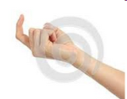
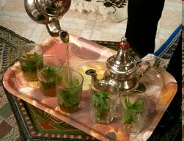



Social customs
Life
Business
-The family is the most significant unit of Moroccan life and plays an important role in all social relations.
When Moroccans greet each other they take their time and converse about their families, friends, and other general topics.
- Handshakes are the customary greeting between individuals of the same sex - The woman must extend her hand first. If she does not, a man should bow his head in greeting.
Say good-bye to each person individually when leaving
eat and drink only with the right hand ( as in any muslim countries)
do not begin to eat until the host blesses the food, begins or invite you to begin to eat.
dress and present yourself well.
Mint tea !
Avoid discussion about the royal family
take off your shoes when entering a house.
Ask permission before taking picture of people
- Appointments are necessary and should be made as far in advance as possible and confirmed a day or two before the meeting.
- Avoid Friday between 11:15 a.m. and 3 p.m. since most companies close for prayers.
- Arrive at meetings on time but be prepared to wait.
Companies are hierarchical. The highest ranking person makes decisions, but only after obtaining a group consensus.
- Decisions are reached after great deliberation.
- Do not criticize anyone publicly. It is important that you do not cause your Moroccan business associates to lose face.
-Moroccans are non-confrontational. They may agree in meetings rather than cause you to lose face.
- Decisions are made slowly. Do not try to rush the process, as it would be interpreted as an insult.
Verify anything that has been agreed to in front of others
- Business attire is formal and conservative.
Moroccans prefer to do business with those they know and respect, therefore expect to spend time cultivating a personal relationship before business is conducted.
Do not criticize anyone publicly. It is important that you do not cause your Moroccan business associates to lose face
But in Africa
Miscellaneous
May 1st

Slide 5
Useful links:
http://yfuusa.org/media/yes_lounge/Morocco.pdf
http://www.ehow.com/how_7461362_speak-conversational-french.html
http://french.about.com/library/travel/bl-ma-language.htm
http://wikitravel.org/en/Moroccan_Arabic_phrasebook

