Slide 1
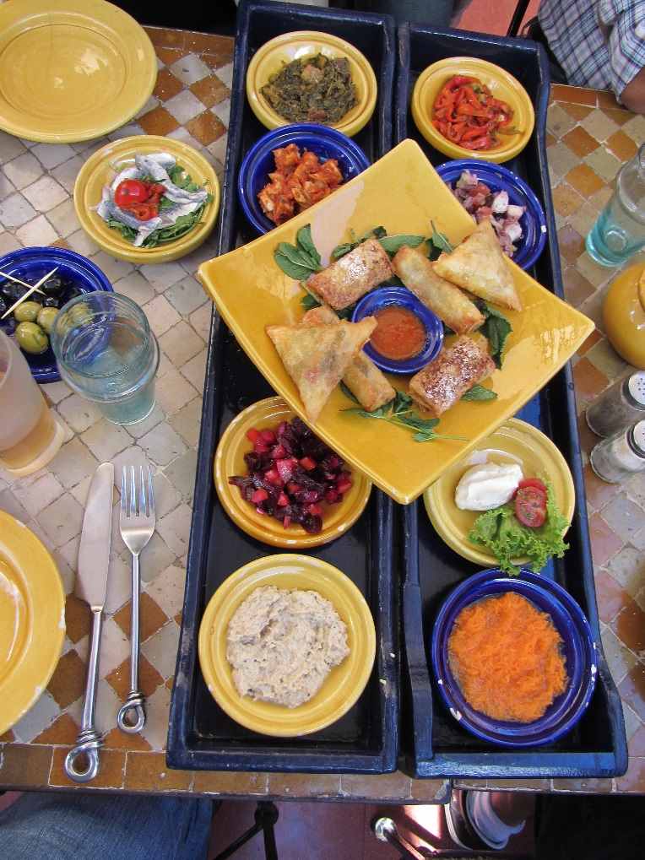
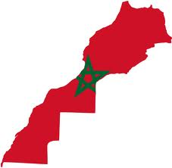
Corporate Service Corps
Team Morocco 5
April 25 – May 24, 2014
This report contains information that is confidential and proprietary to IBM and is solely for the use of IBM personnel. No part of it may be used, circulated, quoted, or reproduced for distribution outside IBM. If you are not the intended recipient of this report, you are hereby notified that the use, circulation, quoting, or reproducing of this report is strictly prohibited and may be unlawful.

Slide 2
About the CSC Program
The Corporate Service Corps was launched in 2008 to help provide IBMers with high quality leadership development while delivering high quality problem solving for communities and organizations in emerging markets.
The program empowers IBM employees as global citizens by sending groups of 10 - 15 individuals from different countries with a range of skills to an emerging market for 4 week community-based assignments.
During the assignment, participants perform community-driven economic development projects working at the intersection of business, technology, and society.

Slide 3
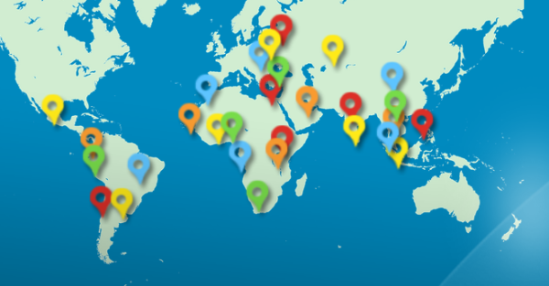
About the CSC Program
The Corporate Service Corps offers a triple benefit: leadership development for the IBMers, leadership training and development for the communities, and greater knowledge and enhanced reputation in the growth markets for IBM.
The Corporate Service Corps program has sent over 2400 participants on over 200 teams to more than 30 countries around the world.
https://cscserv2.chicago.ibm.com/CorporateServiceCorpsRegistration/
Argentina, Brazil, Cambodia, Chile, China, Colombia, Egypt, Ethiopia, Ghana, India, Indonesia, Kazakhstan, Kenya, Malaysia, Mexico, Morocco, Nigeria, Peru, The Philippines, Poland, Romania, Russia, Senegal, South Africa, Sri Lanka, Taiwan, Tanzania, Thailand, Tunisia, Turkey, Vietnam, UAE and Ukraine

Slide 4
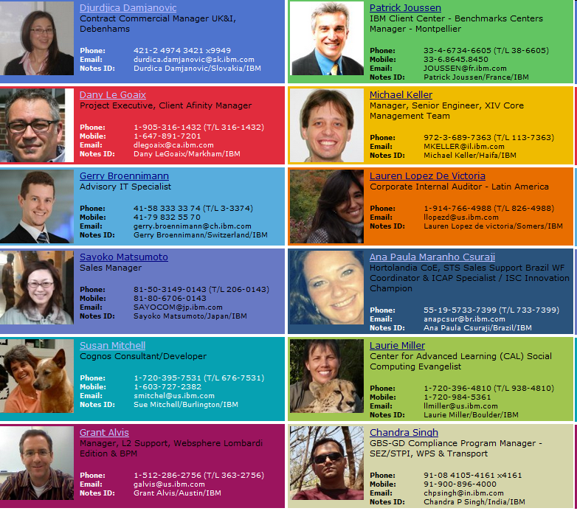










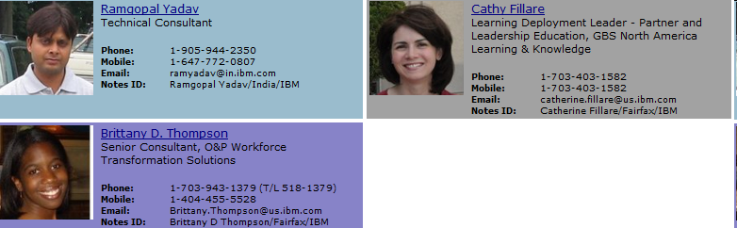


Slide 5
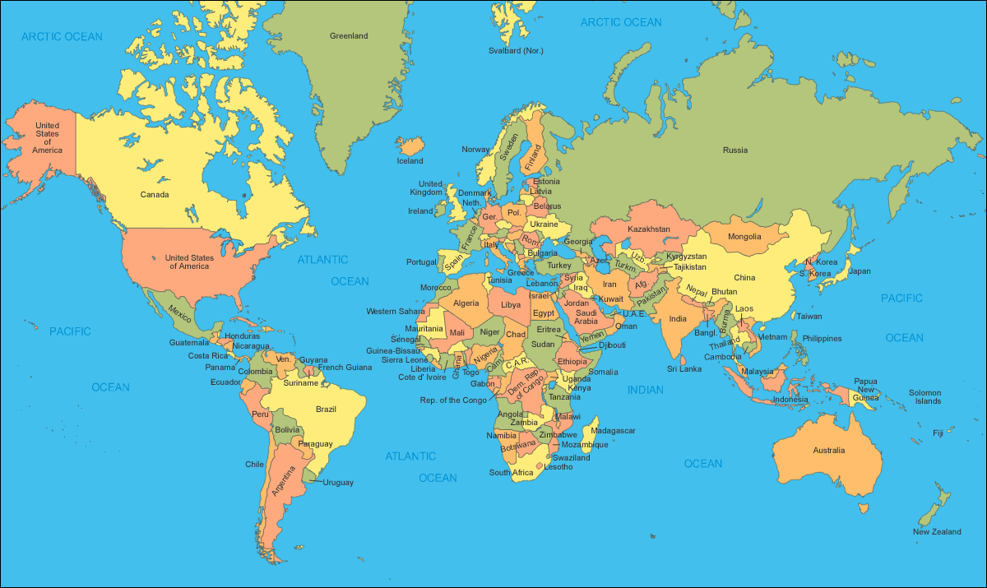






















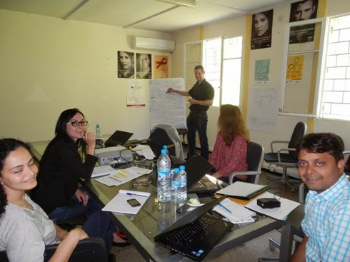
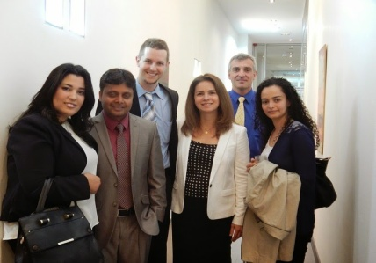
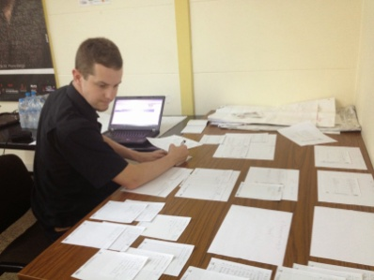
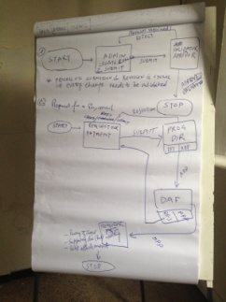
IBM Corporate Service Corps Team
Team Composition
  15 global representatives
  10 nationalities
  5+ unique professional profiles
Client Partners
    ALCS
    CHU Ibn Rochd
    OFPPT
    Ministry of Tourism
Gerry Broennimann, IT Specialist
Catherine Fillare, Education & Knowledge Leader
Patrick Joussen, Project Manager, Manager
Ramgopal Yadav, SAP Technical Consultant

Slide 6

Association for AIDS prevention

Slide 7

About ALCS
First and largest association against AIDS in the Maghreb and the Middle East.
Founded in 1988 when only 30 AIDS cases were reported.
Active throughout Morocco, works locally with key populations, youth and the general public, and provides psycho-social care for people living with HIV.
National office with 19 sections and manages 28 anonymous and free HIV screening centers
83 employees, 150 field workers and 300 volunteers
The ALCS is growing day by day…
… but its work tools have proven to be limited and not adapted to the size of the organization and workload.

Slide 8
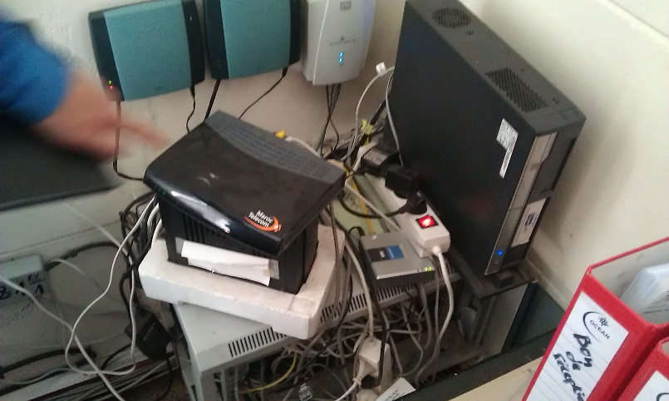
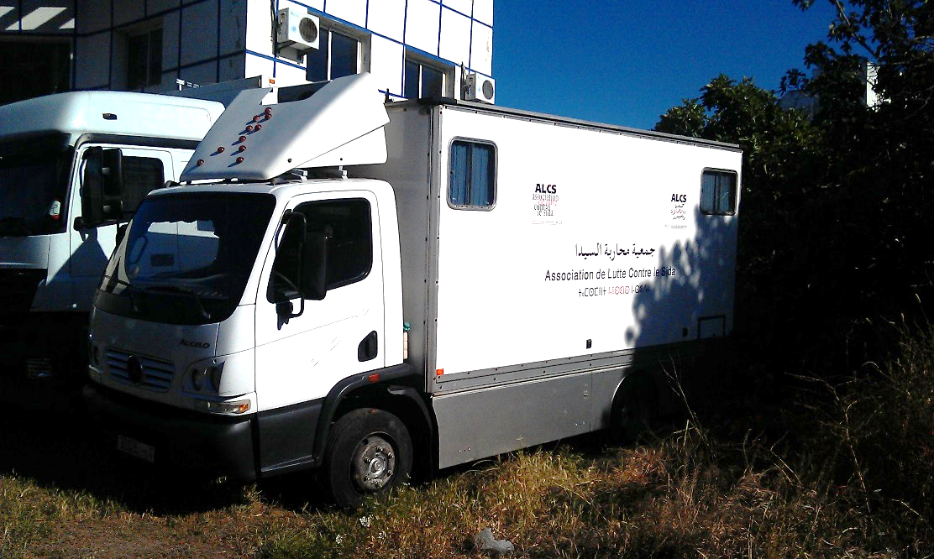
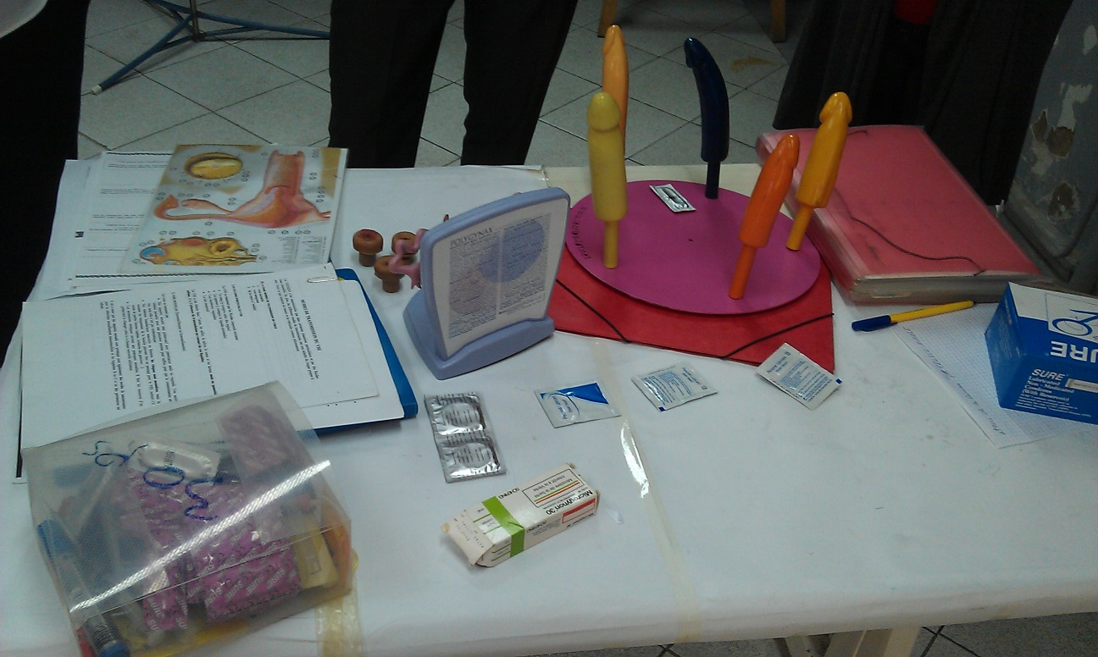
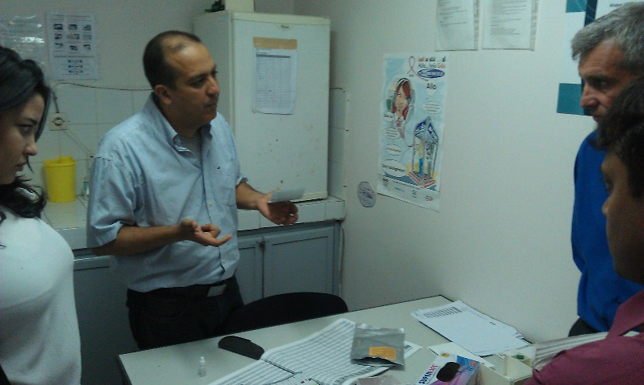
About ALCS

Slide 9
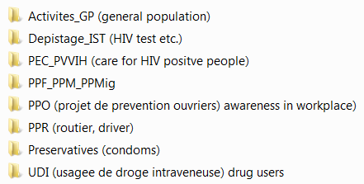
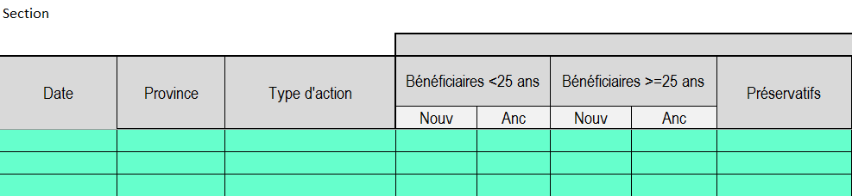
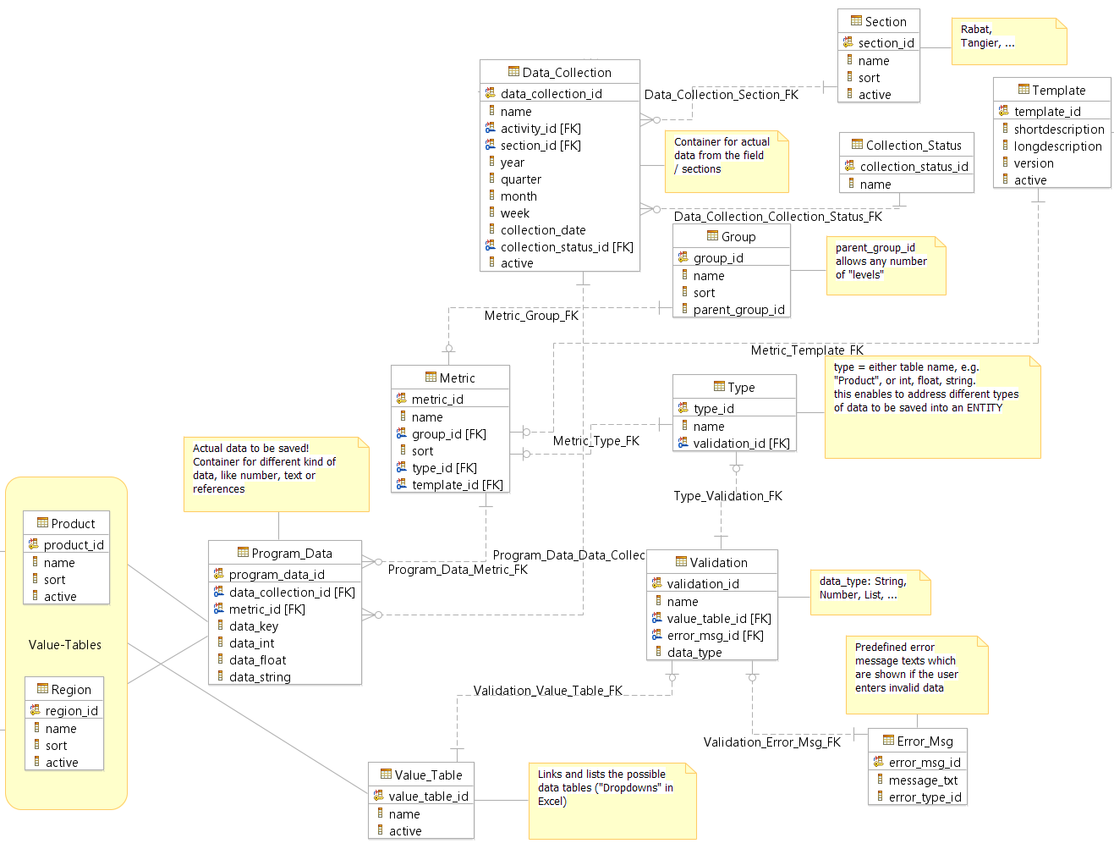
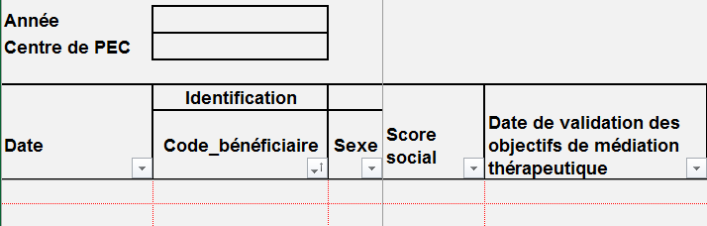
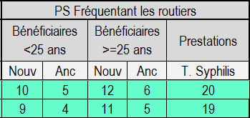
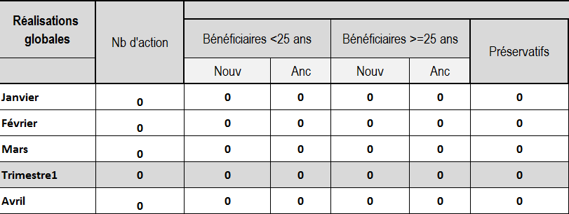
Today - Future
Delays
Source of errors
Current state
  Manual reconciliation of Excel sheets
  Decentralized data storage
  No real-time project status information
Future state
  Automated reconciliation and reports
  Centralized data storage in relational DB
  Real-time project status information
9

Slide 10
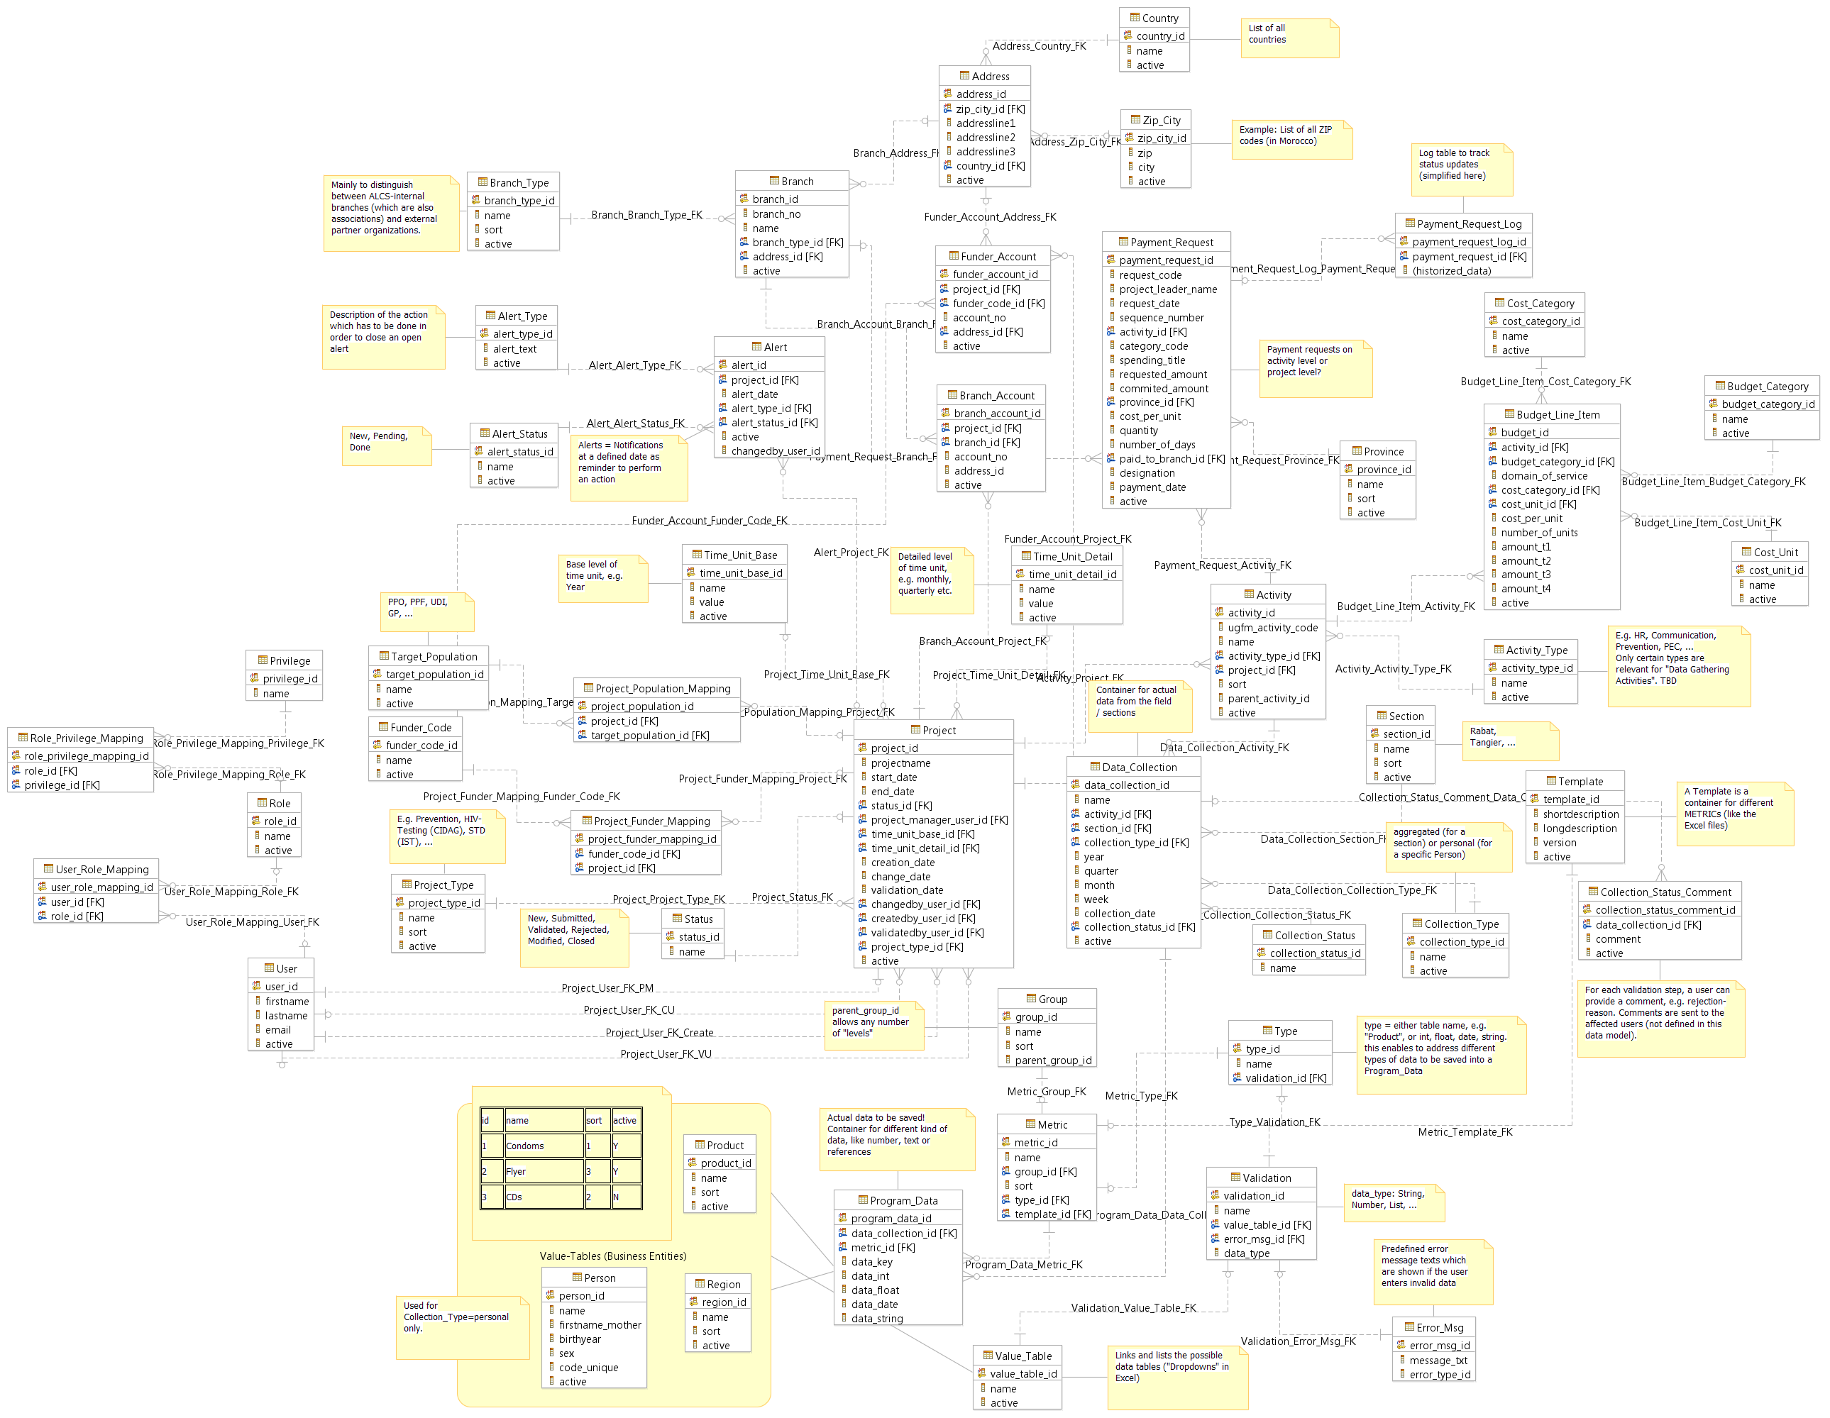
Data Model
Finance
User Admin
Project Admin
Data Collection

Slide 11

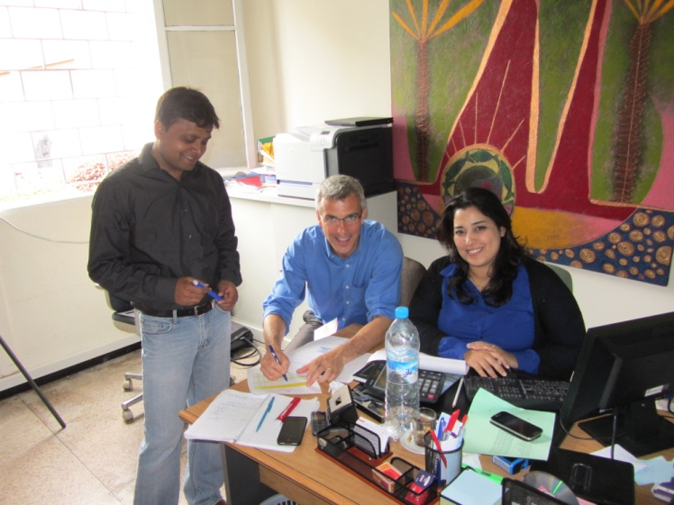
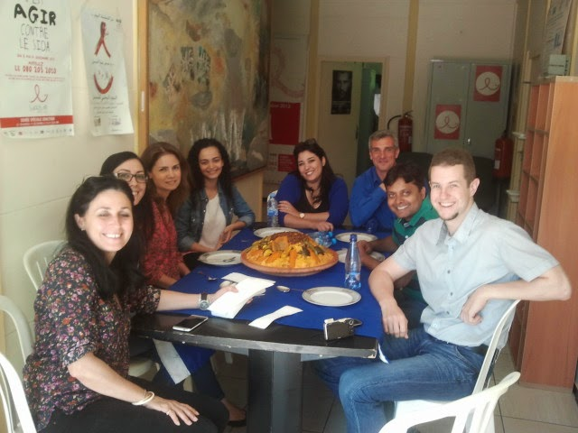
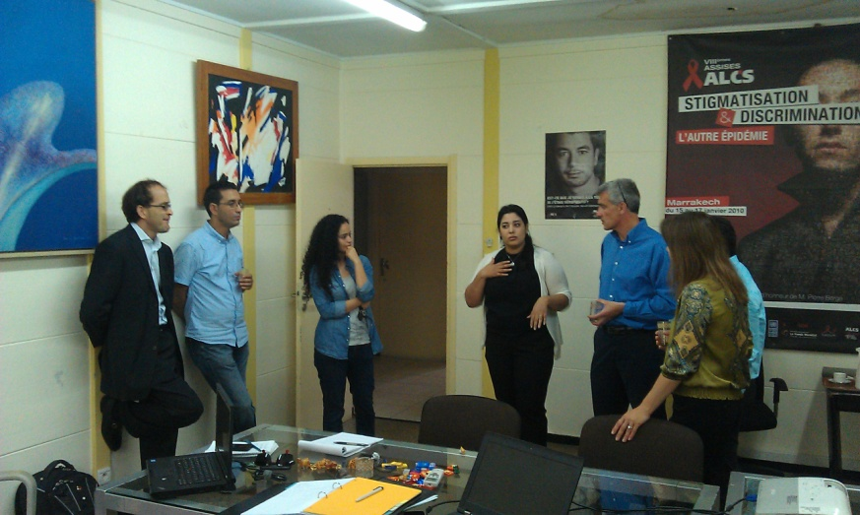
ALCS members contributed to the project with their passion, expertise and tremendous Moroccan hospitality
11
Notes:
11

Slide 12
ALCS has a strong base of capabilities – and a series of challenges
Strengths
Allegiance to founding principles and core values
Strong organizational identity and ALCS brand
Expansive national reach to target audiences
Strong political support, including partnership with the Ministry of Health
Experienced, engaged and motivated personnel and volunteers
Well defined operational business processes and performance metrics
Global partnerships with like minded organizations
Innovative approaches to fundraising and marketing, including SIDACTION
Open to change and continuous process improvements
Weaknesses
Lack of secure global funding sources in the future
Strong dependency on individual funding resource commitments and their compliance requirements
Lack of automated methods to assess program effectiveness; return on investments
Manual business operations and limited use of standardized IT infrastructure
Limited physical and cyber security in place; lack of back up/disaster recovery plan
Minimum use of social media to tap funding sources/ potential donors
Strong dependency on individual personnel performance, limited succession planning
Limited personnel resources for IT infrastructure support; limited IT capacity for field and mobile units
Source: Discussions with FTAM
12
Notes:
12

Slide 13
Strengths and weaknesses may be turned into opportunities – keeping in mind the potential threats
Opportunities
Become a ‘Center of Excellence’ in the Maghreb region for HIV/AIDS prevention
Serve as a role model, sharing best practice methods with other NGOs and health care providers
Extend prevention support for other contagious diseases
Adopt a centralized information repository to improve operational efficiency, increase performance and information sharing
Use collaboration tools to improve communications and performance metrics reporting
Outsource IT infrastructure support, ensuring use of latest technology and security methods
Optimize donor database information to support fundraising strategy for sustainability
Leverage social media, including mobile applications:
  Provide care and support for target audiences
  Share real time data between doctors and clients on testing results, appointments and treatments
  Support public awareness campaign activities
  Increase promotion of success stories/income generating activities
Threats
Future pipeline of international and government funding may be limited
Lack of robust IT infrastructure to support growth
Lack of qualified personnel resources, including doctors and trained volunteers
Ongoing discrimination and human rights violations against target audiences
Limited ability to track trending data following participation with ALCS
Potential for IT security incidents and data breaches
13
Notes:
13

Slide 14

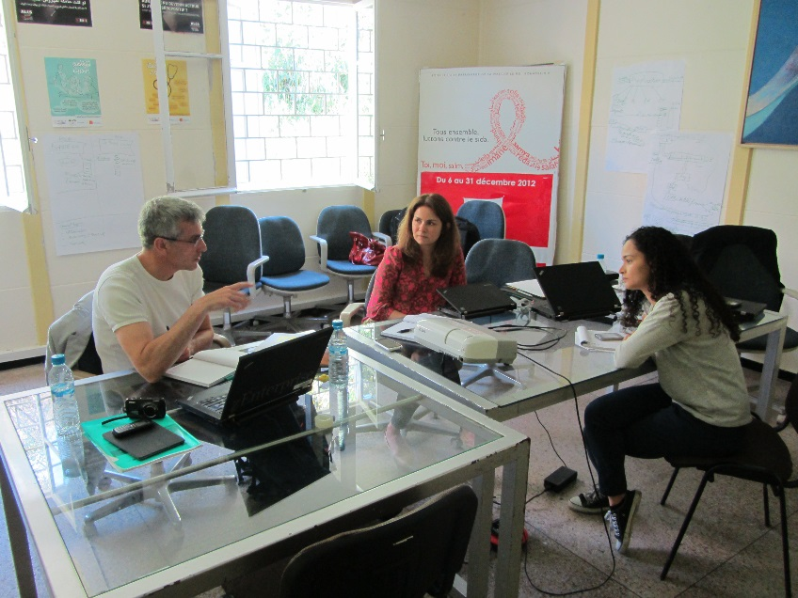
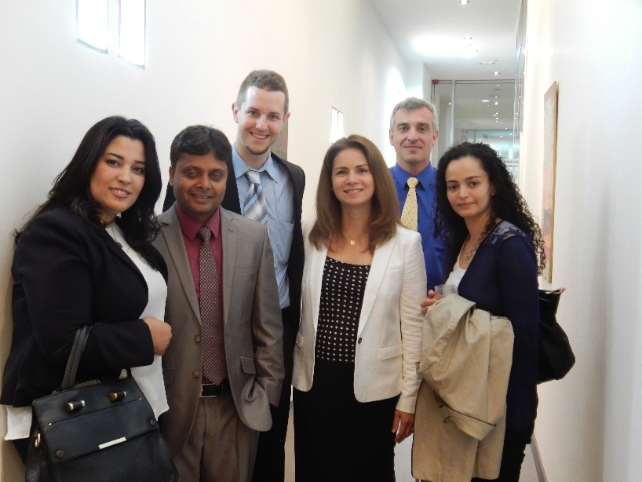
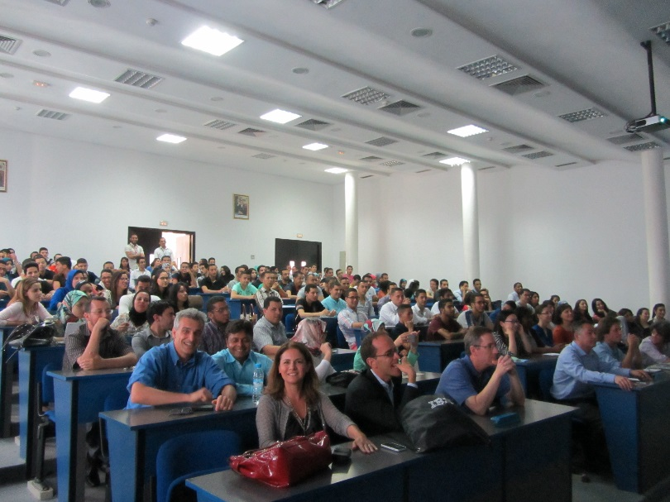
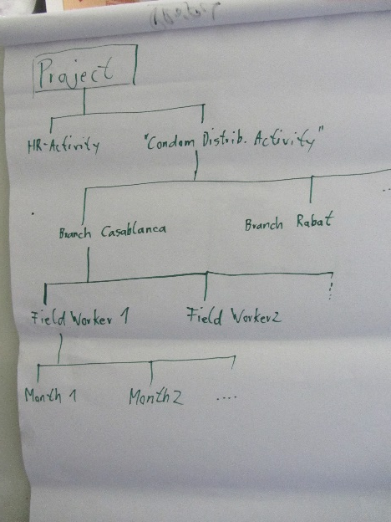
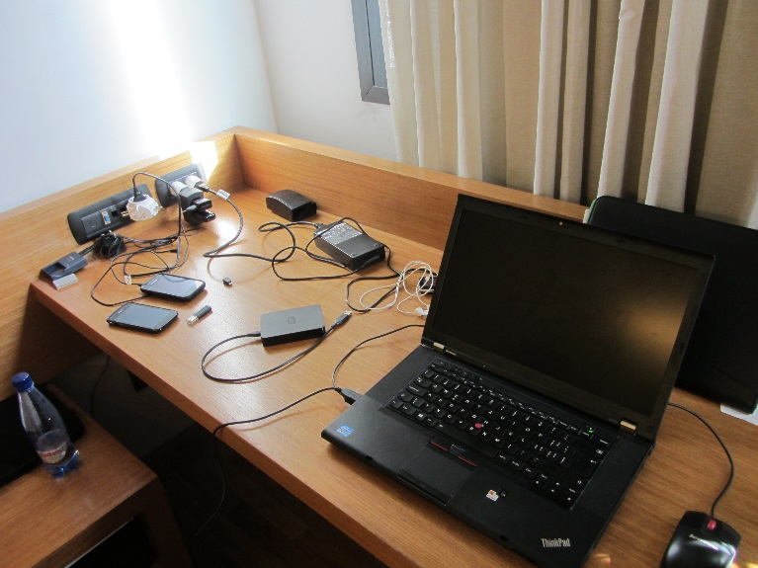
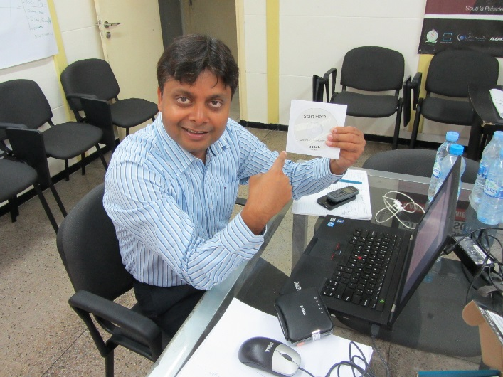
Work…

Slide 15
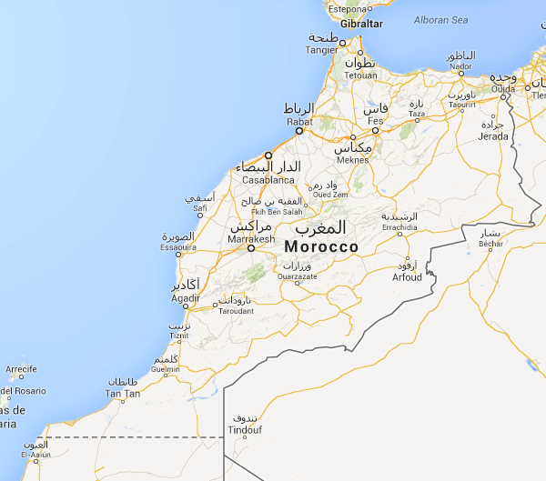
Morocco

Slide 16
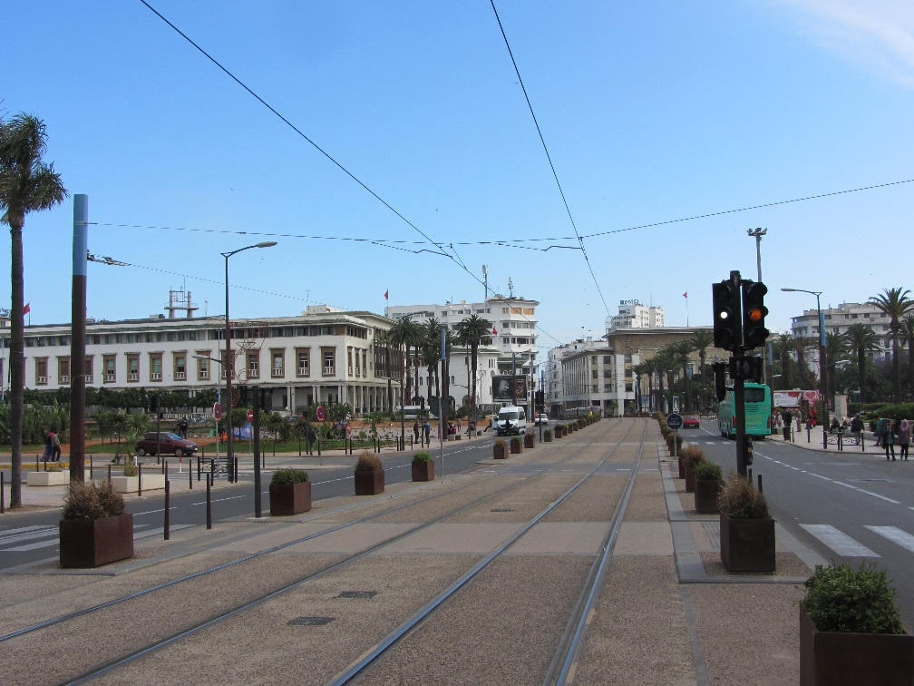
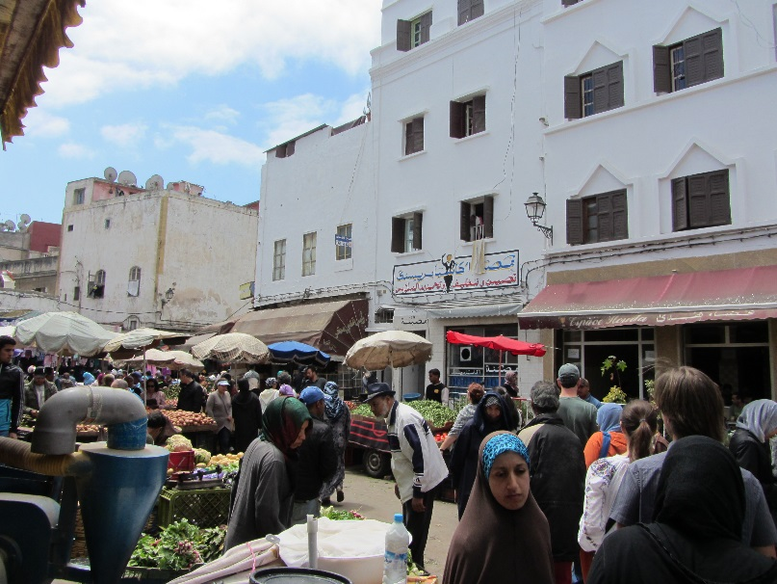

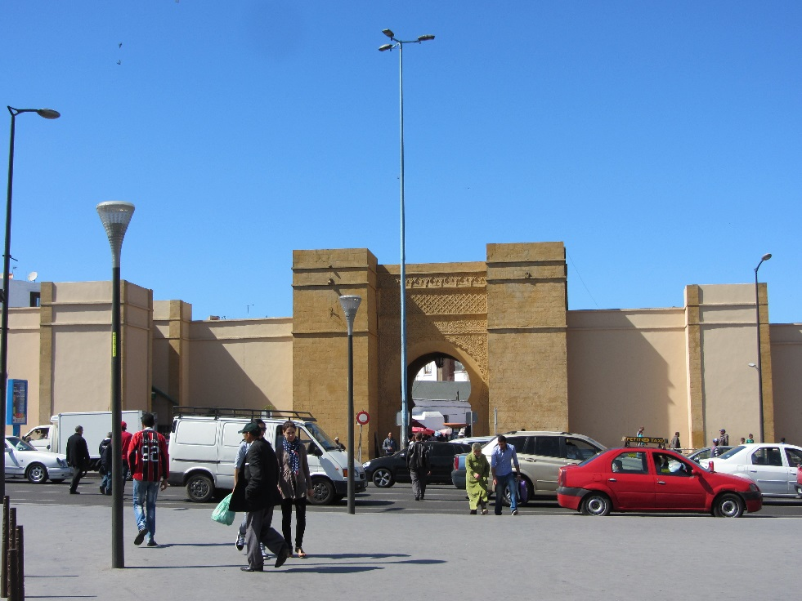
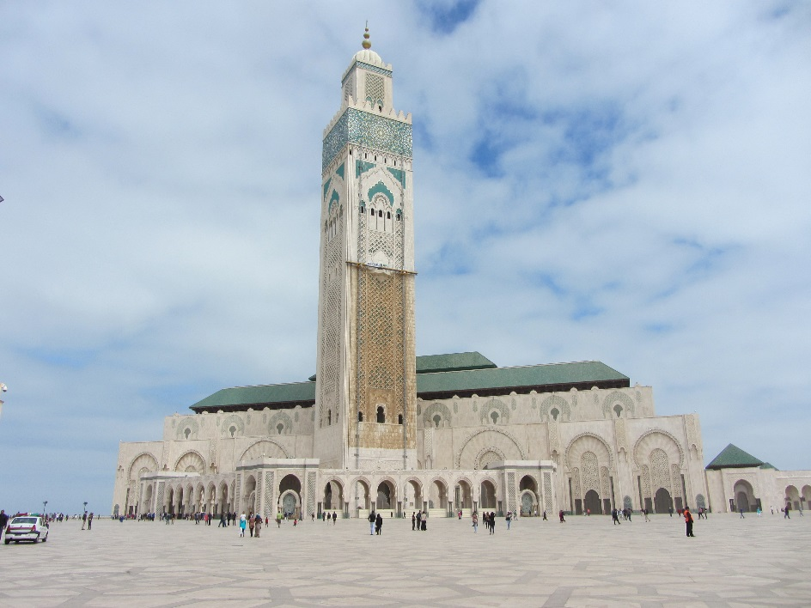
Casablanca

Slide 17
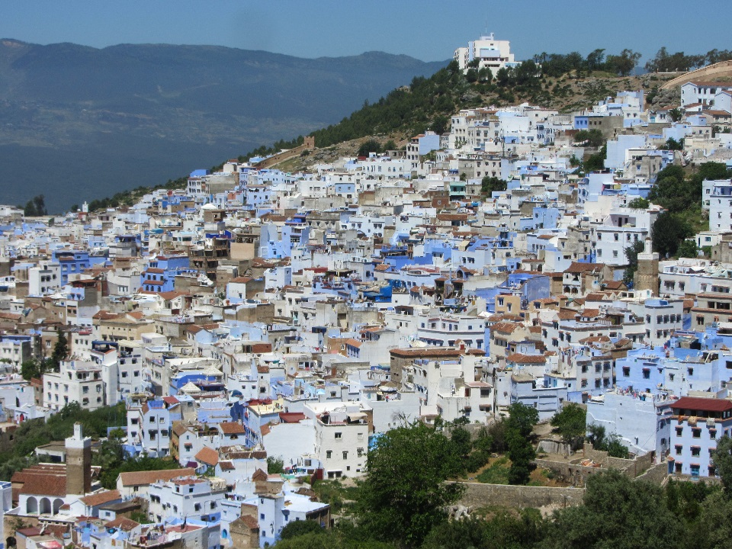
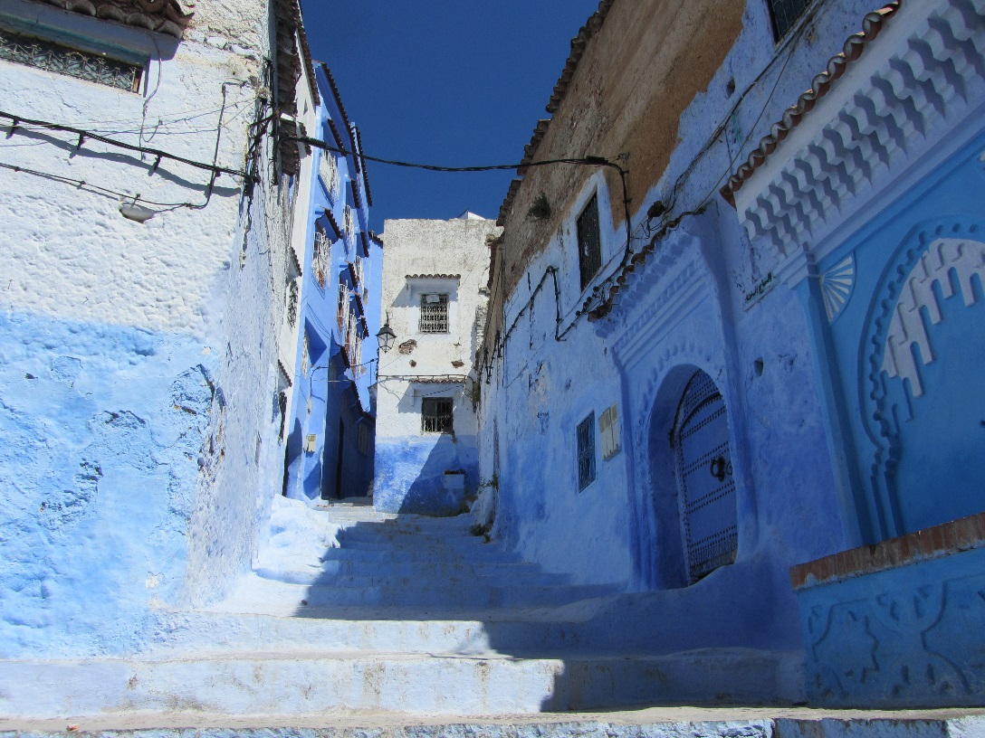
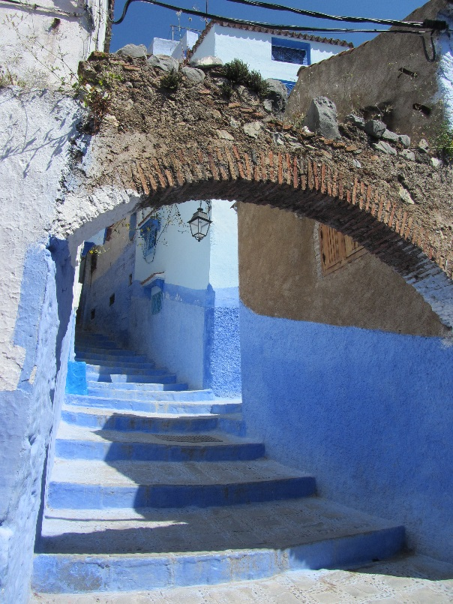
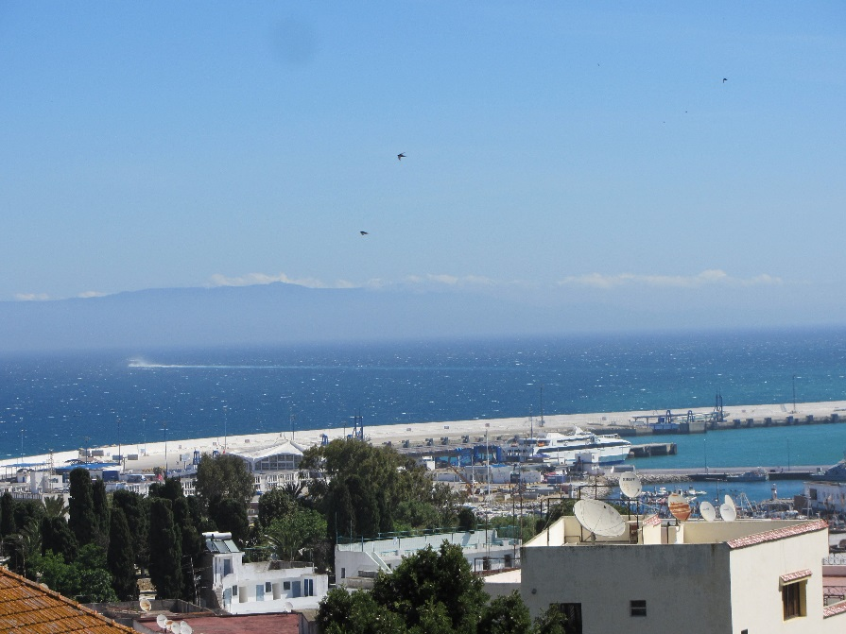
Chefchaouen / Tangier

Slide 18
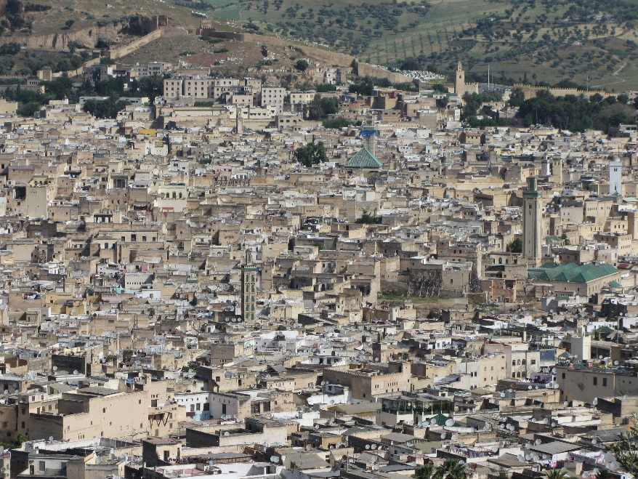
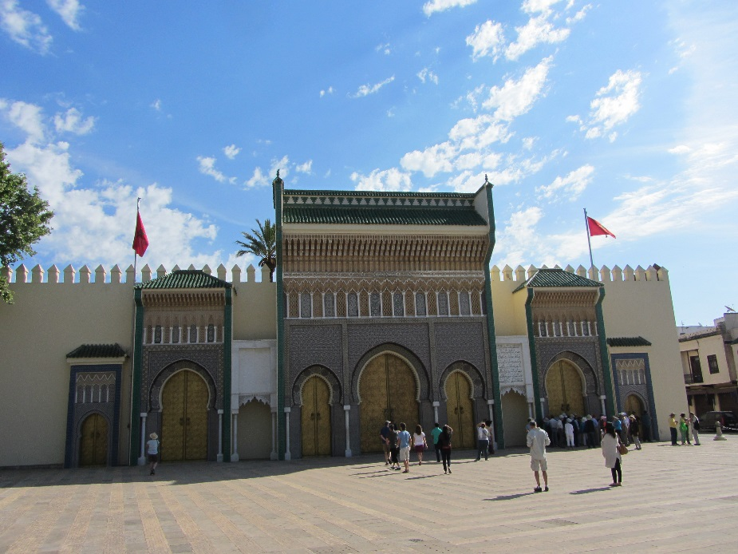
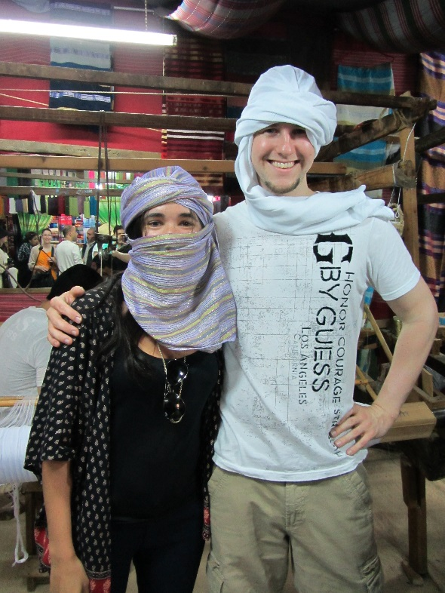
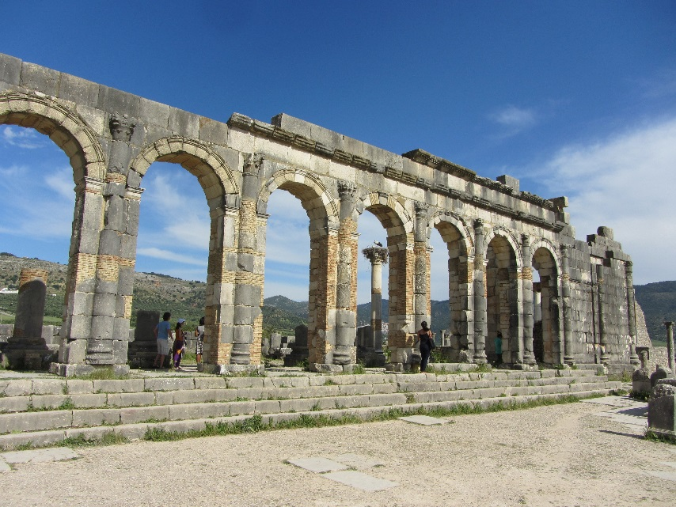
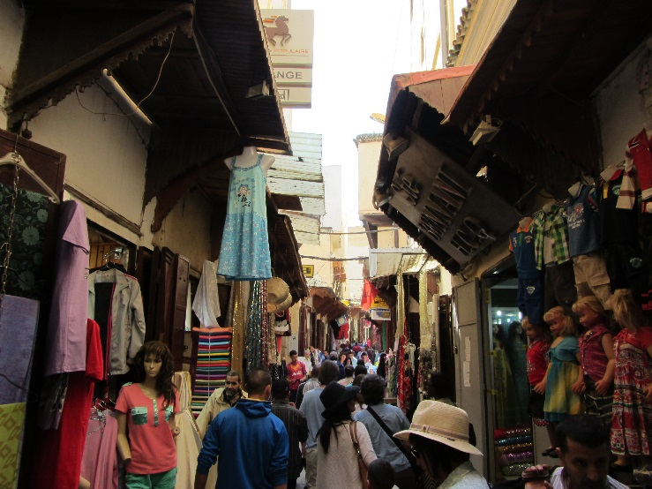
Fès / Volubilis

Slide 19
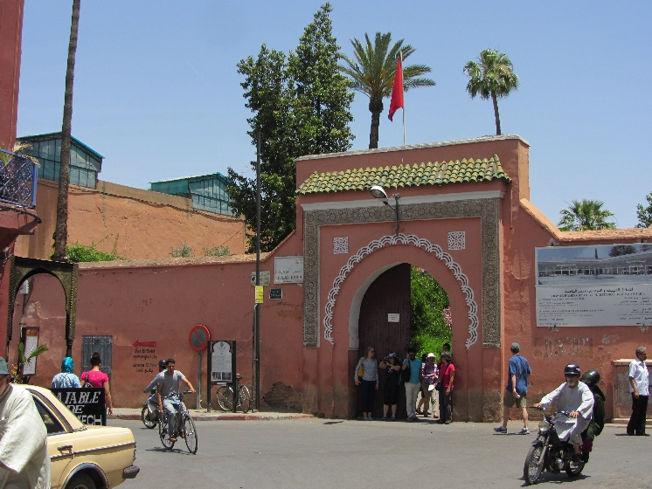
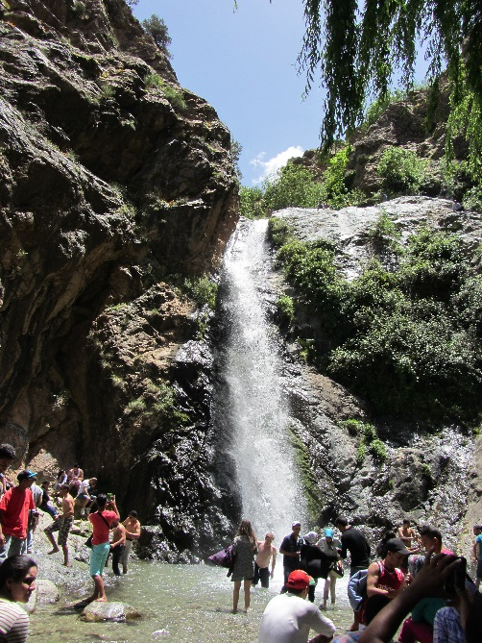
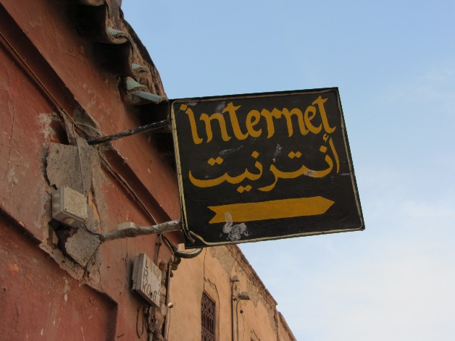
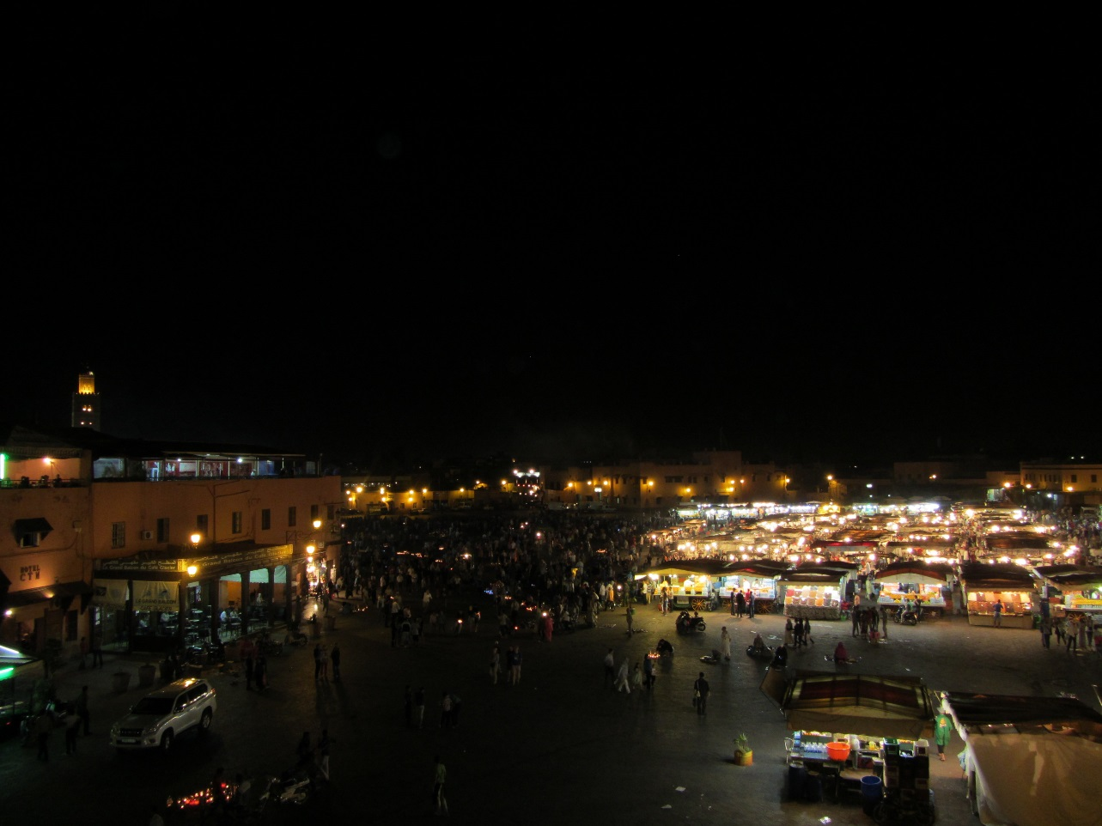
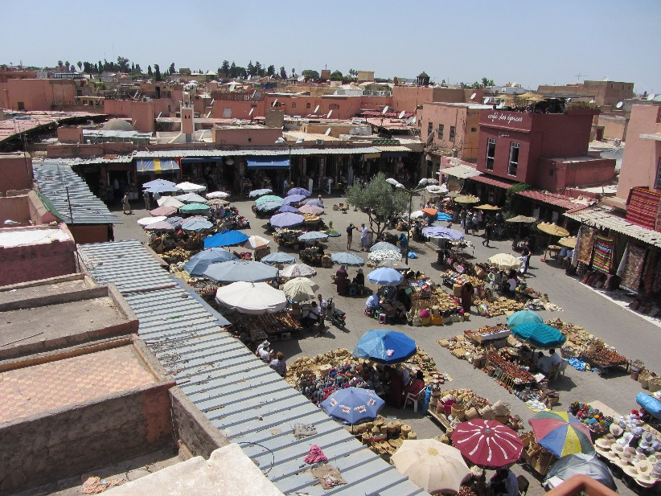
Marrakesh

Slide 20
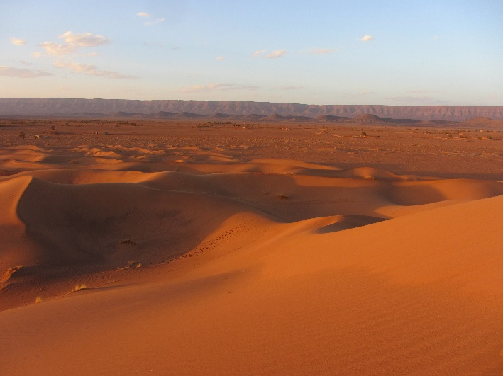



Ouarzazate – Tinfou – Aït Benhaddou

Slide 21

http://morocco.chickenfactory.ch

