Slide 1
System Integration
What is integration?
Need for system Integration
Business benefits for System Integration
System Integration Life Cycle phases and activities
What is interface?
Data Mapping
SAGE Interfaces & Data elements
Risk and challenges with SAGE interfaces
Data Mapping Document

Slide 2
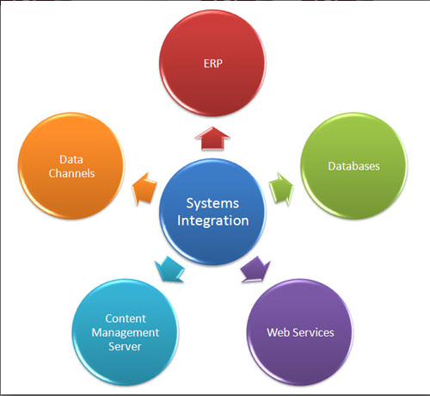
System Integration
is the process of linking together different computing systems and software applications physically or functionally, to act as a coordinated whole.

Slide 3
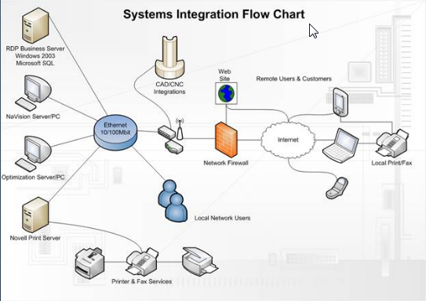
System Integration

Slide 4
Need for System Integration
Extraneous systems and applications
Cumbersome manual tasks
Hindered Scalability
Multiple disparate systems with poor compatibility
Slow processing time

Slide 5
Business Benefits of System Integration
Lower ongoing system administration expenses
Accelerate application development using modern RAD platforms
Control and simplify business processes via workflow
Efficiently incorporate modern security programs
Lay an architectural framework that will provide the enterprise with greater agility

Slide 6
System Integration Life Cycle phases and activities
Requirement definition and specification
  Definition of requirement by use
  Review of requirement for ambiguity, conflict etc.
  Development of system specifications
Feasibility Analysis
  Determine likelihood of successful development and deployment
  Examine new technologies; assess risk and develop risk strategies
System Architecture Development
  Describe functional system architecture
  Specify required technical capabilities
Management Plan
  Identify technical architecture alternatives
  Specify required configuration categories
  Prepare program and project plans
  prepare sub-contractor management plan
  Prepare risk management plan

Slide 7
System Design
  Logical and physical design
  Design approaches
  Use of automated aids
Implementation
  Identify technical configuration
  Specify required configuration component items
  Procurement from subcontractors
  Perform system tests
  System development
Evaluation
  Review and evaluate system functioning
  Obtain, install, test and accept modified components
  Maintain, modify, augment and enhance systems
  Plan for system retirement/replacement

Slide 8
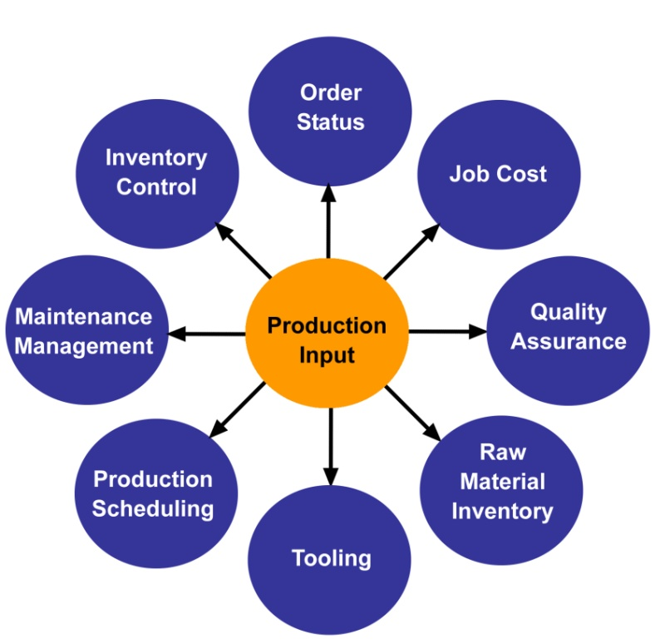
Interface
is a shared boundary across which two separate components of a computer system exchange information. The exchange can be between software, computer hardware, peripheral devices, humans and combinations of these.

Slide 9
Data Mapping
Data mapping is a very important aspect in data integration, in fact this is the first and most crucial step.
Data mapping includes:
  data transformation or data mediation between a data source and its destination
  identification of relationships in data which is vital in analysis of data lineage
  discovery of sensitive data like some last digits in a social security number
  consolidation of many databases or database fields into one while identifying redundancy

Slide 10
SAGE Interface
SAGE1000
DATA ELEMENTS
SAGE100
Interface – for example file based interface
As Is Process
To Be process
SAGE 1000 and SAGE 100 runs on 2 disconnected computers
Accounting report is generated in PDF format in SAGE1000, printed and handed over to SAGE 100 for manual data entry
Manual data transfer happens every quarter
Inconsistency of data between 2 systems
SAGE systems will be connected through shared drive in ALCS network
Data Transfer and processing will be automated through interface
Data transfer will happen with higher frequency e.g. daily, weekly or monthly
Consistent data between 2 systems due to interface

Slide 11
System Landscape
SAGE 1000
Current Landscape
SAGE 100
SAGE 1000
Future Landscape
SAGE 100
Shared Network Drive –Delimited text file

Slide 12
Interface Design
Data will be extracted from SAGE 1000 in a fixed template at scheduled time interval and will be stored in a shared folder
Data cleansing activity(manual or script) will be performed to cleanse data into desired format
SAGE 100 will pick the file at scheduled intervals and process the file through a batch job, creating data into system without any manual intervention
Data extraction in SAGE 100 at certain intervals
Cleanse data as per the desired format and put it into a delimited text file
Read data files from shared drive and process it in background to enter all data without any manual activity
Place data file into shared directory so that target system can read and process it

Slide 13
SAGE Interface – Data elements
SAGE1000 Data Elements
    DATE (Date)
    N° PIECE (Bank Number)
    BENEFICIAIRE (Beneficiary)
    INTITULE DEPENSES / REVENUS (Title Expenditure / Revenue)
    CAT. DE COUT (Cost Category)
    MACRO CATEGORIE (Macro Category)
    BUT (Purpose)
    OBJECTIF (Objective)
    DPS ()
    ACTIVITE (Activity)
    DEBIT MAD (Debit MAD)
    DEBIT USD (Debit USD)
    CREDIT MAD (Credit MAD)
    CREDIT USD (Credit USD)
    SOLDE MAD (Balance MAD)
    SOLDE MAD (Balance USD)

Slide 14
Risk and Challenges with SAGE Interface
SAGE1000 runs on web where as SAGE100 runs on a local PC based server
No documentation of current functionality or implementation guide to understand existing functionality
No development framework/infrastructure available; not sure if this part of existing contract
Lack of information about product and its capability
Lack of effective training on SAGE to current users
SAGE1000 is not currently working due to bug with WW Analytics Code
There are only 2-3 common data elements between both the systems
Lot of manual data is entered in SAGE100 based on scan files and report from SAGE1000 which can be derived with any formula and hence we can’t have automated interface
User’s are not trained enough to understand basic concepts of commonality who can customize system and start working in single system of SAGE100

Slide 15
Data Mapping
Data mapping for sage interface is simple, it is one to one field mapping from SAGE 1000 to SAGE 100 without need of any transformation
File extracted from SAGE 1000 needs to be cleansed as per the agreed format before being moved to shared folder
SAGE 100 will read the file from shared folder and process it. File processing in SAGE 100 should be automated

Slide 16
Future Considerations/Recommendations for Implementations
Redefine processes to include common elements from both the systems and remove manual steps to automate interface
Other alternative could be to customize and use single system instead of using 2 SAGE systems
File format should be standardized and agreed with both the SAGE teams
Cleansing rules should be clearly defined and agreed
Target system should be customized to reduce maintenance of cost of 2 different systems
Automated batch job should be developed to read file from shared folder and process it without any manual intervention
Shared folder path and access should be clearly defined
Test plan should be defined with specific test cases for testing of interface
SAGE implementation vendor should be reached out to determine implementation cost, resources and timelines needed for this interface development
A test environment should be created for interface implementation and testing before applying this interface in live production system
A back up process (manual steps) should be defined in case this interface fails during execution for any reason
Clear rules should be defined for commit and rollback processes

Slide 17
Thank You

