Slide 1
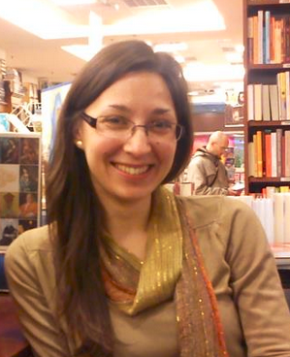
Insert Pictures
IBM FACTS
Years at IBM | 4 years
What does a Day In the Life look like for you in your job at IBM? | Day starts around 8.30 am with checking Calendar and e-mails, setting up priorities for the day/week, catch-up with colleagues over a coffee, and than work on daily priorities. Usually it involves a few calls with team in UK. I often work from different locations in Bratislava, to interact with all of my peers.
PERSONAL FACTS
Personal Hobbies | Yoga, running, reading
Favorite Musician | Paul van Dyk, Emeli Sande, Miles Davis, Gibonni, many others
If you could do anything for a day, what would it be? | I would be in the nature, away from mobile phone signal, reading a book
What are you passionate about? | Helping people who need help, supporting handball – Croatia
Family or friends you would like to mention? | My closest family are my parents, brother and a cat, but also under “family” I conceder a group of friends in home country (Croatia) and a group of international friends in my current country (Slovakia)
Durdica Damjanovic
(Duki)
Contract Commercial Manager
GTS
GPS-D
durdica.damjanovic@sk.ibm.com
Bratislava, Slovakia
+421 2 4974 3421 9949

Slide 2
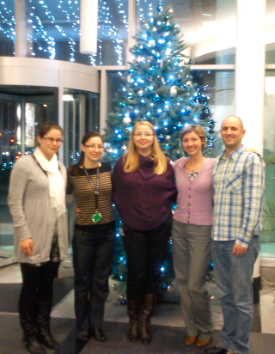
More Pictures
CSC-RELATED FACTS
Why did you apply for the CSC? | As member of student organization I was working on international student exchange, but didn’t use my chance to experience one, than I noticed in newsletter CSC, and I know I want to experience it. I choose Africa since my best working experience was in MEA STG pre-sales team where I really enjoyed the culture and wanted to experience it.
What are your goals for our CSC experience? | Get to know the culture, business environment and daily life Deliver relevant and sustainable solution to client Extend my comfort zone in terms of leadership
What are your professional strengths & weaknesses? | Strengths: analytical and objective approach to problem, but individual approach to people; strong team player Weakness: lack of assertiveness, “quiet” leader
Anything else we should know about you? Fun fact? | I amSucrologist - collecting sugars sachet from all around the world. My name means Lily of the Valley
Durdica Damjanovic
(Duki)
Contract Commercial Manager
GTS
GPS-D
durdica.damjanovic@sk.ibm.com
Bratislava, Slovakia
+421 2 4974 3421 9949

