Slide 1
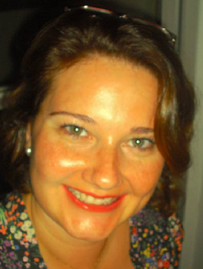
Insert Pictures
IBM FACTS
Years at IBM | 3 years and 9 months
What does a Day In the Life look like for you in your job at IBM? | As a Workflow coordinator for sales transactions support, it’s quite dynamic, unique and busy by interacting with sellers from all kinds of business as STG, HW, SW, Services…as well as challenging when allocating the best skilled bid managers to the right deals. As an ICAP Specialist, research is my daily activity, as well as being responsible for keeping the Intellectual Capital Property of IBM well written and up to date, for Latin America.
PERSONAL FACTS
Personal Hobbies | Gardening, Cooking, Teaching, Painting, Art
Favorite Musician | I’m very eclectic and seasonal regarding music, and at this moment I’ve being listening to Oliver Mtukudzi and Djavan.
If you could do anything for a day, what would it be? | Have a meeting with all Countries representatives, and make them listen to what is my concept of an ideal smart world and make them understand the real meaning of PEACE.
What are you passionate about? | People, languages, culture and Innovation.
Family or friends you would like to mention? | My beloved Mother Sonia (in memoriam) who has taught me to reach out eagerly and without fear for newer and richer experiences on helping people.
Ana Paula Csuraji
ICAP Specialist & Workflow Coordinator
Sales Support Org
ISC
anapcsur@br.ibm.com
Hortolandia, Brazil
+55 19 5733 7399

Slide 2
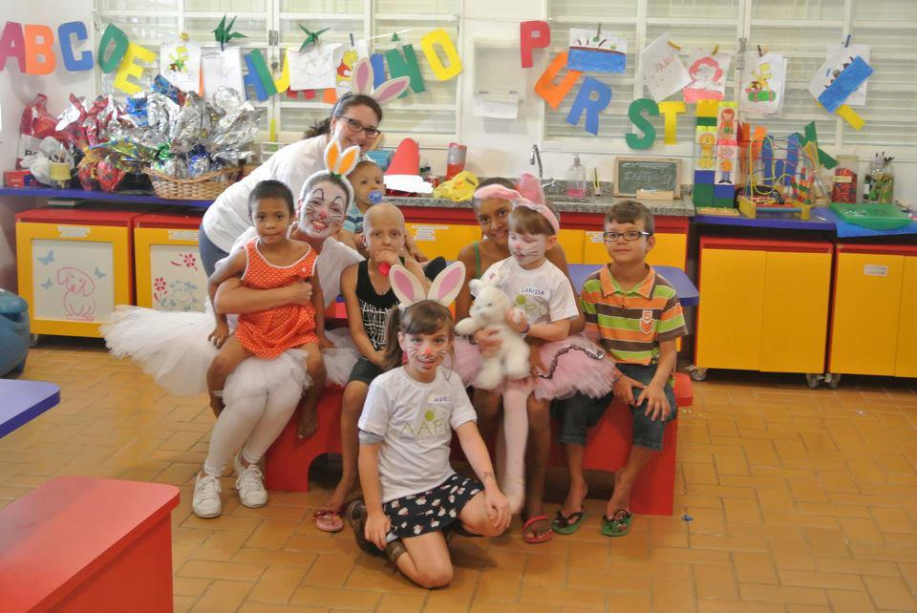
More Pictures
CSC-RELATED FACTS
Why did you apply for the CSC? | I’m willing to learn new cultures, people, as well as about my own self, while sharing all my skills, knowledge and experiences with all parties at this journey.
What are your goals for our CSC experience? | Be 100% engaged to all that is to come, and make a difference on people lives.
What are your professional strengths & weaknesses? | Strengths: Analytic, adaptability and innovation driven. Weaknesses: Hard time dealing with not motivated people, and don’t close business while it isn’t done.
Anything else we should know about you? Fun fact? | I’m an Innovation Champion for the CoE in Brazil with IBM. I run a NGO that supports people undergoing cancer treatment. I’m a teacher at a local language school, to children with autism.
Ana Paula Csuraji
ICAP Specialist & Workflow Coordinator
Sales Support Org
ISC
anapcsur@br.ibm.com
Hortolandia, Brazil
+55 19 5733 7399

Slide 3
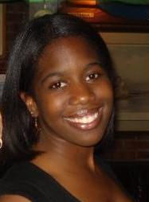
IBM FACTS
Years at IBM | 4.5 Years
What does a Day In the Life look like for you in your job at IBM? | My project work takes up the majority of my day. Usually, I am asked to create strategies (marketing, business process, communications, etc.) or other work products for my clients. I participate in a lot of meetings and conference calls, both internally and with the client. Other than project work, I also work on business development (e.g., proposals) and mentor other IBMers.
PERSONAL FACTS
Personal Hobbies | Singing with the Congressional Chorus Traveling Reading Catching up on TV (House of Cards, Scandal)
Favorite Musician | I have several! I like Jill Scott, Ella Fitzgerald, The Beatles, and Michael Jackson, to name a few.
If you could do anything for a day, what would it be? | I would travel somewhere I’d never been, immerse myself in the culture, and learn a few words from their language.
What are you passionate about? | I am passionate about my family.
Family or friends you would like to mention? | I’m an only child, but I have a very large extended family. Lots of aunts, uncles, and cousins! My parents also live nearby.
Brittany Thompson
Senior Consultant
Workforce Transformation Solutions
Global Business Services
Brittany.Thompson@us.ibm.com
Washington, D.C.
404-455-5528

Slide 4
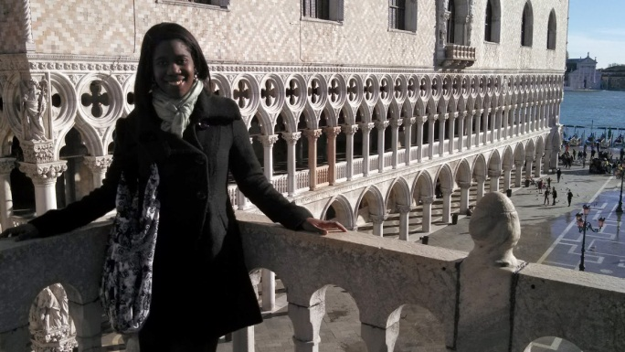
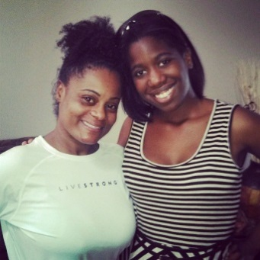
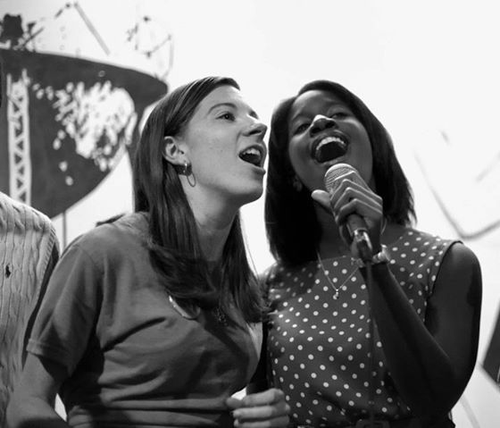
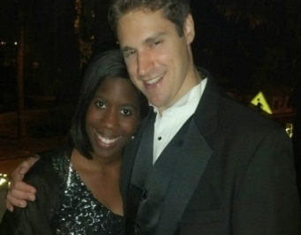
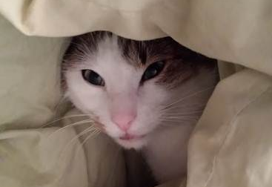
CSC-RELATED FACTS
Why did you apply for the CSC? | I have always been passionate about foreign service, and I admire that IBM has a program to support business and development in emerging markets. I believed I could contribute to the program, while also benefitting from the experience, professionally and personally.
What are your goals for our CSC experience? | Work closely with NGO and locals to learn their business challenges and goals Develop meaningful relationships with our team Develop my personal skills (particularly leadership) Immerse myself in Moroccan culture Practice my professional French
What are your professional strengths & weaknesses? | Strengths: I have strong communications skills, and I am good at creating and maintaining relationships with my teammates and the client. I tend to see both sides of an argument or idea, and I can rationalize the best solution for a situation. Weaknesses: I do not have much experience leading large teams. I occasionally procrastinate, though I always get the job done.
Anything else we should know about you? Fun fact? | I have a cat, Caillou, who is French! I adopted him when I studied abroad in France.
Brittany Thompson
Senior Consultant
Workforce Transformation Solutions
Global Business Services
Brittany.Thompson@us.ibm.com
Washington, D.C.
404-455-5528

Slide 5
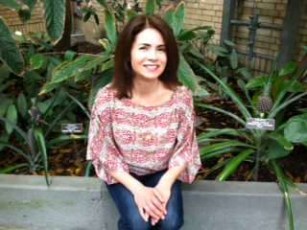
IBM FACTS
Years at IBM | 14 Years
What does a Day In the Life look like for you in your job at IBM? | I connect virtually from my home office with IBM colleagues and business leaders to identify skill gaps and learning needs that may be addressed through in house or external professional development
PERSONAL FACTS
Personal Hobbies | Hiking, Yoga, Reading, Cooking, Family Time
Favorite Musician | JJ Grey at the moment
If you could do anything for a day, what would it be? | I would spend time in nature, exploring areas in New Zealand or another magical place with family and friends
What are you passionate about? | I am passionate about living authentically by my core values and beliefs I am also passionate about great food
Family or friends you would like to mention? | My husband Joe and I have known each other since childhood I have 3 precious children, Antonio (9), Amelia (6) and Ava (3)
Cathy Fillare
North America Learning Deployment Leader – Partner & Leadership Education
IBM Global Business Services
Learning & Knowledge
Catherine.fillare@us.ibm.com
Arlington, Virginia
703.403.1582

Slide 6
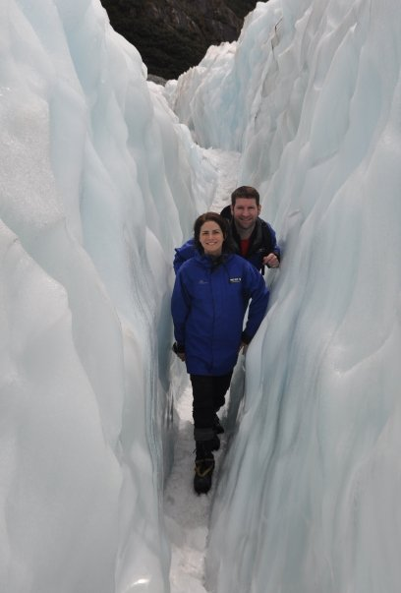
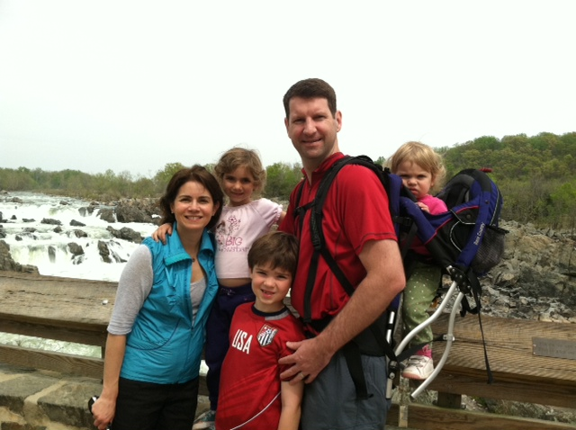
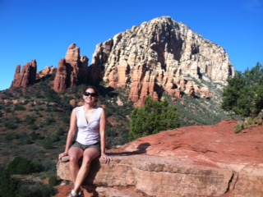
CSC-RELATED FACTS
Why did you apply for the CSC? | I am passionate about helping to make a difference in the world. This is a tremendous opportunity to give back, learn and grow both personally and professionally
What are your goals for our CSC experience? | Challenge myself in new ways Trust that I have the knowledge and tools within myself to help make a difference Identify new ways to align and work within our GMU markets
What are your professional strengths & weaknesses? | Relationship building skills Strategic thinking/mindset Team building/collaboration skills Negotiation skills Weaknesses Limited standardized process follower Limited deep technical savvy :)
Anything else we should know about you? Fun fact? | I am proud of my family’s Italian heritage and love practicing my basic language skills I enjoy great music and dancing/movement I strive to live a healthy lifestyle filled with good times, great food and new learning experiences

Slide 7
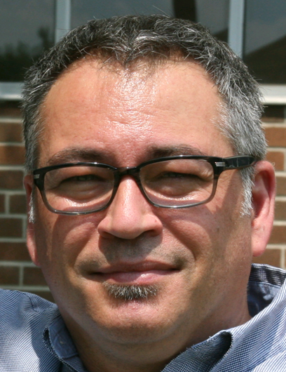
Insert Pictures
IBM FACTS
Years at IBM | 25 Years
What does a Day In the Life look like for you in your job at IBM? | I oversee about 15 staff for 2 IBM accounts in Toronto. Work at the Client and at IBM sites. Either working on new solutions regarding pricing or ensuring projects are green or get back to green. Also tracking to account rev, cost and GP targets.
PERSONAL FACTS
Personal Hobbies | Dad, Running, Yoga, Music, Movies
Favorite Musician | Spoon
If you could do anything for a day, what would it be? | Be President of the US
What are you passionate about? | My IBM teams, new experiences, music, food, family, technology.
Family or friends you would like to mention? | Married for 20 years, daughter 17, two sons 14 and 11 years of age.
Dany Le Goaix
Client Affinity Manager,
Strategic Outsourcing
Global Technology Services
dlegoaix@ca.ibm.com
Toronto, Canada
905-316-1432

Slide 8
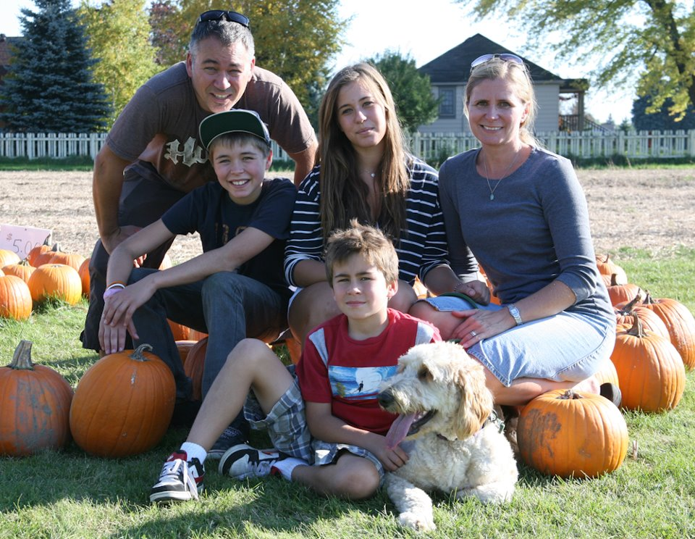
More Pictures
CSC-RELATED FACTS
Why did you apply for the CSC? | On a personal level, my motivation for joining the Corporate Service Corps is to give back to the world as I have been blessed with the good fortune of a good education, health and working for a great company like IBM. I’m involved in my local community and I love the idea of giving back in a global context. My best IBM experiences have been global opportunities.
What are your goals for our CSC experience? | Personal growth - Learn and expand my horizon in seeing things from a different perspective. Create new relationships in and outside of IBM.
What are your professional strengths & weaknesses? | Strengths – relationships, collaborative, pragmatic. Weakness – want immediate results, understanding corporate financials.
Anything else we should know about you? Fun fact? | Parents immigrated from France to Canada in 1964. Can speak French. Fun fact; like to Disc Jockey neighbourhood events.
Dany Le Goaix
Client Affinity Manager,
Strategic Outsourcing
Global Technology Services
dlegoaix@ca.ibm.com
Toronto, Canada
905-316-1432

Slide 9
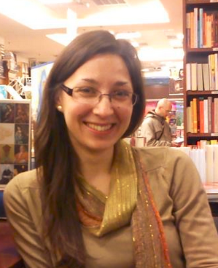
Insert Pictures
IBM FACTS
Years at IBM | 4 years
What does a Day In the Life look like for you in your job at IBM? | Day starts around 8.30 am with checking Calendar and e-mails, setting up priorities for the day/week, catch-up with colleagues over a coffee, and than work on daily priorities. Usually it involves a few calls with team in UK. I often work from different locations in Bratislava, to interact with all of my peers.
PERSONAL FACTS
Personal Hobbies | Yoga, running, reading
Favorite Musician | Paul van Dyk, Emeli Sande, Miles Davis, Gibonni, many others
If you could do anything for a day, what would it be? | I would be in the nature, away from mobile phone signal, reading a book
What are you passionate about? | Helping people who need help, supporting handball – Croatia
Family or friends you would like to mention? | My closest family are my parents, brother and a cat, but also under “family” I conceder a group of friends in home country (Croatia) and a group of international friends in my current country (Slovakia)
Durdica Damjanovic
(Duki)
Contract Commercial Manager
GTS
GPS-D
durdica.damjanovic@sk.ibm.com
Bratislava, Slovakia
+421 2 4974 3421 9949

Slide 10
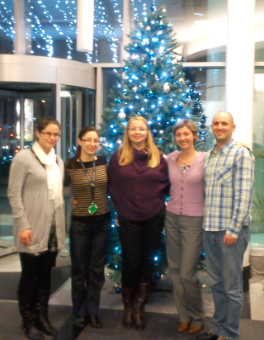
More Pictures
CSC-RELATED FACTS
Why did you apply for the CSC? | As member of student organization I was working on international student exchange, but didn’t use my chance to experience one, than I noticed in newsletter CSC, and I know I want to experience it. I choose Africa since my best working experience was in MEA STG pre-sales team where I really enjoyed the culture and wanted to experience it.
What are your goals for our CSC experience? | Get to know the culture, business environment and daily life Deliver relevant and sustainable solution to client Extend my comfort zone in terms of leadership
What are your professional strengths & weaknesses? | Strengths: analytical and objective approach to problem, but individual approach to people; strong team player Weakness: lack of assertiveness, “quiet” leader
Anything else we should know about you? Fun fact? | I amSucrologist - collecting sugars sachet from all around the world. My name means Lily of the Valley
Durdica Damjanovic
(Duki)
Contract Commercial Manager
GTS
GPS-D
durdica.damjanovic@sk.ibm.com
Bratislava, Slovakia
+421 2 4974 3421 9949

Slide 11
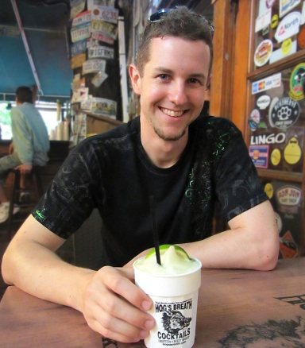
IBM FACTS
Years at IBM | 6 Years
What does a Day In the Life look like for you in your job at IBM? | I have an architectural role in a Global Delivery project about the Swiss social insurance system. I log in to the customer‘s ticket system to check if any urgent problems occured in the productive environments. If not I can continue with the specification of Change Requests, make a handover call with the Indian development team and support them for a (hopefully) defect-free implementation.
PERSONAL FACTS
Personal Hobbies | Sports (skiing, football, track and field), travel, cinema, reading (comic books and thrillers)
Favorite Musician | Sunrise Avenue, Linkin Park, Die Toten Hosen (German Punk Rock band)
If you could do anything for a day, what would it be? | Spend it on the International Space Station, or even better: on the moon!
What are you passionate about? | Tech news, science breakthroughs, smartphones, football worldcup 2014 in Brasil, my car, beer from all over the world, Oktoberfest, BBQ, any international success in sports of a Swiss compatriot or team
Family or friends you would like to mention? | I live together with my girlfriend. During my assignment she will wait for the results of her lawyer exams.
Gerry Broennimann
Advisory IT Specialist
Application Services
IBM Global Business Services
gerry.broennimann@ch.ibm.com
Zurich, Switzerland
+41 (0) 58 333 33 74

Slide 12
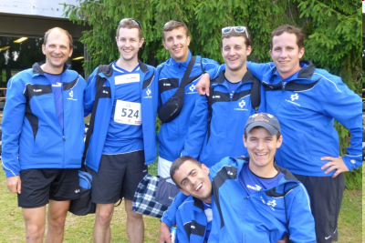
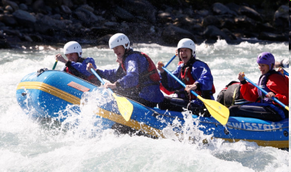
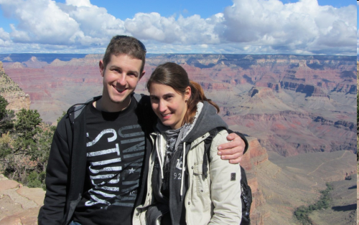
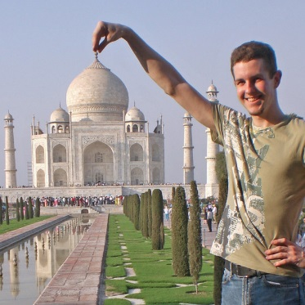
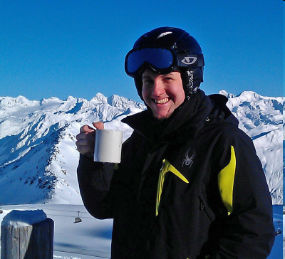
CSC-RELATED FACTS
Why did you apply for the CSC? | The CSC reminded me of my 10-months assignment in India when I started at IBM. I wanted to do something exceptional, travel to a foreign space, interact with other cultures, break out of the daily routine – while contributing to a great give-back.
What are your goals for our CSC experience? | Being part of something special Make valuable contributions to the team Interact with the local culture Learn and develop myself further Have a good time with the team Refresh and improve my school French
What are your professional strengths & weaknesses? | (+) Passionate for quality, motivated to achieve targets, looking for compromises and team harmony (-) Not yet the strong leader personality (prefer doing over managing) (+/-) I hate typos and formatting issues in documents and reject or correct them!
Anything else we should know about you? Fun fact? | Friends and I used to organize foam parties – nowadays we run our own bar at open air festivals Friends and family also know me for painting cartoons (especially chicken) President of a local sports association Programmed an Android App for Bluepages synch (http://goo.gl/AdnJdw) Blogged about my India experiences (http://goo.gl/EWNyAu) [German]

Slide 13
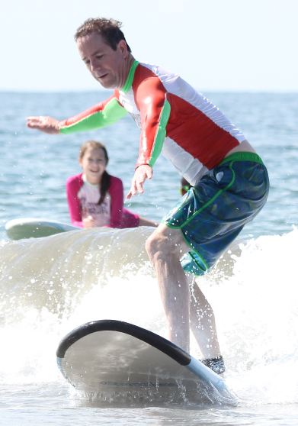
Insert Pictures
IBM FACTS
Years at IBM | 9 Years
What does a Day In the Life look like for you in your job at IBM? | Resolving customer escalations, Managing organizational transformation
PERSONAL FACTS
Personal Hobbies | Playing Piano Snowboarding Collecting vinyl records
Favorite Musicians | Jeff Tweedy (Wilco), Paul McCartney
If you could do anything for a day, what would it be? | Speak fluently in the language of a foreign country I am visiting
What are you passionate about? | Music. Playing it, listening to it, going to see it, and collecting it (vinyl)
Family or friends you would like to mention? | Wife - Mandy Son – Sam, 14 Daughter – Anna, 12 Dog – Princess, 7
Grant Alvis
Manager, BPM Level 2 Support
Application Integration Middleware
Software Group
galvis@us.ibm.com
Austin, TX USA
512-619-7667 (m)

Slide 14
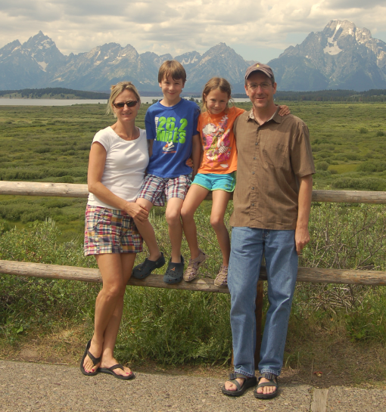
CSC-RELATED FACTS
Why did you apply for the CSC? | For a career growth opportunity and for a meaningful life experience that is completely different from my day-to-day work life.
What are your goals for our CSC experience? | To apply my skills to a face-to-face client engagement and meet our objectives while enjoying an immersive Moroccan experience. And of course developing new friendships w/ my teammates!
What are your professional strengths & weaknesses? | Strengths – Collaborate globally, Embrace challenges, Build mutual truest Weaknesses – Face-to-face client interaction
Anything else we should know about you? Fun fact? | I love to travel and am always planning our family’s next vacation.
Grant Alvis
Manager, BPM Level 2 Support
Application Integration Middleware
Software Group
galvis@us.ibm.com
Austin, TX USA
512-619-7667 (m)

Slide 15
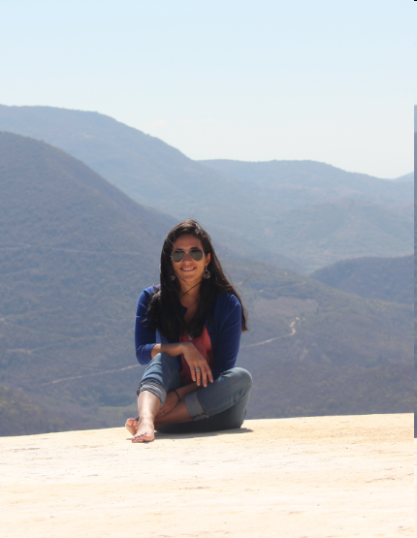
Insert Pictures
IBM FACTS
Years at IBM | 4 Years
What does a Day In the Life look like for you in your job at IBM? | Having daily interaction with the audit client Sharing an office with up to 7 more people Having useful discussions as how to approach an audit test, how to interlock what every member of the team is doing and find common areas Working long hours when its last week of audit
PERSONAL FACTS
Personal Hobbies | Read and travel as much as possible
Favorite Musician | Café Tacuba (Spanish) and Incubus (English)
If you could do anything for a day, what would it be? | Journalist (foreign correspondent)
What are you passionate about? | Travelling – try to travel and getting immersed in different cultures. Trying different types of food.
Family or friends you would like to mention? | My sister also works at IBM (in New York) The rest of my family lives in Puerto Rico
Lauren Lopez de Victoria
Latin America
Corporate Internal Auditor
Finance, CHQ
llopezd@us.ibm.com
Mobile – 100% Travel
Cell – 1-939-397-1050

Slide 16
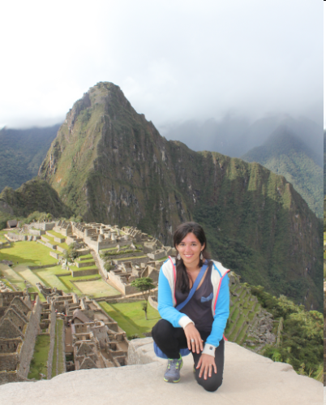
More Pictures
CSC-RELATED FACTS
Why did you apply for the CSC? | Traveling 100% of the time does not really allow for community service/social service activities, which I used to be involved in before audit
What are your goals for our CSC experience? | Have a successful engagement with the client/project assigned Get to know as much as possible of Morocco Make lasting relationships with fellow CSC’ers
What are your professional strengths & weaknesses? | Strengths: risk assessment, control, planning and forecasting, negotiation skills Weaknesses: Have never had a client facing job (external client)
Anything else we should know about you? Fun fact? | Will be going to the 2014 Brazil World Cup!
Lauren Lopez de Victoria
Latin America
Corporate Internal Auditor
Finance, CHQ
llopezd@us.ibm.com
Mobile – 100% Travel
Cell – 1-939-397-1050

Slide 17
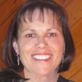
IBM FACTS
Years at IBM | I started in 1981, but was part of the Loral sale of FSD in ’93. I came back after some overseas travels. So “officially” 26 but I am a lifer. ☺
What does a Day In the Life look like for you in your job at IBM? | I help new and soon-to-be IBMers learn what it’s like to work at IBM, running Social Media projects and events, & I help the people who will help new IBMers make the first two years of an IBMer’s life great. I also “own” & work on a few other Learning programs: THINK40, the Mentoring Center, and the Informal Learning Exchange.
PERSONAL FACTS
Personal Hobbies | Skiing Quilting Yoga Reading (book clubs) Cooking Animals (feline mostly)
Favorite Musician | None particular – mostly 60’s rock
If you could do anything for a day, what would it be? | Experience being a different person – knowing what they know & how they think.
What are you passionate about? | Helping animals and people, being creative, and fitness.
Family or friends you would like to mention? | I have been married almost 17 years – will have my anniversary during our assignment. We have two furry four-legged children. I live in a fantastic neighborhood with great friends. We recently went through the flood of 2014 together – and really bonded. I’m very lucky.
Laurie Miller
Social Media Evangelist
Center for Advanced Learning
IBM CHQ – Human Resources
llmiller@us.ibm.com
Boulder, Colorado (Mountain time)
720 396-4810

Slide 18
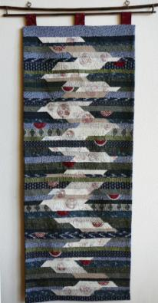
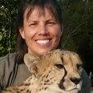
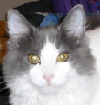

CSC-RELATED FACTS
Why did you apply for the CSC? | I’ve always wanted to be in the Peace Corps. I want to make a difference. What better way than using the skills I have? What an incredible experience it will be!
What are your goals for our CSC experience? | I want to leave a lasting impression of IBM’s help in Morocco. I want the client(s) to learn a way to make whatever they do better, more successful, more efficient. I want to experience the Moroccan culture. I want to make some lasting friendships.
What are your professional strengths & weaknesses? | I get things done in a short period of time. I’m realistic, and I put myself in the client’s shoes. I’m easy to get along with. And I’m not afraid to say what’s on my mind (both a strength and a weakness.) I hate red tape. I am impatient with long-winded people.
Anything else we should know about you? Fun fact? | I’m an avid skier – I’m heading out for 11 days of skiing next week, culminating in a ski-cat trip where we’ll ski virgin powder for an entire day (kind of like heli-skiing without the big carbon footprint.) I work with cats as a volunteer, and spent 2 weeks in S. Africa on a ‘big-cat’ sanctuary, taking care of lions, tigers, cheetahs, leopards, and more.
Laurie Miller
Social Media Evangelist
Center for Advanced Learning
IBM CHQ – Human Resources
llmiller@us.ibm.com
Boulder, Colorado (Mountain time)
720 396-4810

Slide 19
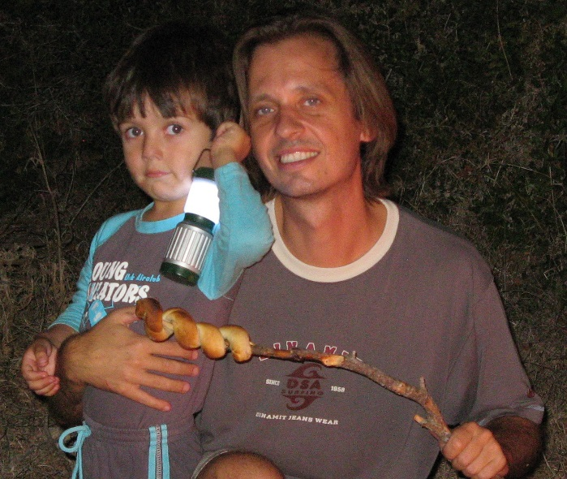
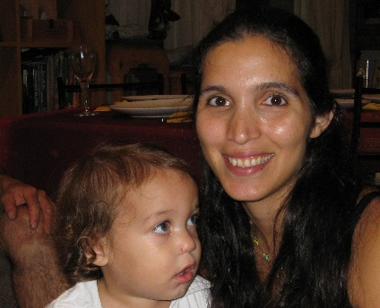
IBM FACTS
Years at IBM | 5 Years
What does a Day In the Life look like for you in your job at IBM? | Ride train to Tel Aviv; on train, answer e-mails, write/review designs, or code. At the office usually a 1:1 with a team member. After that, bug scrubbing, designing or coding. 12.00 team stand-up! Lunch in mall (ugh!). Afternoon, usually technical meetings. Later on, bug investigations (sometimes field). Train home (same as train there).
PERSONAL FACTS
Personal Hobbies | Play the piano (Chopin, Brahms, …) Play World of Warcraft Baking
Favorite Musician | Herbie Hancock, John Coltrane
If you could do anything for a day, what would it be? | Hike in the alps (didn’t do this for 10 years).
What are you passionate about? | Music, programming, my job.
Family or friends you would like to mention? | My three sons, Lukas (7), Daniel (5) and Tom (2), who keep me firmly anchored in the real world.
Michael Keller
Manager, Senior Engineer
IBM XIV R&D
STG
mkeller@il.ibm.com
Tel Aviv, Israel
+972-50-4078877

Slide 20
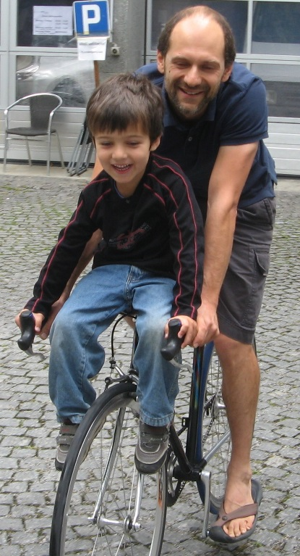
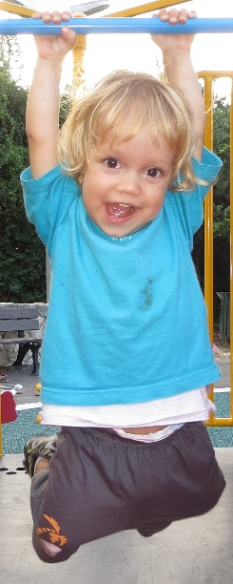
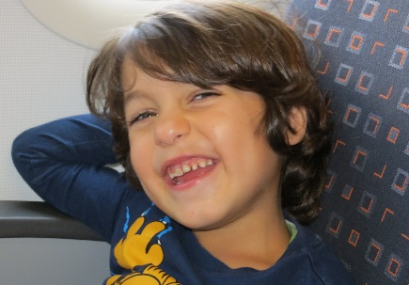
CSC-RELATED FACTS
Why did you apply for the CSC? | I have good friends who volunteered abroad – I always admired this, but was always too involved professionally to do this as an extracurricular break. So when I heard about the CSC (via TechGen), I immediately applied.
What are your goals for our CSC experience? | Help! Connect, listen, learn. Dust off my French in the process. See whether Casablanca looks anything like it does in the famous movie. Learn what IBM is about in emerging markets. Find out whether IBM (or part thereof) can truly care about people.
What are your professional strengths & weaknesses? | Strengths: Analytically thorough, technical leader, motivating manager. Weaknesses: Getting upset about political decisions, bad for the long term. Still solving too many day-to-day issues by myself.
Anything else we should know about you? Fun fact? | I was a professional cello player/teacher before going over to the Dark Side (= computing). I had to learn French in school. Now, when I try to speak French, I mix it up with Hebrew. My wife’s family emigrated from Morocco in the 60s – I eat Moroccan food every Friday! My wife and I celebrate both Christian and Jewish holidays (we’re not religious).
Michael Keller
Manager, Senior Engineer
IBM XIV R&D
STG
mkeller@il.ibm.com
Tel Aviv, Israel
+972-50-4078877

Slide 21
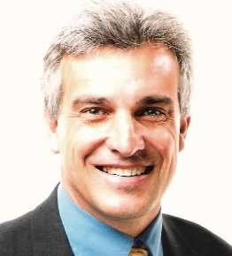
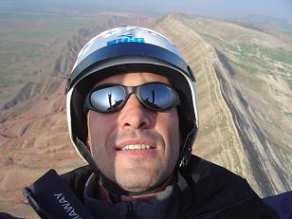
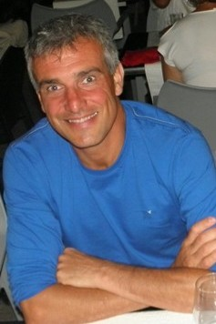
IBM FACTS
Years at IBM | 25 years
What does a Day In the Life look like for you in your job at IBM? | Meet people of my teams to help them making The difference/added-value in front of customers
PERSONAL FACTS
Personal Hobbies | Sport ( swimming, running, paragliding) Travels with « adventures » and people meeting
Favorite Musician | No one especially
If you could do anything for a day, what would it be? | Build a new house for Family, friends, guests with good food and wine to relax and enjoy.
What are you passionate about? | Chocolate, wine, food, life !
Family or friends you would like to mention? | My spouse and children ( 20 and 18 years old)
Patrick Joussen
Patrick Joussen
Technical Sales Manager
IBM Systems & Technology Group
IBM Client Center, Montpellier
joussen@fr.ibm.com
Montpellier, France
+33 4 67 34 66 05
+33 6 86 45 84 50
Technical Sales Manager
IBM Systems & Technology Group
IBM Client Center, Montpellier
joussen@fr.ibm.com
Montpellier, France
+33 4 67 34 66 05
+33 6 86 45 84 50

Slide 22
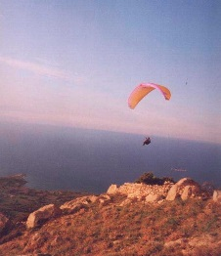
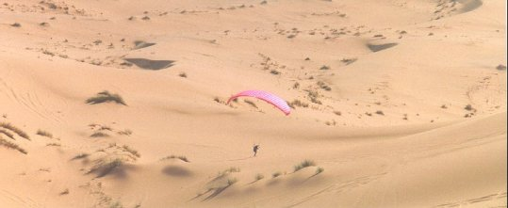
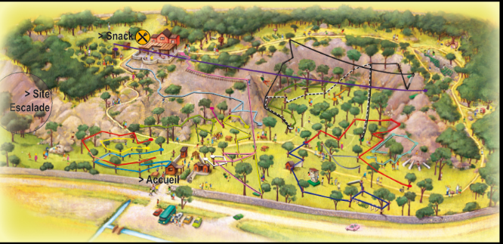
CSC-RELATED FACTS
Why did you apply for the CSC? | My motivation to apply for CSC came from the travels we made in family in countries like Nicaragua, China, Thailand, Africa where we always mixed some adventure and the discovery of the culture and people. It pushed me not only to be a tourist but to stay more to understand deeply other culture and to share my experiences and knowledge
What are your goals for our CSC experience? | I would like to take this CSC opportunity to bring my passion and enthusiasm for the work and projects I am responsible for, my personal dedication and high achievement motivation and myself being a team player. I enjoy being part of an team which provides us deeper experiences in diversification, culture and real-life issues aside the normal business of IBM .
What are your professional strengths & weaknesses? | Dedication, motivation, enthousiasm, customers and people oriented, Lead by example and coaching, participative Lack/too much of speed and reactivity sometimes My French accent
Anything else we should know about you? Fun fact? | Several times to Morroco for Paragliding and country discovery ( south part of Morocco): http://pjn.chez-alice.fr/ma.html ( pictures above) and video here http://www.youtube.com/watch?v=dgMdLgFfs1I Christmas break abroad: last time motobikes in Senegal ( Africa)
Patrick Joussen
Technical Sales Manager
IBM Systems & Technology Group
IBM Client Center, Montpellier
joussen@fr.ibm.com
Montpellier, France
+33 4 67 34 66 05
+33 6 86 45 84 50

Slide 23
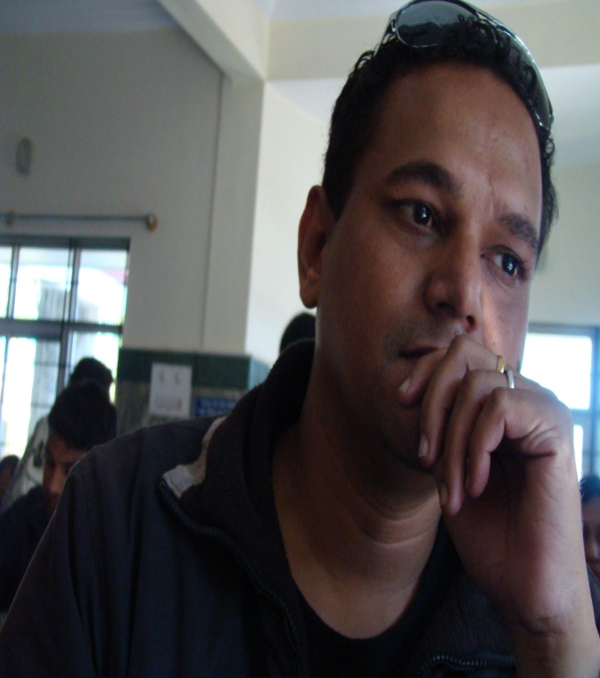
Insert Pictures
IBM FACTS
Years at IBM | 6 Years
What does a Day In the Life look like for you in your job at IBM? | Every Day is a Surprise, it opens a lot of opportunities at times very challenging….. I push my limits, capabilities in finding solutions which is realistic, acceptable by our clients and results in a satisfied Customer……
PERSONAL FACTS
Personal Hobbies | Cooking Sketching Singing Movies Art Literature
Favorite Musician | AR Rehman (Indian Musician)
If you could do anything for a day, what would it be? | Would love to Teach
What are you passionate about? | Achieving Results with Quality and organizing Events
Family or friends you would like to mention? | Family and Friends would be spoken about when we meet
Name: Chandra Prashant Singh
Call Name: Prashant
Job Title: Compliance Program Manager
IBM Group: Business Operations
IBM Business Unit: GBS-GD
Email: chpsingh@in.ibm.com
Office Location: Bangalore - India
Phone Number: 91 80 41924161

Slide 24
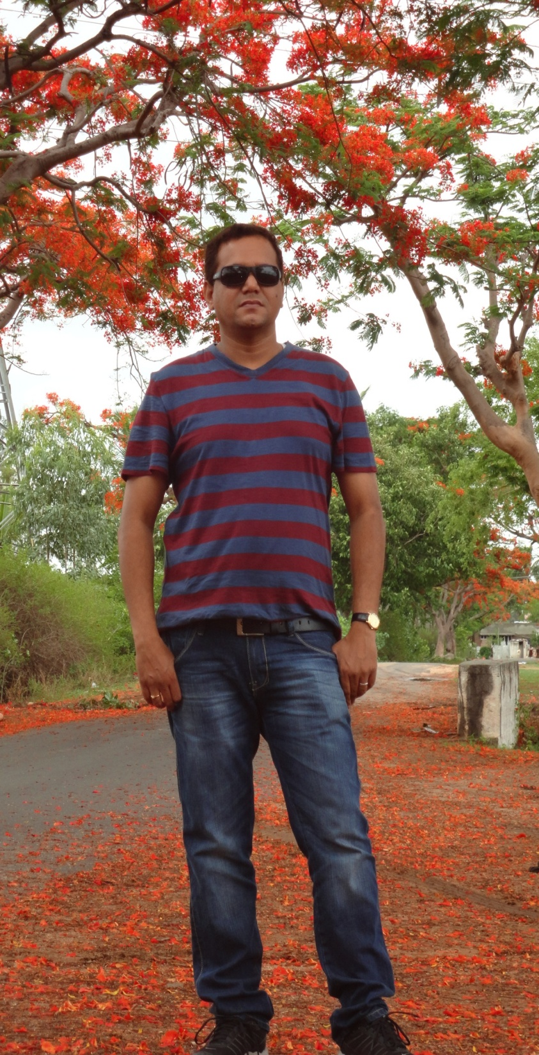
CSC-RELATED FACTS
Why did you apply for the CSC? | Want to Experience what very few privileged IBMers have experienced…. Want to experience how different people think, cooperate and come a single successful Team
What are your goals for our CSC experience? | Be a good Team Player, Provide valuable suggestions and make a difference
What are your professional strengths & weaknesses? | Strengths I am Organized, Assertive, Take Risks, Good Team Player, Self motivated, Optimistic, Quick Learner and result oriented Weakness I do have weakness but wouldn’t like to discuss
Anything else we should know about you? Fun fact? | My Hummer definitely ensures the environment becomes lighter and warmer. I am a Optimistic person and laugh and make others laugh, ensuring no one feels any pressure

Slide 25
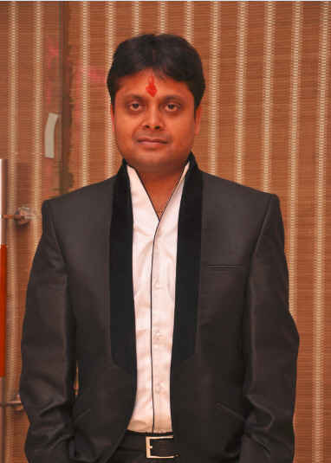
Insert Pictures
IBM FACTS
Years at IBM | 10 Years
What does a Day In the Life look like for you in your job at IBM? | - Meeting with clients - speaking to teams scattered globally - Guiding team members & client folks - Requirement reviews and technical design
PERSONAL FACTS
Personal Hobbies | Reading Movies Visiting new places
Favorite Musician | A. R. Rahman (Indian)
If you could do anything for a day, what would it be? | Make people smile - Educate people about humanity and human values
What are you passionate about? | My work - my family - visiting places - cricket
Family or friends you would like to mention? | My wife Monika, My brother and many friends
Ramgopal Yadav
Consultant
IBM India Pvt Ltd
GBS
ramyadav@in.ibm.com
Gurgaon, HR, India
+91 88002 25799

Slide 26
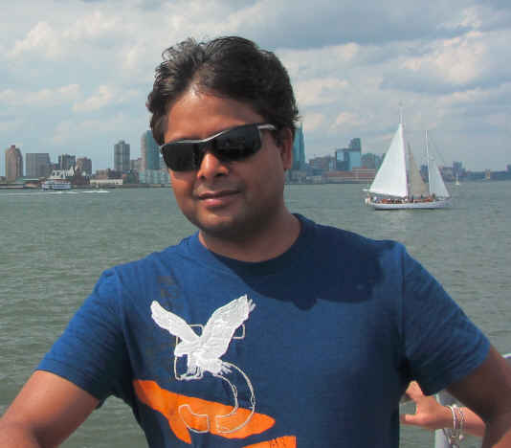
More Pictures
CSC-RELATED FACTS
Why did you apply for the CSC? | To contribute towards social cause and learn from skilled and experience leaders in IBM
What are your goals for our CSC experience? | To interact and learn from great leaders in IBM in my team and to contribute to the society. Learn about culture and people of Morocco
What are your professional strengths & weaknesses? | Strengths: -Strong analytical skill, -Technical skill and - Capability to work smart & hard to deliver IBM values to the client Weakness: Introvert nature -Not very aggressive
Anything else we should know about you? Fun fact? | I love to visit places for this I can stretch a lot e.g. without food and rest - playing cards - late night horror movies
Ramgopal Yadav
Consultant
IBM India Pvt Ltd
GBS
ramyadav@in.ibm.com
Gurgaon, HR, India
+91 88002 25799

Slide 27
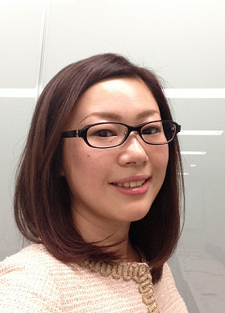
IBM FACTS
Years at IBM | 11 Years
What does a Day In the Life look like for you in your job at IBM? | Responsible for successfully selling and negotiating complex outsourcing proposals, client relationships in steel, petroleum, aerospace & defense, architectural products and electronics companies. Manager of 7 solutions sales representatives, two are senior sales executives and one is a new university hire.
PERSONAL FACTS
Personal Hobbies | Travelling around Japan and the world (visited 28 countries), Reading books, Networking, Hot yoga and Learning different cultures
Favorite Musician | Monday Michiru (Japanese) Jazz and Bossa Nova
If you could do anything for a day, what would it be? | Traveler – to see the breathtaking sights in the world
What are you passionate about? | Obtaining new knowledge and experience Exceed expectations Create new ideas and solutions
Family or friends you would like to mention? | My brother works at Honda (Japanese automotive company) The rest of family lives in Fukushima (North east part of Japan)
Sayoko Matsumoto
Solution Sales Manager
Strategic Outsourcing
GTS, IBM Japan
sayocom@jp.ibm.com
Hakozaki, Tokyo –IBM Japan HQ
+81-50-3149-0143

Slide 28
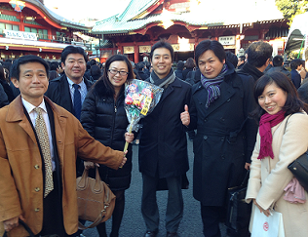
CSC-RELATED FACTS
Why did you apply for the CSC? | Expand my network globally Work outside of Japan Collaborate with culturally diverse team Touch upon foreign cultures Have new experiences
What are your goals for our CSC experience? | Successfully run the project Experience Moroccan culture as much as possible Make lasting friendships with CSC team members and people in Morocco
What are your professional strengths & weaknesses? | Strengths; Leave an established comfortable area and build new trust relationship with clients and team members in a short term In difficult situations, have the stress tolerance to overcome and deal with the situations persistently Weaknesses; I hate routine work
Anything else we should know about you? Fun fact? | During studying English in London in 2001, I was backpacking around Europe. Love drinking! A member of J-win (Japan Women’s Innovative Network) and TOMODACHI Women’s Leadership Program (US embassy leading initiative); both invest Japanese female leaders through networking and educational program.
Sayoko Matsumoto
Solution Sales Manager
Strategic Outsourcing
GTS, IBM Japan
sayocom@jp.ibm.com
Hakozaki, Tokyo –IBM Japan HQ
+81-50-3149-0143

Slide 29
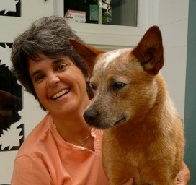
Insert Pictures
IBM FACTS
Years at IBM | I worked for Cognos for 8 years before we were acquired by IBM in 2008
What does a Day In the Life look like for you in your job at IBM? | Pinged via ST for urgent data/report request Research extracting data from multiple system and consolidate in data warehouse Research and design new reports to automate manual analyzes; facilitate analysts investigations; provide insight to our customers
PERSONAL FACTS
Personal Hobbies | Agility/herding with my dog; skiing and kayaking with the disabled
Favorite Musician | No specific preference, very eclectic – from opera to country to alternative
If you could do anything for a day, what would it be? | Right now I actually feel that I am doing exactly what I want to be doing
What are you passionate about? | Life
Family or friends you would like to mention? | My family is mainly still up in Canada, Eastern Townships of Quebec
Sue Mitchell
Senior Consultant
IBM Security Services
GTS
smitchel@us.ibm.com
Home Office – Sunapee, NH
603 763 1266

Slide 30
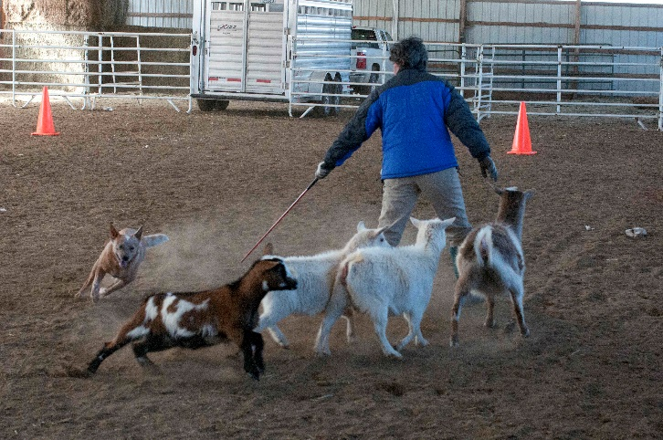
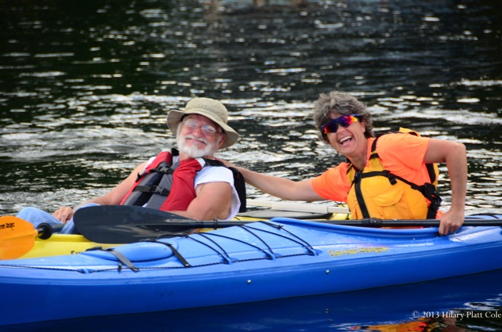

More Pictures
CSC-RELATED FACTS
Why did you apply for the CSC? | I am at the stage of my life where I have more flexibility and the desire to give back to the world. As soon as I heard about the program I knew I wanted to be involved, do some good and travel to a foreign country again.
What are your goals for our CSC experience? | Learn and live in a new culture while making a difference to the organization to which we are assigned.
What are your professional strengths & weaknesses? | I have strong analytical skills and can see many sides to a situation, it does make it somewhat difficult at times to make a decision.
Anything else we should know about you? Fun fact? | Technically I am now on my 6th career: teacher, retail sales, climber, programmer, software trainer, now a developer/consultant

